Slide 1

Chapter 5: Chemical Kinetics
AMU, CNS, DEP’T OF CHEMISTRY May, 2017

Slide 2
Introduction
Adjective “kinetic” originates from Greek “kinetikos” that, in turn, originates from Greek “kinetos’ which means “moving”.
Noun “kinetics” is used in a singular form only.
Example: “The kinetics of this process is fast”
In general, the word “kinetics” is used in physical and life sciences to represent the dependence of something on time.
Chemical kinetics is a branch of chemistry which is concerned with the rates of change in the concentration of reactants in a chemical reaction.
Thermodynamics tells us which direction a reaction will go but Kinetics can tell us how quickly it will get there.

Slide 3
Cont’d…
Aims of Chemical Kinetics
1) at the macroscopic level
to define “rate of reaction”, “order of reaction” and “rate law”
to examine how “rates” and “orders” are determined
2) at the molecular (microscopic) level
to predict plausible “reaction mechanisms” from experimental “rate laws”
Note: The macroscopic level operates with measurable parameters (e.g. T, P, V).
The microscopic level operates with parameters that are hard to measure directly (e.g. velocity of a molecule)

Slide 4
Cont’d…
Generally, Chemical kinetics deals with:
    How rapidly reactants are consumed and products are formed
    How reaction rates respond to change in conditions and catalyst
    Identification of steps by which reaction takes place
    The mechanisms of the reaction proceeds

Slide 5

Cont’d…
For example, the Haber process for the production of ammonia requires high temperatures to achieve commercially feasible reaction rates.
However, even higher temperatures (and more cost) would be required without the use of iron oxide, which speeds up the reaction.
Rate of chemical reaction
Reaction rate of a chemical reaction is defined as the change in concentration of reactant or product per unit time.
Let us consider the general one-way chemical reaction

Slide 6



Cont’d…
The rate of consumption of a reactant A is defined by the relation.
The rate of formation of a product S is
The rate of reaction is,
Where c_{i} stands for the reactants concentrations and τ for time.

Slide 7
Rate Laws
One objective of chemical kinetics is to establish a relationship between the rate of reaction and the concentration of the reactants - this relationship is called the rate law, or rate equation
There are two types of rate laws.
1. The differential rate law (often called simply the rate law} shows how the rate of a reaction depends on concentrations.
2. The integrated rate law shows how the concentrations of species in the reaction depend on time.
The product are not involved in the equation since the reaction is not reversible (forward arrow only in the balanced equation).

Slide 8
Cont’d…
Generally, The rate law expresses the relationship of the rate of a reaction to the rate constant and the concentrations of the reactants raised to some powers.
aA + bB cC + dD
Rate = k [A]ª[B]^{b}
reaction is a^{th} order in A
reaction is b^{th} order in B
reaction is (a +b)^{th} order overall
The order of reaction with respect to a given substance is defined as the index, or exponent, to which its concentration term in the rate equation is raised.

Slide 9




Cont’d…
Example Reaction: Concentration and Rate
This equation is called the rate law, and k is the rate constant.
The units for k depend upon the order of reaction and it is positive

Slide 10

Cont’d…
Exponents tell the order of the reaction with respect to each reactant
This reaction is
First-order in [NH₄⁺]
First-order in [NO₂⁻]
The overall reaction order can be found by adding the exponents on the reactants in the rate law.
This reaction is second-order overall.

Slide 11
Differential Reaction Rate Laws
Dependence of reaction rate on the concentrations of reactants is called the rate law, which is unique for each reaction.
For a general reaction, a A + b B + c C → products
The rate law has the general form :
order wrt A, B, and C, determined experimentally
reaction rate = k [A]^{X}[B]^{Y} [C]^{Z}
the rate constant
For example, the rate law is
rate = k [Br⁻] [BrO₃⁻] [H⁺] for
reaction 1st order wrt all three reactants, total order 3

Slide 12
Cont’d…
Method of Initial Rates
At the start of an experiment (t = 0), the initial concentration of the reagents can be known.
A tangent to the concentration-time curve at t = 0 will provide the initial rate of reaction.
Based on this we will:
Measure initial rates for two different concentrations of every reactant keeping concentrations of other reactants constant.
Compare relative rates and initial concentrations to find m, n and k
Reaction: aA → bB rate of reaction = R = k[A]^{m}

Slide 13
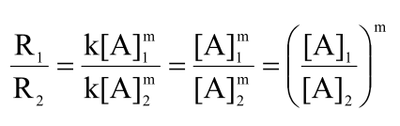

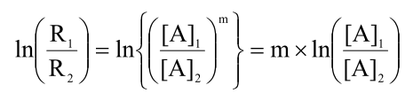
Cont’d…
Two unknowns: k and m. Two equations are needed to determine 2 unknowns.
2 experiments are needed to generate two equations
Experiment 1: R₁ = k[A]₁^{m}
Experiment 2: R₂ = k[A]₂^{m}
Step 1: To find “m”, exclude “k” from equations by dividing one by another. Instead of 2 equation with 2 unknown we will get 1 equation with 1 unknown:

Slide 14

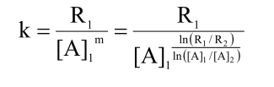
Cont’d…
Step 2: To find “k”, use the rate expression for one of the two sets of experiments (e.g. experiment 1):

Slide 15
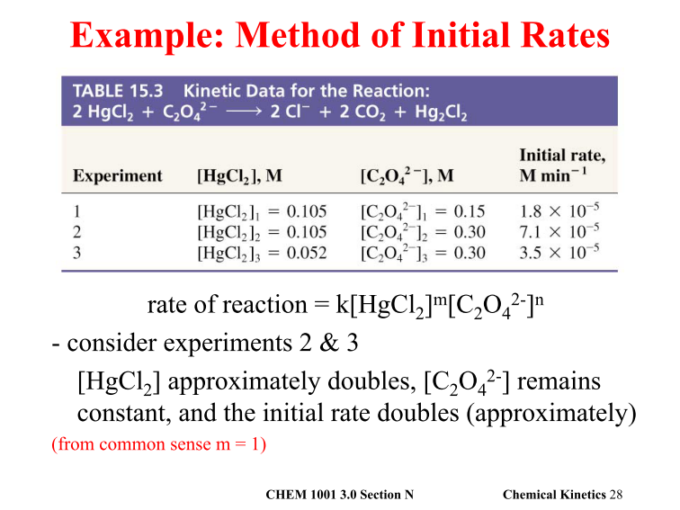
Cont’d…

Slide 16
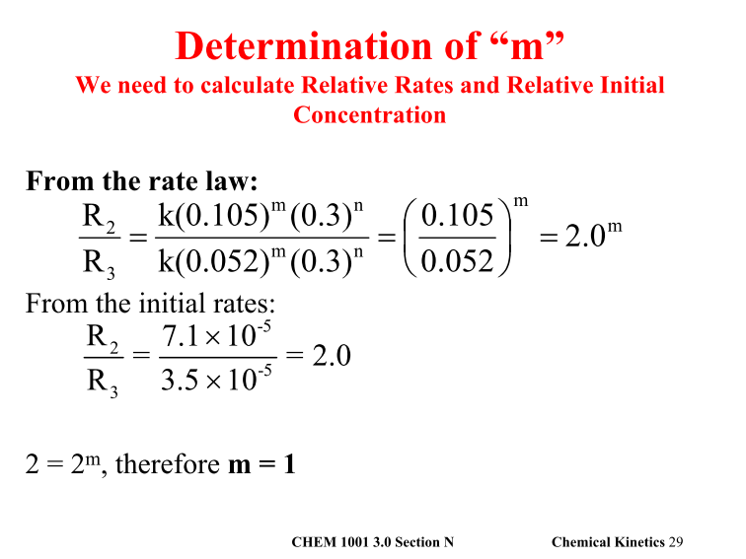
Cont’d…

Slide 17
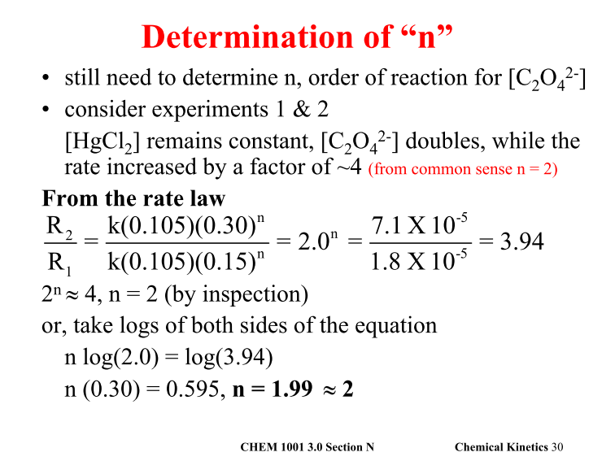
Cont’d…

Slide 18
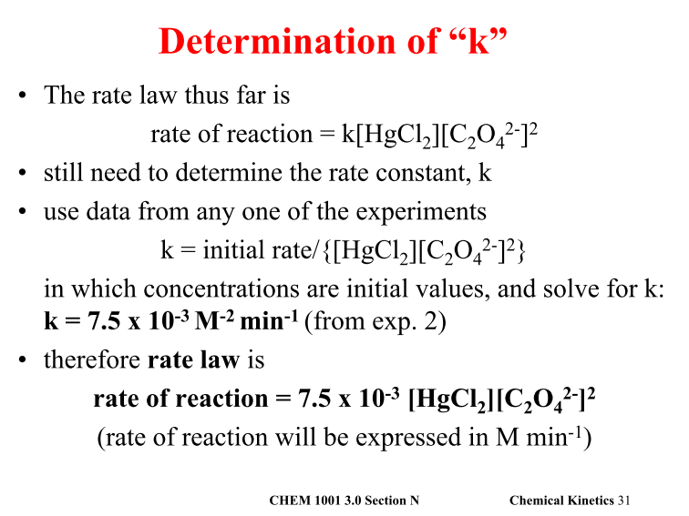
Cont’d…

Slide 19
Cont’d…
Exercise
1. Estimate the orders and rate constant k from the results observed for the reaction? What is the rate when [H₂O₂] = [I⁻] = [H⁺] = 1.0 M?
H₂O₂ + 3 I⁻ + 2 H⁺ → I₃⁻ + 2 H₂O
Exp’t [H₂O₂] [I⁻] [H⁺] Initial rate M s⁻¹
1 0.010 0.010 0.0050 1.15e-6
2 0.020 0.010 0.0050 2.30e-6
3 0.010 0.020 0.0050 2.30e-6
4 0.010 0.010 0.0100 1.15e-6

Slide 20
Cont’d…
2. From the following reaction rates observed in experiments, derive the rate law for the reaction
A + B + C → products
where reaction rates are measured as soon as the reactants are mixed.
Expt 1 2 3 4
[A]_{o} 0.100 0.200 0.200 0.100
[B]_{o} 0.100 0.100 0.300 0.100
[C]_{o} 0.100 0.100 0.100 0.400
rate 0.100 0.800 7.200 0.400
This example illustrates the strategy to determine, and a reliable method to solve rate-law experimentally

Slide 21






Integrated Reaction Rate Laws
Consider a simple 1st order reaction: A → B
Differential form:
How much A is left after time t? Integrate:

Slide 22



Cont’d…
The integrated form of first order rate law:
Can be rearranged to give:
[A]₀ is the initial concentration of A (t=0).
[A]_{t} is the concentration of A at some time, t, during the course of the reaction.
Manipulating this equation produces…

Slide 23


Cont’d…
Can be rewritten in the form of:
Describe the features of plot of [A] vs. t and ln[A] vs. t for 1st order
which is in the form
y = mx + b
b
Slope (m) = - k
ln[A]_{t}
Time,

Slide 24
Cont’d…
Example Reaction Rate Laws
F₂ (g) + 2ClO₂ (g) 2FClO₂ (g)
Quadruple [ClO₂] with [F₂] constant
Rate quadruples
y = 1 rate = k [F₂][ClO₂]
rate = k [F₂]^{x}[ClO₂]^{y}
Double [F₂] with [ClO₂] constant
Rate doubles
x = 1

Slide 25
Cont’d…
Half life & k of First Order Decomposition
The time required for half of A to decompose is called half life t_{1/2}.
Since [A] = [A]_{o} e ^{– k t} or ln [A] = ln [A]_{o} – k t
When t = t_{1/2}, [A] = ½ [A]_{o}
Thus ln ½ [A]_{o} = ln [A]_{o} – k t_{1/2}
– ln 2 = – k t_{1/2}
k t_{1/2} = ln 2 = 0.693 ← relationship between k and t_{1/2}
Radioactive decay usually follow 1st order kinetics, and half life of an isotope is used to indicate its stability.

Slide 26
Integrated Rate Law－second order
1/[A]_{t} = k t + 1/[A]_{o} So, a plot of 1/[A]_{t} vs t should give a straight line with slope = k and y intercept = 1/[A]_{o}
t_{1/2} = 1 Note: Now t_{1/2} depends on initial M
k x [A]₀

Slide 27




Cont’d…
Half-Life- 2nd order
For a second-order process, set [A]_{t}=0.5 [A]₀ in 2nd order equation.

Slide 28
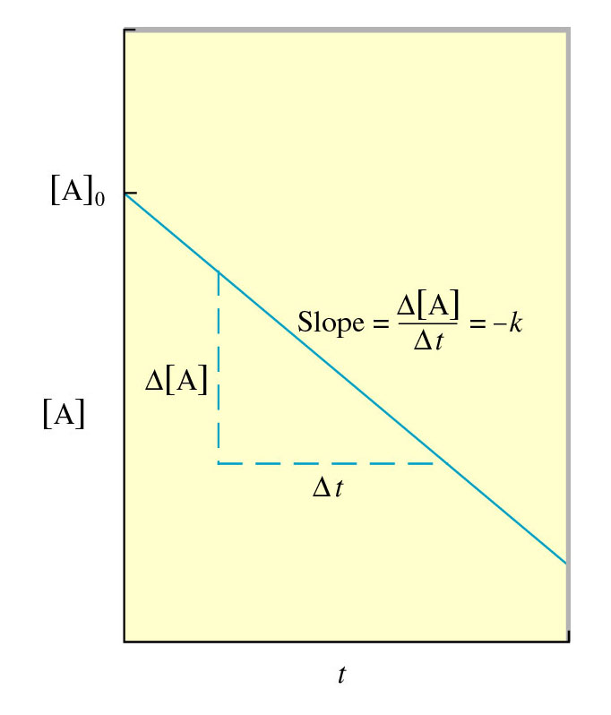
Integrated Rate Law－zero order
Half life for zero order
t_{½} = t when [A] = [A]₀/2
[A]₀
t_{½} =
2k

Slide 29
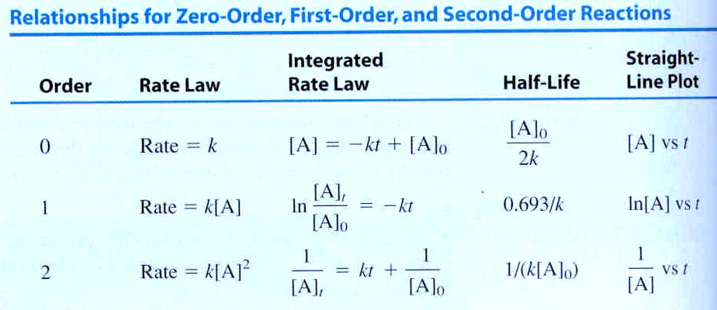
Order Integrated Rate Law - Summary
Δ Rate when double [M]
None
Double
Quadruple

Slide 30
Order Integrated Rate Law - Summary
A→ B Δ[A]/Δt = k[A]^{n}
Note: slope = k in each case
0th Order n=0
[A]_{t} = - kt + [A]_{o}
[A]_{t}
Time, t
1st Order n=1
ln[A]_{t} = - kt + ln[A]_{o}
ln[A]_{t}
Time, t
2th Order n=2
1/[A]_{t} = kt + 1/[A]_{o}
1/[A]_{t}
Time, t

Slide 31
Cont’d…
Rate Constant & Units
Note: Assume time is in seconds (s). Rate = k [A]^{x}
Solve for k & plug in units; k = Rate / [A]^{x}
Overall Rxn Order, x Units for k
zero Ms⁻¹
first s⁻¹
second M⁻¹s⁻¹
third M⁻²s⁻¹

Slide 32
Factors that Affect Rate of Reaction
1. Temperature: At higher temperatures, reactant molecules have more kinetic energy, move faster, and collide more often and with greater energy
Increase in temperature → increase in velocity of reactants→ increase in number of collision→ increase the effective reactions →increase the rate of reaction
2. Concentrations of reactants
In terms of collision theory, as the concentration of reactants increases → increase the number of collision →increase rate of reaction.
3. Surface area of a solid reactant
Increase in surface area →decrease in number of collision between molecules → decrease the rate of reaction

Slide 33
Cont’d…
4. Catalysts
Catalyst provides the different pathway for a reaction; which lowers activation energy than the original route.
So the presence of catalyst decreases the time taken by the reaction, increases rate of chemical reaction.
5. Pressure of gaseous reactants or products
The concentration of a gas is a function of the pressure on the gas.
Increasing the pressure of a gas is exactly the same as increasing its concentration.
Under higher pressure or at a higher concentration, gas molecules collide more frequently and react at a faster rate

Slide 34
Determination of order of reaction
Order from units of k: If you are given the units of the rate constant for a reaction, then you will know the overall order. Not too common.
Order from altering M: Measure initial rates keeping one reactant constant and change the concentration of another; observe the rates; calculate order as illustrated in the next few slides.
Order from integrated rate expression: Use calculus & integrate the rate expression between the limits of time = 0 & time = t. By plotting out the variables of these integrated rate expressions you can determine the order.

Slide 35
Cont’d…
Determination of Order by varying M
Example #1: Determine the order for & rate expression for:
2N₂O₅ ---) 4NO₂ + 1O₂ rate = k [N₂O₅]^{m}
Exp #1: Rate = 4.8x10⁻⁶ Ms⁻¹ at 1.0x10⁻² M N₂O₅
Exp #2: Rate = 9.6x10⁻⁶ Ms⁻¹ at 2.0x10⁻² M N₂O₅
Order: Note that when [N₂O₅] doubles, the rate doubles. Since rate α [N₂O₅]^{m} & rate doubles when [N₂O₅] doubles, the value of must be 1; the order is 1
rate α [N₂O₅]^{m} & rate doubles when [N₂O₅]doubles, then:
go from [1]^{m} = 1 to [2]^{m} = 2 m has to be 1
Rate law: rate = k x [N₂O₅]¹

Slide 36
Cont’d…
Summary
EFFECTS of doubling reagent M while keeping others constant:
Rate remains the same 0th order: [M]⁰
Rate doubles 1st order: [M]¹
Rate quadruples 2nd order: [M]²
Rate increases eightfold 3rd order: [M]³

Slide 37
Cont’d…
Example #2: 2 NO + Cl₂ -----) 2 NOCl - Calculate order of Rxn
Exp Initial [NO] Initial [Cl₂] Initial Rate, Ms⁻¹
1 0.0125 0.0255 2.27x10⁻⁵
2 0.0125 0.0510 4.57x10⁻⁵
3 0.0250 0.0255 9.08x10⁻⁵
Rate = k[NO]^{m}[Cl₂]^{n}
a) calculate n: From 1 & 2 - double [Cl₂] & keep [NO] constant & rate increases by factor of 2.01; n = 1
b) calculate m: From 1 & 3 - double [NO] & keep [Cl₂] constant & rate increases by factor of 4.00; m = 2
Rate = k[NO]²[Cl₂]¹
2nd order wrt [NO]; 1st order wrt [Cl₂]; 3rd order overall

Slide 38
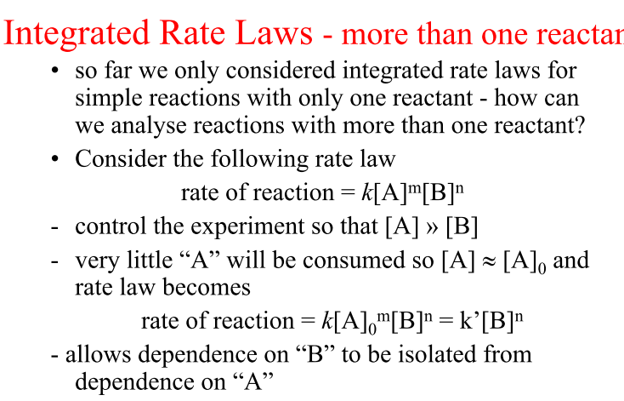
Pseudo order reaction

Slide 39
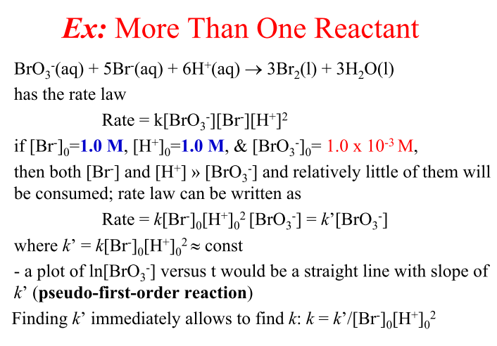
Cont’d…

Slide 40
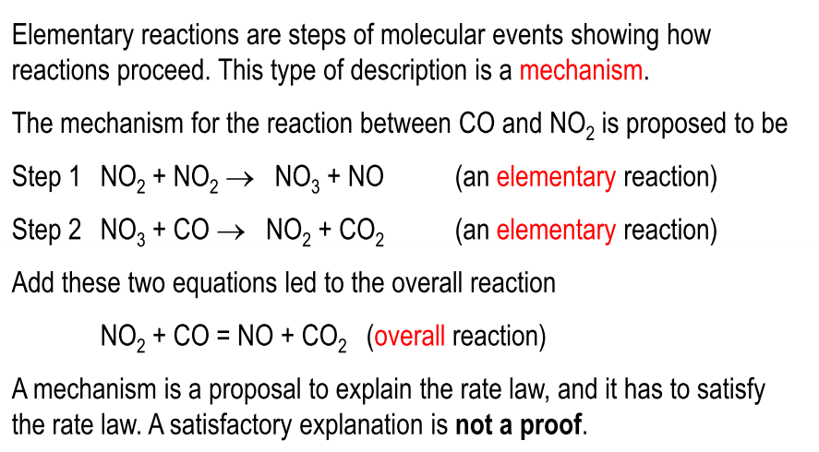
Elementary Reactions and Mechanism

Slide 41
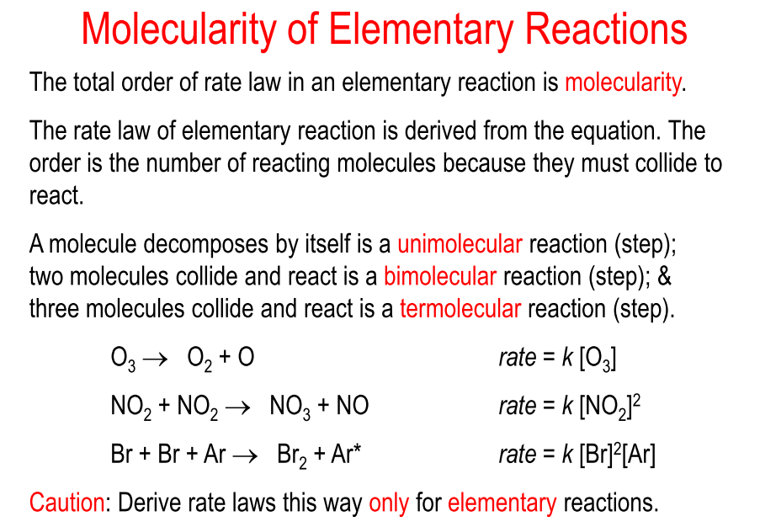
Cont’d…

Slide 42
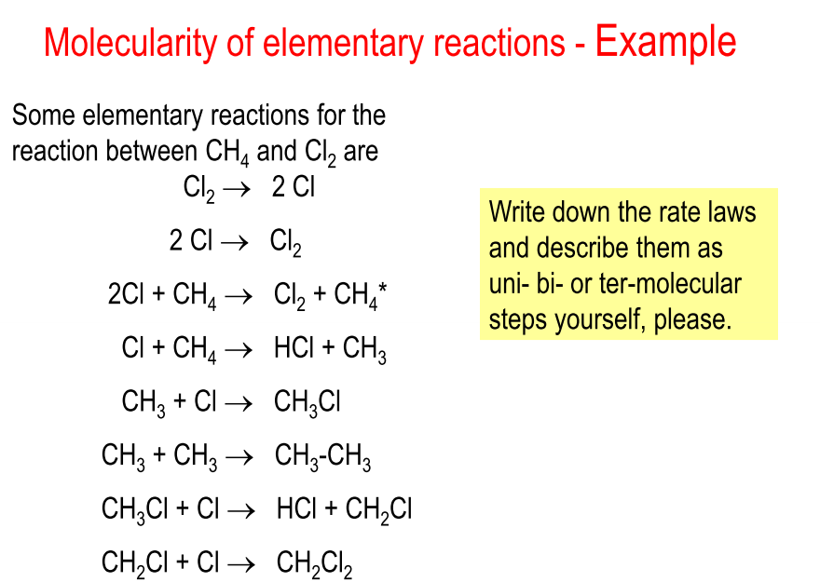
Cont’d…

Slide 43
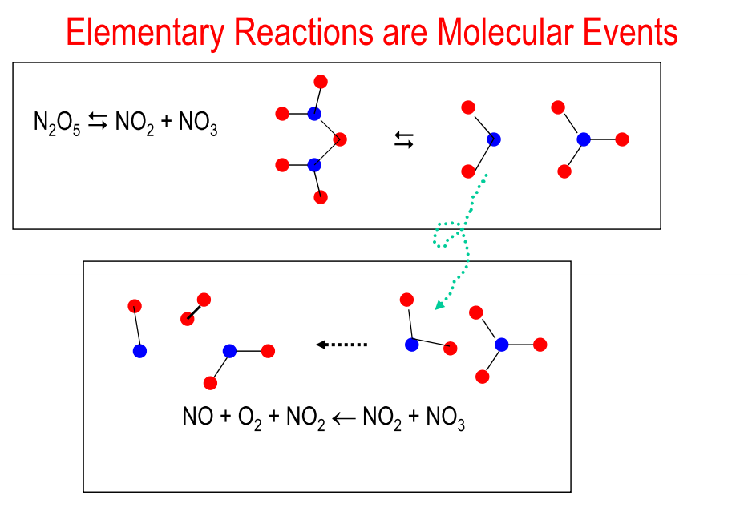
Cont’d…

Slide 44
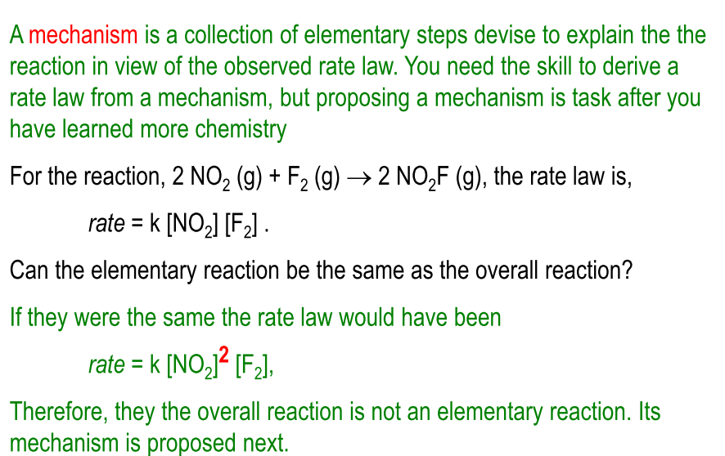
Rate Laws and Mechanisms

Slide 45
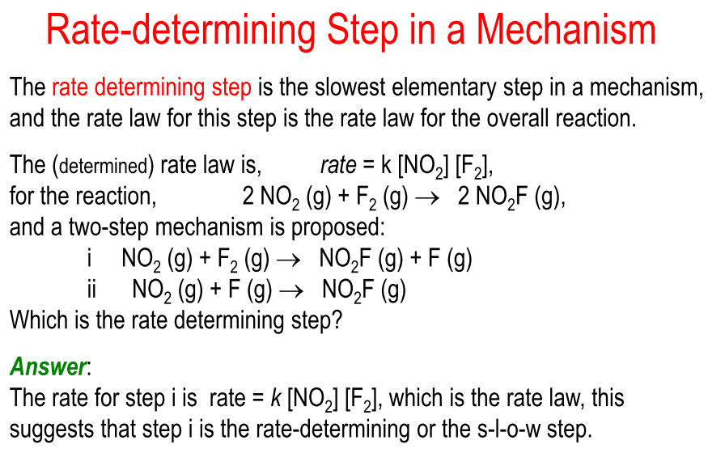
Cont’d…

Slide 46
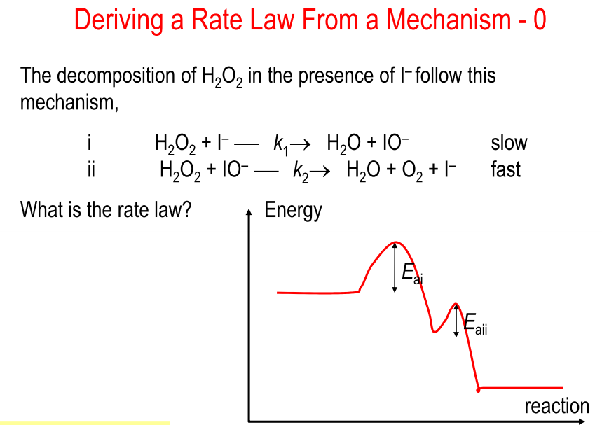
Cont’d…

Slide 47
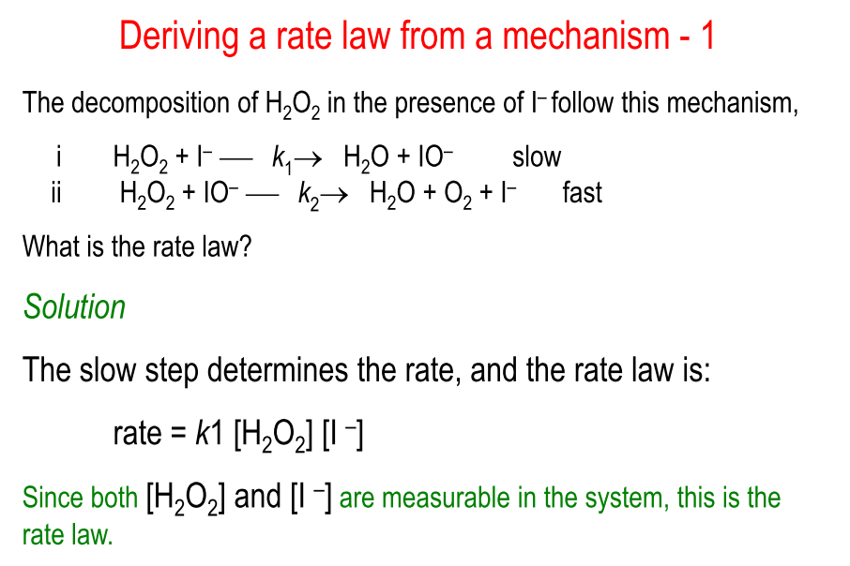
Cont’d…

Slide 48
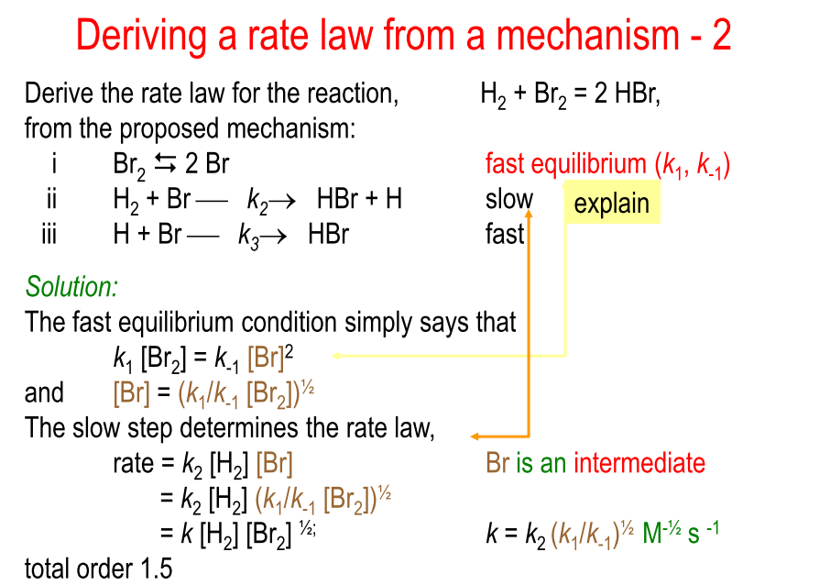
Cont’d…

Slide 49
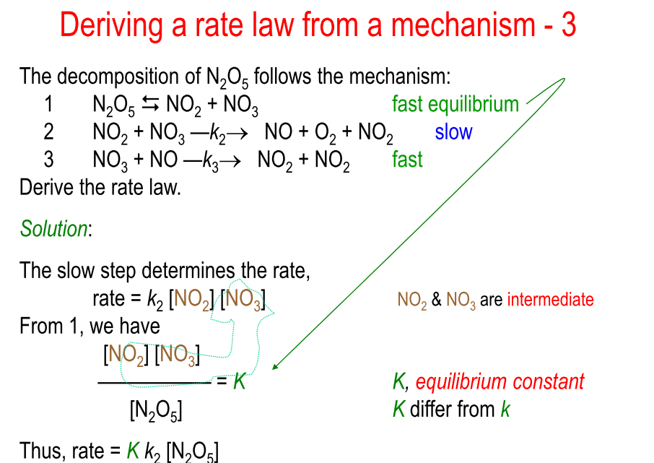
Cont’d…

Slide 50
Kinetics of Complex reactions
Reaction can be divide into the following
    Simple reaction (irreversible)
    Reversible (opposing) reaction
    Parallel (side) reaction
    Consecutive (sequential) reactions
    Chain reactions
Simple reaction
or
Single arrow is used to represent the reaction is irreversible reaction.
Therefore, rate law and order of reaction simply be derived like 0th order, 1st order, 2nd order and 3rd order.

Slide 51
Cont’d…
B) Reversible reaction
Consider the following reversible reaction
Double half arrow is used represent the reversible reaction which means reactants form product and simultaneously products form reactant.
Rate of forward is:
Rate of backward is:
But according to law of mass action: R_{f} = R_{b}

Slide 52
Cont’d…
Rearranging of this equation gives:
Where k_{f} is forward rate constant and k_{b} is backward rate constant
But where k equilibrium constant
Overall order:

Slide 53
Cont’d…
C) Parallel (concurrent) reaction
Many products are formed from the same reactants. Different path for the reaction
A
Assume the steps are first order
………. (a)
………... (b)
…………… (c)

Slide 54
Cont’d…
Integration of equation (a-c) gives:
The rate of decay of A is the sum of ( )

Slide 55
Cont’d…
D) Consecutive (sequential) reactions
Some reactions proceed through the formation of an intermediate (I), as in the consecutive unimolecular reactions.
An example is the decay of a radioactive family, such as:
Usually an exact deduction of the rate law from the differential rate equations of a multistep mechanism is not possible.
Therefore, one of two approximation methods is generally used, the rate-determining-step approximation or the steady state approximation.

Slide 56
Cont’d…
Rate- determining-step approximation
Consider the following mechanism composed of unimolecular (elementary) reactions.
Where step 2 ( ) is assumed to be the rate-determining step
For this assumption to be valid, we must have
The slow rate of B→C compared with B→A ensures that most B molecules go back to A rather than going to C, thereby ensuring that step 1 remains to equilibrium.
The overall rate is then controlled by the rate determining step B→C.

Slide 57
Cont’d…
The Steady-State Approximation
Multistep reaction mechanisms usually involve one or more intermediate species that do not appear in the overall equation.
Frequently, these intermediates are very reactive and therefore do not accumulate to any significant extent during the reaction; that is, [I] << [R] and [I] << [P].
where I is an intermediate and R and P are reactants and products.
In the R, I, P notation, we have:
and

Slide 58
Cont’d…
It is therefore frequently a good approximation to take d[I]/dt = 0 for each reactive intermediate. This is the steady-state (or stationary-state) approximation.
The steady-state approximation assumes that (after the induction period) the rate of formation of a reaction intermediate essentially equals its rate of destruction, so as to keep it at a near-constant steady-state concentration.
Example
Examine the following simple reaction mechanism
Rate = k₂[B] Rate of product formation, v_{p}, is proportional to the concentration of an intermediate.

Slide 59
Cont’d…
Look for the intermediate in the mechanism.
  Step 1 – B is produced.
  Reverse of Step 1 – B is consumed.
  Step 2 – B is consumed.
The Steady State Approximation applied to the intermediate B.

Slide 60
Cont’d…
Substitute the expression for the concentration of B into the rate law
E) Chain reaction
Since a radical has an unpaired electron, its reaction with a molecule having paired electron gives rise to chain of the reaction.
In chain reaction:
  The reactive intermediate is consumed
  The reactants are converted to products and the intermediate is regenerated

Slide 61
Cont’d…
The regeneration of the intermediate allows the cycle to be repeated over and over again
Consider the following unbranched chain reaction
Initiation:
Propagation:
Or

Slide 62
Cont’d…
The chain reaction rapidly reaches a steady state in which
and are both approximately zero.
The steady state rate law derived from the mechanism under these conditions is:
Where is the equation constant for the overall reaction
If

Slide 63
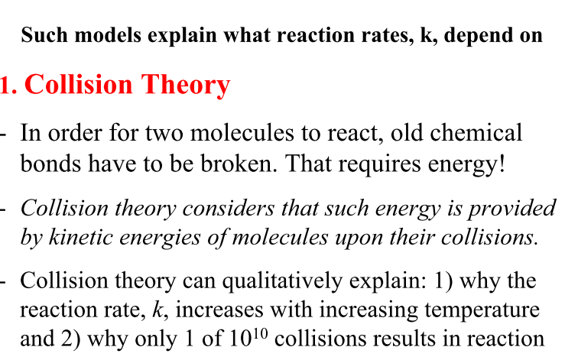
Reaction rate theories

Slide 64
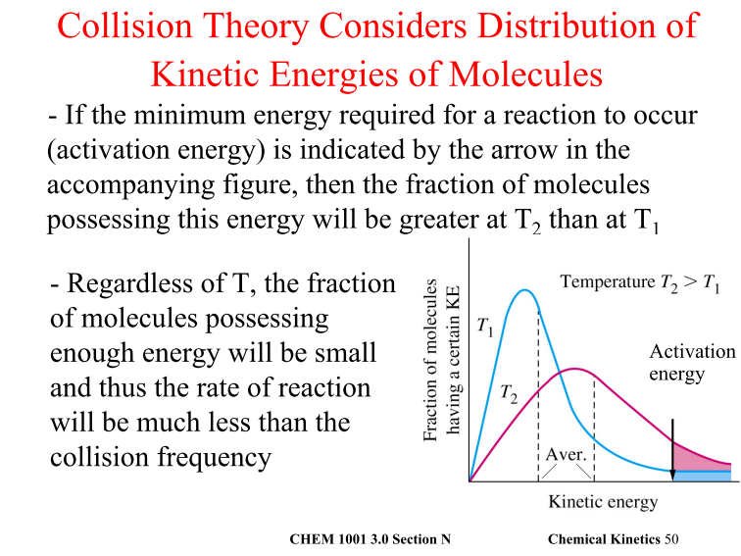
Cont’d…

Slide 65
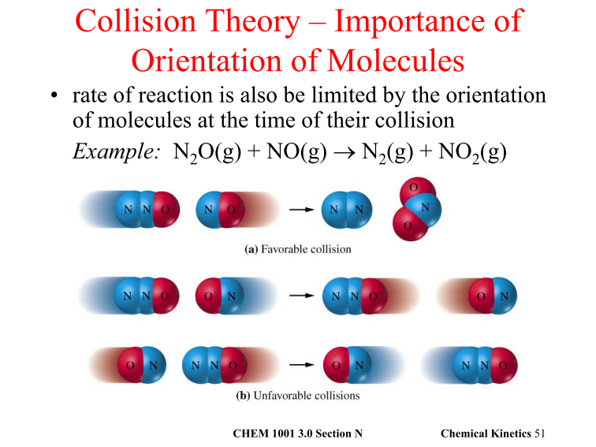
Cont’d…

Slide 66
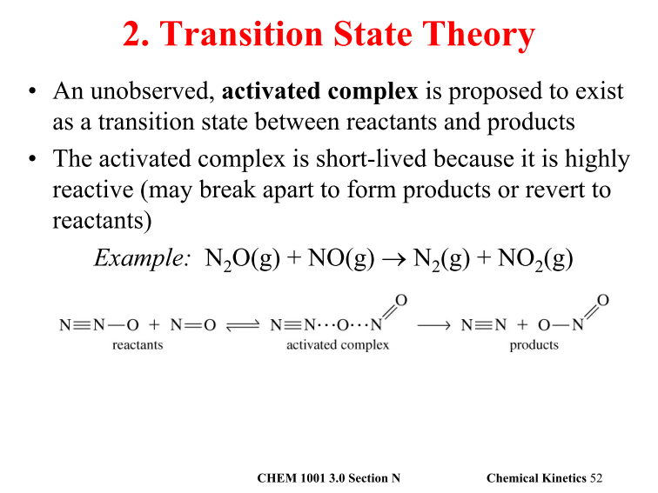
Cont’d…

Slide 67
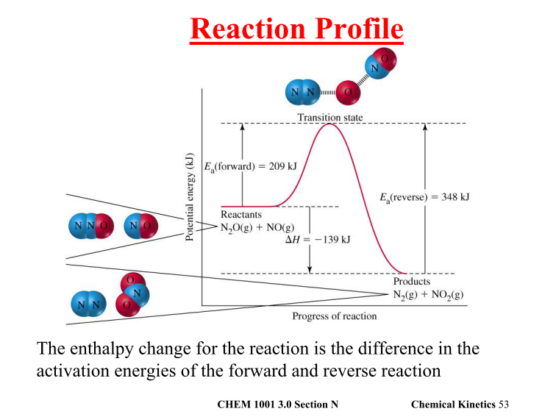
Cont’d…

Slide 68
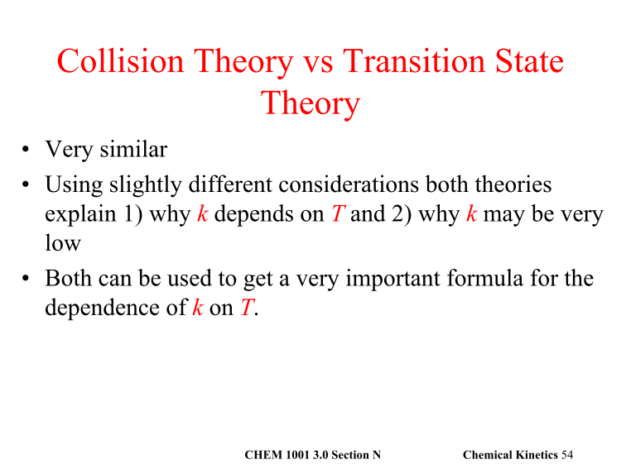
Cont’d…

Slide 69
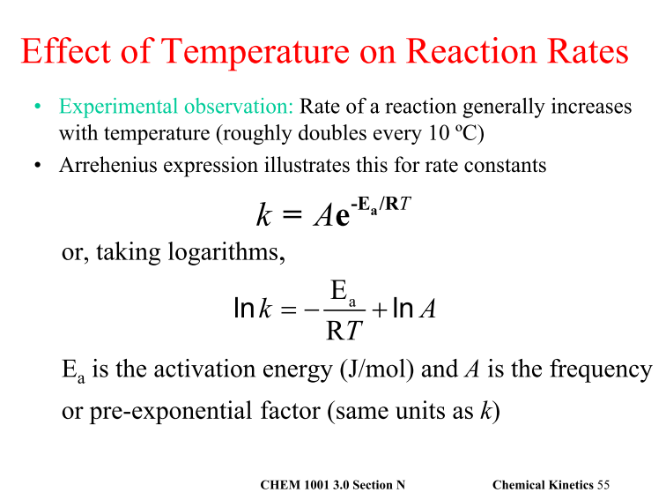
Cont’d…

Slide 70
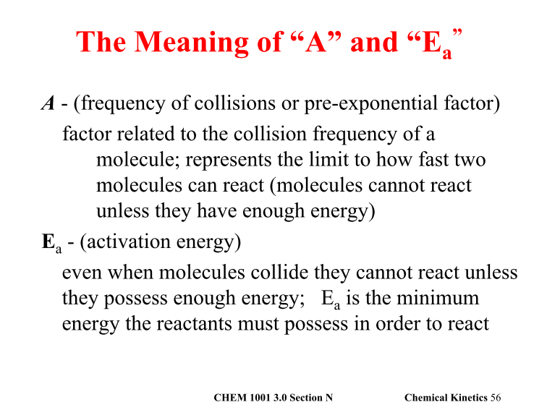
Cont’d…

Slide 71
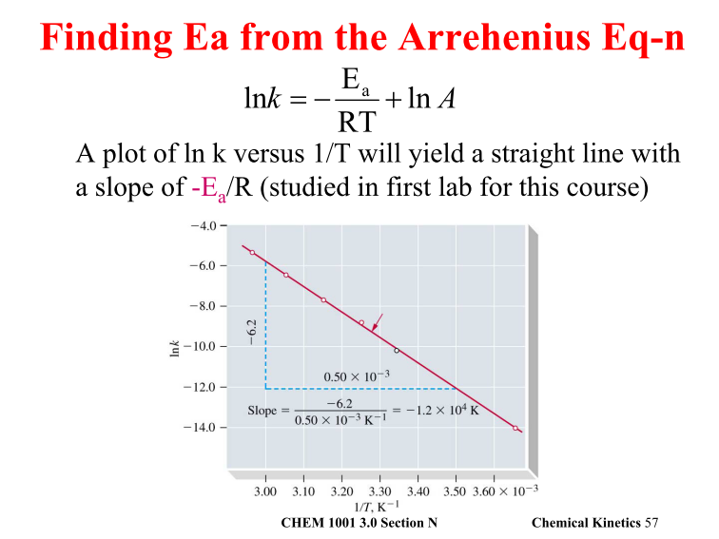
Cont’d…

Slide 72
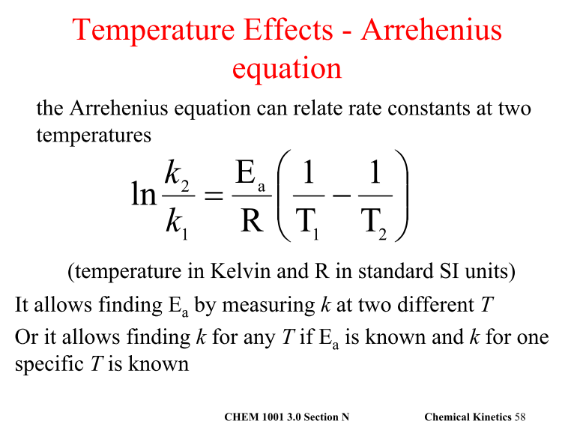
Cont’d…

Slide 73
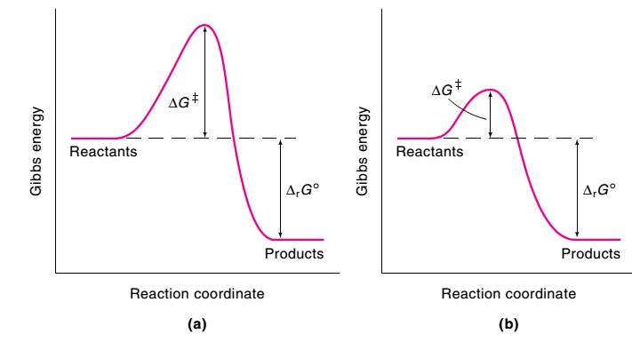
Catalysis
A catalyst is a substance that increases the rate of a reaction without itself being consumed by the process.
A reaction in which a catalyst is involved is called a catalyzed reaction, and the process is called catalysis.
In studying catalysis, keep in mind the following characteristics:
i) A catalyst lowers the Gibbs energy of activation by providing different mechanism for the reaction.

Slide 74
Cont’d…
ii) A catalyst forms an intermediate with the reactant(s) in the initial step of the mechanism and is release d in the product-forming step. The catalyst does not appear in the overall reaction.
iii) A catalyst cannot affect the enthalpies or Gibbs energies of the reactants and products. Thus, catalysts increase the rate of approach to equilibrium, but cannot alter the thermodynamic equilibrium constant.
iv) A catalyst does not initiate the reaction, it simply changes the speed of the reaction
v) A catalyst poisoned by the presence of small quantities of certain substance called catalytic poison (Example: CO, HCN).
vi) The activity of catalyst is enhanced by the presence of substance called promoter

Slide 75
Cont’d…
Homogenous and Heterogeneous Catalysis
Homogenous Catalysis: Is catalyst present in the same phase with the reactant.
Heterogeneous Catalysis: when the catalyst exists in different phase than one of the reactants.

Slide 76
Cont’d…
Typically, heterogeneous catalysis involves four steps:
    1. Adsorption and activation of the reactants
    2. Migration of the adsorbed reactants on the surface
    3. Reaction of the adsorbed substances
    4. Escape, or desorption, of the products

Slide 77
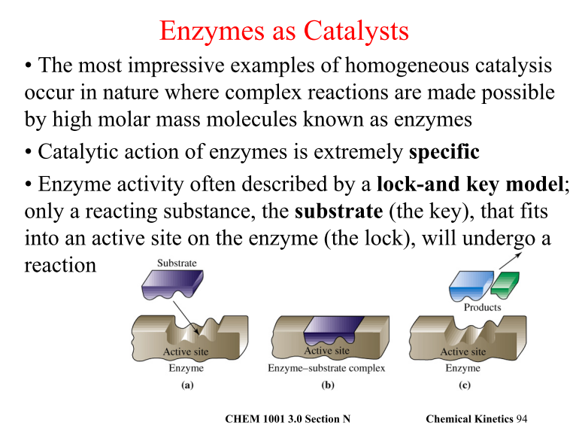
Cont’d…

Slide 78
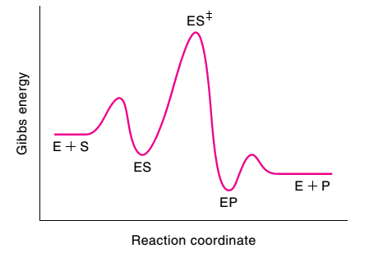
Cont’d…
Enzymes, like other catalysts, increase the rate of a reaction.
Consider a simple enzyme-catalyzed reaction in which one substrate (S) is transformed into one product (P). The reaction proceeds as follows:

Slide 79
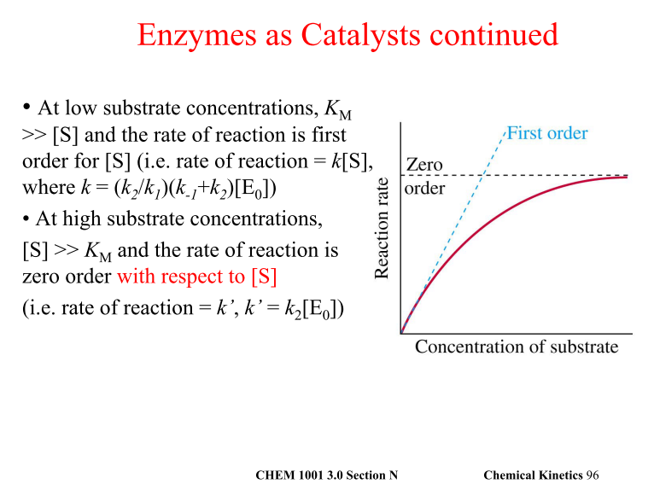
Cont’d…

Slide 80
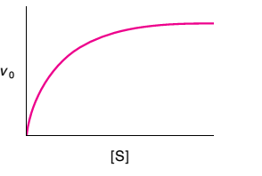
Cont’d…
The Equations of Enzyme Kinetics
In enzyme kinetics, it is customary to measure the initial rate (ν₀) of a reaction to minimize reversible reactions and the inhibition of enzymes by products.
Figure below shows the variation of the initial rate (ν₀) of an enzyme catalyzed reaction with substrate concentration [S].
The rate increases rapidly and linearly with [S] at low substrate concentrations.

Slide 81
Cont’d…
The principal features of many enzyme – catalyzed reactions are as follows:
For a given initial concentration of substrate, [S]₀, the initial rate of product formation is proportional to the total concentration of enzyme, [E]₀
For a given [E]₀ and low values of [S]₀, the rate of product formation is proportional to [S]₀
For a given [E]₀ and high values of [S]₀, the rate of product formation is independent of [S]₀, reaching a maximum value known as the maximum velocity, ν_{max}
The Michealis-Menten mechanism accounts for these features.

Slide 82
Cont’d…
According to this mechanism, an enzyme substrate complex is formed in the first step and either the substrate is released unchanged or after modification to form products.
We show in the following justification that this mechanism leads to the Michealis – Menten equation for the rate of product formation.
………… (x)
Where is the Michealis – Menten constant, characteristic of a given enzyme acting on given substrate.

Slide 83
Cont’d…
The rate of product formation according to Michealis Menten mechanism is:
We can obtain the concentration of the enzyme substrate complex by invoking the steady state approximation and writing
It follows that:
Where [E] and [S] are the concentrations of free enzyme and substrate respectively. Now we can define the michaelis Menten constant as:

Slide 84
Cont’d…
To express the rate law in terms of concentrations of enzyme and substrate added, we note [E]₀ = [E] + [ES].
Moreover, Substrate is typically in large excess relative to the enzyme, the free substrate concentration is approximately equal to the initial substrate concentration and we can write [S] = [S]_{0,} It follows that:
We obtain equation (x) when we substitute this expression for [ES] into that for the rate of product formation
Equation (x) shows that, in accord with experimental observation
i) When [S]₀<< K_{m}, the rate is proportional to [S]₀

Slide 85
Cont’d…
When [S]₀>> K_{m}, the rate reaches its maximum value and is independent of [S]₀
………….. (y)
Substitution of the definitions of K_{m} and ν_{max} into equation (i) gives:
We can rearrange this expression into a form that is amenable to data analysis by linear regression

Slide 86
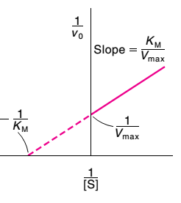
Cont’d…
A Lineweaver – Burk plot is a plot of 1/ν against 1/[S]₀, with intercept 1/ν_{max} and slop of K_{m}/ν_{max}

Slide 87
Cont’d…
The catalytic efficiency of enzymes
The turnover frequency or catalytic constant of enzymes, k_{cat} is the number of catalytic cycles performed by the active site in a given interval divided by the duration of the interval.
The catalytic efficiency, ε (epsilon) of an enzyme is the ratio k_{cat}/K_{m}. the higher the value of ε, the more efficient of the enzyme.

Slide 88
Cont’d…
Example
The following data were obtained for the reaction at pH = 7.1, 273.5 K, an enzyme concentration of 2.3 nmol dm⁻³
Determine the catalytic efficiency of carbonic anhydrase at 273.5 K.
CO₂/mmol dm⁻³ | 1.25 | 2.5 | 5 | 20
Rate/ (mmol dm⁻³ s⁻¹ | 2.78 x 10⁻² | 5.00 x 10⁻² | 8.33 x 10⁻² | 1.67 x 10 ⁻¹

