Slide 1
Coding and decoding of weather messages

Slide 2
Coding and decoding of weather messages
Coded messages are used for the international exchange of meteorological information including observational data provided by the WWW Global Observing System and processed data provided by the WWW Global Data-processing System.

Slide 3
Cont…
Coded messages are also used
  for the international exchange of observed and processed data required in specific applications of meteorology to various human activities and
  for exchanges of information related to meteorology.

Slide 4
Cont…
Code Rules concerning the selection of code forms to be exchanged for international purposes, and the selection of their symbolic words, figure groups and letters, are laid down in the WMO Technical Regulations
From these international codes, several sets of regional codes exist which are intended only for exchanges within a given WMO Region.

Slide 5
Cont…
Each code form allows a number, preceded by the letters FM.
For example FM-12 XI for SYNOP
The FM system of numbering the code forms, together with the corresponding code names is the following:

Slide 6
Cont…
FM 12–XI Ext. SYNOP - Report of surface observation from a fixed land station
FM 13–XI Ext. SHIP - Report of surface observation from a sea station
FM 14–XI Ext. SYNOP MOBIL - Report of surface observation from a mobile land station
FM 15–XII METAR - Aviation routine weather report (with or without trend forecast)

Slide 7
Cont…
FM 16–XII SPECI - Aviation selected special weather report (with or without trend forecast)
FM 18–XII BUOY - Report of a buoy observation
FM 20–VIII RADOB - Report of ground radar weather observation

Slide 8
Cont…
FM 32–XI Ext. PILOT - Upper-wind report from a fixed land station
FM 33–XI Ext. PILOT SHIP - Upper-wind report from a sea station
FM 35–XI Ext. TEMP - Upper-level pressure, temperature, humidity and wind report from a fixed land station

Slide 9
Cont…
FM 36–XI Ext. TEMP SHIP - Upper-level pressure, temperature, humidity and wind report from a sea station
FM 37–XI Ext. TEMP DROP - Upper-level pressure, temperature, humidity and wind report from a sonde released by carrier balloons or aircraft
FM 38–XI Ext. TEMP MOBIL - Upper-level pressure, temperature, humidity and wind report from a mobile land station

Slide 10
Cont…
FM 71–XII CLIMAT - Report of monthly values from a land station
FM 72–XII CLIMAT SHIP - Report of monthly means and totals from an ocean weather station
FM 88–XI SATOB - Report of satellite observations of wind, surface temperature, cloud, humidity and radiation

Slide 11
Cont…
The common synoptic code comprises six sections numbered 0 to 5, each of which is primarily composed of five-figure code groups.
Most groups in sections 0 to 5 begin with a numerical indicator and these indicators are numbered consecutively within each section.

Slide 12
LAND STATION SURFACE SYNOPTIC CODE FM12-IX SYNOP FORMAT
The FM system of numbering the code forms, together with the corresponding code name for report of surface observation from a fixed land station is FM 12–XI Ext. SYNOP
There are two basic forms of land station surface synoptic reports,
  complete form and
  shortened form

Slide 13
Complete form
Referred to as the primary (or main) synoptic, the 6-hourly report, or SYNOP.
Primary synoptic is reported at the standard hours of observation which are: 0000, 0600, 1200, and 1800 UTC
Shortened form
Referred to as the intermediate synoptic or the 3-hourly report.
The intermediate synoptic is reported at the standard hours for the intermediate observations which are: 0300, 0900, 1500, and 2100 UTC.

Slide 14
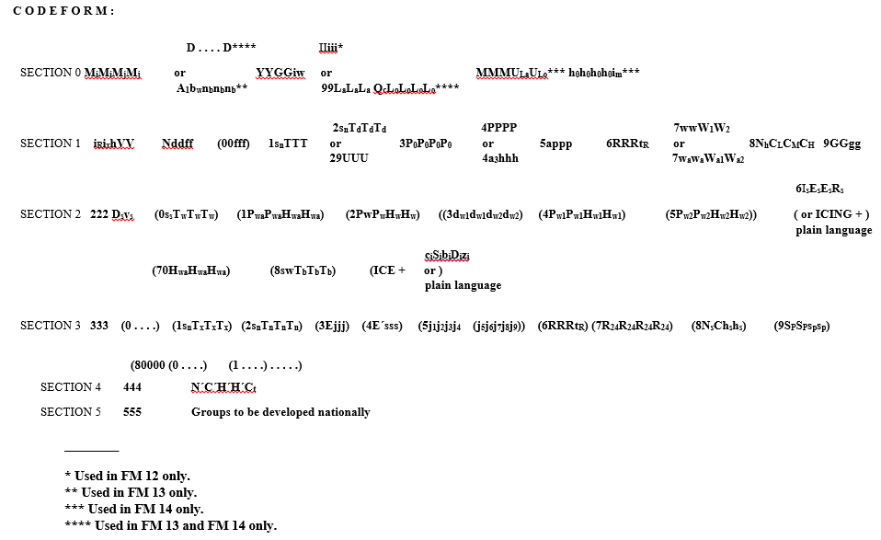
LIST OF CODE FORMS WITH NOTES AND REGULATIONS

Slide 15
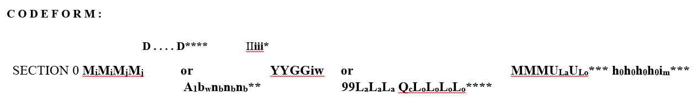
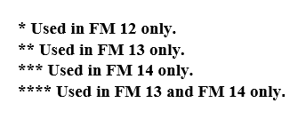
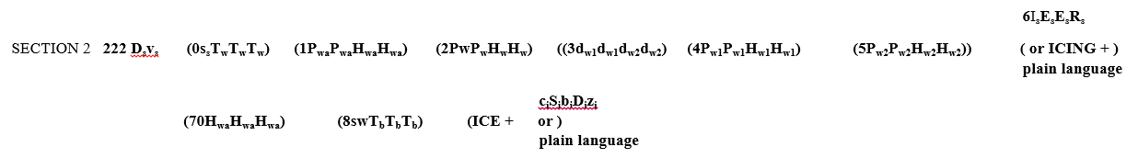

Slide 16

All the groups of Section 0 and the first two groups of Section 1, which are always included in the report of any surface observing station

Slide 17
Cont…
Section 0 — Data for reporting identification (type, ship’s call sign/buoy identifier, date, time, location) and units of wind speed used
Section 1 — Data for global exchange which are common to the SYNOP, SHIP and SYNOP MOBIL code forms
Section 2 222 Maritime data for global exchange pertaining to a sea, or to a coastal station
Section 3 333 Data for regional exchange

Slide 18
Cont…
Section 4 444 - Data for national use for clouds with base below station level, included by national decision
Section 5 555 - Data for national use

Slide 19
FM 12–XI Ext. SYNOP - Report of surface observation from a fixed land station
A code figure in which included in FM 12 SYNOP are:-
M_{i}M_{i}M_{j}M_{j} YYGGi_{w}
IIiii i_{R}i_{x}hVV Nddff (00fff) 1s_{n}TTT 2s_{n}T_{d}T_{d}T_{d} 3P_{o}P_{o}P_{o}P_{o} 4PPPP 5appp 6RRRt_{R} 7wwW₁W₂ 8N_{h}C_{L}C_{M}C_{H} 9GGgg
M_{i}M_{i}M_{j}M coding procedure
If M_{i}M_{i}M_{j}M is coded
            AAXX = A SYNOP report from a fixed land station
            BBXX = A SHIP report from a sea station
            OOXX = A SYNOP MOBIL report from a mobile land station

Slide 20
Cont…
M_{i}M_{i}M_{j}M_{j} YYGGi_{w}
IIiii i_{R}i_{x}hVV Nddff (00fff) 1s_{n}TTT 2s_{n}T_{d}T_{d}T_{d} 3P_{o}P_{o}P_{o}P_{o} 4PPPP 5appp 6RRRt_{R} 7wwW₁W₂ 8N_{h}C_{L}C_{M}C_{H} 9GGgg
IIiii = The identification and position of a fixed land station
II = Region number
iii = Station number

Slide 21
Cont…
M_{i}M_{i}M_{j}M_{j} YYGGi_{w}
IIiii i_{R}i_{x}hVV Nddff (00fff) 1s_{n}TTT 2s_{n}T_{d}T_{d}T_{d} 3P_{o}P_{o}P_{o}P_{o} 4PPPP 5appp 6RRRt_{R} 7wwW₁W₂ 8N_{h}C_{L}C_{M}C_{H} 9GGgg
YYGGi_{w}
YY = Indicate date of observation
GG = Actual time of observation to the nearest hours UTC.
i_{w} = indicates Indicate for source and units of wind speed.

Slide 22
Cont…
M_{i}M_{i}M_{j}M_{j} YYGGi_{w}
IIiii i_{R}i_{x}hVV Nddff (00fff) 1s_{n}TTT 2s_{n}T_{d}T_{d}T_{d} 3P_{o}P_{o}P_{o}P_{o} 4PPPP 5appp 6RRRt_{R} 7wwW₁W₂ 8N_{h}C_{L}C_{M}C_{H} 9GGgg
i_{R}i_{x}hVV
i_{R} = Rain fall indicator
i_{x} = weather indicator
h = the height of the lowest cloud base
VV = visibility indicator

Slide 23
M_{i}M_{i}M_{j}M_{j} YYGGi_{w}
IIiii i_{R}i_{x}hVV Nddff (00fff) 1s_{n}TTT 2s_{n}T_{d}T_{d}T_{d} 3P_{o}P_{o}P_{o}P_{o} 4PPPP 5appp 6RRRt_{R} 7wwW₁W₂ 8N_{h}C_{L}C_{M}C_{H} 9GGgg
Nddff
N = Total cloud cover
dd = wind direction
ff = wind speed
If the wind speed > 99 code ff replaced by (00fff) included

Slide 24
M_{i}M_{i}M_{j}M_{j} YYGGi_{w}
IIiii i_{R}i_{x}hVV Nddff (00fff) 1s_{n}TTT 2s_{n}T_{d}T_{d}T_{d} 3P_{o}P_{o}P_{o}P_{o} 4PPPP 5appp 6RRRt_{R} 7wwW₁W₂ 8N_{h}C_{L}C_{M}C_{H} 9GGgg
1 is group indicator for air temperature
s_{n} is sign indicator for air temperature 0 for +ve 1 for -ve
1s_{n}TTT is the amount of air temperature

Slide 25
M_{i}M_{i}M_{j}M_{j} YYGGi_{w}
IIiii i_{R}i_{x}hVV Nddff (00fff) 1s_{n}TTT 2s_{n}T_{d}T_{d}T_{d} 3P_{o}P_{o}P_{o}P_{o} 4PPPP 5appp 6RRRt_{R} 7wwW₁W₂ 8N_{h}C_{L}C_{M}C_{H} 9GGgg
2 is group indicator for air dew-point temperature
s_{n} is sign indicator for air dew-point temperature 0 for +ve 1 for -ve
T_{d}T_{d}T_{d} is the amount of dew-point temperature

Slide 26
M_{i}M_{i}M_{j}M_{j} YYGGi_{w}
IIiii i_{R}i_{x}hVV Nddff (00fff) 1s_{n}TTT 2s_{n}T_{d}T_{d}T_{d} 3P_{o}P_{o}P_{o}P_{o} 4PPPP 5appp 6RRRt_{R} 7wwW₁W₂ 8N_{h}C_{L}C_{M}C_{H} 9GGgg
3 is a group indicator for station level pressure
P_{o}P_{o}P_{o}P_{o} is the amount of station level pressure

Slide 27
M_{i}M_{i}M_{j}M_{j} YYGGi_{w}
IIiii i_{R}i_{x}hVV Nddff (00fff) 1s_{n}TTT 2s_{n}T_{d}T_{d}T_{d} 3P_{o}P_{o}P_{o}P_{o} 4PPPP 5appp 6RRRt_{R} 7wwW₁W₂ 8N_{h}C_{L}C_{M}C_{H} 9GGgg
4 is a group indicator for mean sea level pressure
PPPP is the amount of mean sea level pressure

Slide 28
M_{i}M_{i}M_{j}M_{j} YYGGi_{w}
IIiii i_{R}i_{x}hVV Nddff (00fff) 1s_{n}TTT 2s_{n}T_{d}T_{d}T_{d} 3P_{o}P_{o}P_{o}P_{o} 4PPPP 5appp 6RRRt_{R} 7wwW₁W₂ 8N_{h}C_{L}C_{M}C_{H} 9GGgg
5 is a group indicator for pressure tendency
a indicates pressure tendency character
ppp is a 3 hours pressure difference value

Slide 29
M_{i}M_{i}M_{j}M_{j} YYGGi_{w}
IIiii i_{R}i_{x}hVV Nddff (00fff) 1s_{n}TTT 2s_{n}T_{d}T_{d}T_{d} 3P_{o}P_{o}P_{o}P_{o} 4PPPP 5appp 6RRRt_{R} 7wwW₁W₂ 8N_{h}C_{L}C_{M}C_{H} 9GGgg
6 is rain fall group indicator for
RRR the amount of rain fall
6RRRt_{R} = Duration Period of reference for amount of precipitation, ending at the time of the report

Slide 30
M_{i}M_{i}M_{j}M_{j} YYGGi_{w}
IIiii i_{R}i_{x}hVV Nddff (00fff) 1s_{n}TTT 2s_{n}T_{d}T_{d}T_{d} 3P_{o}P_{o}P_{o}P_{o} 4PPPP 5appp 6RRRt_{R} 7wwW₁W₂ 8N_{h}C_{L}C_{M}C_{H} 9GGgg
7 is a group indicator for present and past weather
ww is indicates the types of weather at time of observation
W₁W₂ is indicates the type of weather during past hours

Slide 31
M_{i}M_{i}M_{j}M_{j} YYGGi_{w}
IIiii i_{R}i_{x}hVV Nddff (00fff) 1s_{n}TTT 2s_{n}T_{d}T_{d}T_{d} 3P_{o}P_{o}P_{o}P_{o} 4PPPP 5appp 6RRRt_{R} 7wwW₁W₂ 8N_{h}C_{L}C_{M}C_{H} 9GGgg
8 is a group indicator for types of cloud group
N_{h} = Amount of all the C_{L} cloud present or, if no C_{L} cloud is present, the amount of all the C_{M} cloud present
C_{L} = types of low cloud
C_{M} = types of middle cloud
C_{H} = types of high cloud

Slide 32
M_{i}M_{i}M_{j}M_{j} YYGGi_{w}
IIiii i_{R}i_{x}hVV Nddff (00fff) 1s_{n}TTT 2s_{n}T_{d}T_{d}T_{d} 3P_{o}P_{o}P_{o}P_{o} 4PPPP 5appp 6RRRt_{R} 7wwW₁W₂ 8N_{h}C_{L}C_{M}C_{H} 9GGgg
This group shall be included: When the actual time of observation differs by more than 10 minutes from the standard time GG reported in Section 0;
9 is a group indicator
GG = actual observation time (hour)
gg = actual minues

