Slide 1
Ships Synoptic Code and Observing Methods
THE SHIPS SYNOPTIC CODE FM13-X
Code FM-13-X-SHIP, the ships synoptic code, is contained of 23 groups of symbolic letters representing meteorological and oceanographic elements, report identification and ship location data.
BBXX D.....D YYGGi_{w} 99L_{a}L_{a}L_{a} Q_{c}L_{o}L_{o}L_{o}L_{o} i_{R}i_{x}hVV Nddff 00fff 1s_{n}TTT 2s_{n}T_{d}T_{d}T_{d} 4PPPP 5appp 7wwW₁W₂ 8N_{h}C_{L}C_{M}C_{H} 222D_{s}v_{s} 0s_{s}T_{w}T_{w}T_{w} 2P_{w}P_{w}H_{w}H_{w} 3d_{w1}d_{w1}d_{w2}d_{w2} 4P_{w1}P_{w1}H_{w1}H_{w1} 5P_{w2}P_{w2}H_{w2}H_{w2} 6I_{s}E_{s}E_{s}R_{s} 8s_{w}T_{b}T_{b}T_{b} ICE c_{i}S_{i}b_{i}D_{i}z_{i} (or plain language)

Slide 2

Cont’d
The ship synoptic code has three main sections 0, 1, and 2.
Section 0, consisting of the first 5 code groups,
Contains the identification data (ship report identifier, ship’s call sign, date, time, location), and units of wind speed used.
Ships Synoptic Code Section 0

Slide 3
Cont’d
Section 1 consists of code groups 6-14 and contains most of the meteorological data of the report (precipitation and weather data indicators, cloud base height, visibility, cloud cover, wind direction and speed, air and dew point temperatures, sea level pressure, the 3 hours pressure change and tendency character, present and past weather, and cloud type).
Ships Synoptic Code Section 1
i_{R}i_{x}hVV Nddff 00fff 1s_{n}TTT 2s_{n}T_{d}T_{d}T_{d}
4PPPP 5appp 7wwW₁W₂ 8N_{h}C_{L}C_{M}C_{H}

Slide 4
Cont’d
Section 2 consists of code groups 15-23 and contains ships movement data (ships course and speed), oceanographic data (sea surface temperature, wind wave period and height, primary and secondary swell direction, period, and height), and ice data (for any ice deposit on ship or on the sea surface), and the wet-bulb temperature group.
Ships Synoptic Code Section 2
222D_{s}v_{s} 0s_{s}T_{w}T_{w}T_{w} 2P_{w}P_{w}H_{w}H_{w} 3d_{w1}d_{w1}d_{w2}d_{w2} 4P_{w1}P_{w1}H_{w1}H_{w1} 5P_{w2}P_{w2}H_{w2}H_{w2} 6I_{s}E_{s}E_{s}R_{s} 8s_{w}T_{b}T_{b}T_{b} ICE c_{i}S_{i}b_{i}D_{i}z_{i}

Slide 5
Cont’d
BBXX, Ship Report Indicator
SECTION 0 — IDENTIFICATION DATA
BBXX D.....D YYGGi_{w} 99L_{a}L_{a}L_{a} Q_{c}L_{o}L_{o}L_{o}L_{o}
SECTION 1 — METEOROLOGICAL DATA
i_{R}i_{x}hVV Nddff 00fff 1s_{n}TTT 2s_{n}T_{d}T_{d}T_{d}
4PPPP 5appp 7wwW₁W₂ 8N_{h}C_{L}C_{M}C_{H}
SECTION 2 — OCEANOGRAPHIC DATA
222D_{s}v_{s} 0s_{s}T_{w}T_{w}T_{w} 2P_{w}P_{w}H_{w}H_{w} 3d_{w1}d_{w1}d_{w2}d_{w2} 4P_{w1}P_{w1}H_{w1}H_{w1} 5P_{w2}P_{w2}H_{w2}H_{w2} 6I_{s}E_{s}E_{s}R_{s} 8s_{w}T_{b}T_{b}T_{b} ICE c_{i}S_{i}b_{i}D_{i}z_{i}
Definition: The symbolic letters BBXX identify a ship report from a sea station.

Slide 6
Cont’d
D . . . . D, Ship’s Radio Call Sign
SECTION 0 — IDENTIFICATION DATA
BBXX D.....D YYGGi_{w} 99L_{a}L_{a}L_{a} Q_{c}L_{o}L_{o}L_{o}L_{o}
SECTION 1 — METEOROLOGICAL DATA
i_{R}i_{x}hVV Nddff 00fff 1s_{n}TTT 2s_{n}T_{d}T_{d}T_{d} 4PPPP 5appp 7wwW₁W₂ 8N_{h}C_{L}C_{M}C_{H}
SECTION 2 — OCEANOGRAPHIC DATA
222D_{s}v_{s} 0s_{s}T_{w}T_{w}T_{w} 2P_{w}P_{w}H_{w}H_{w} 3d_{w1}d_{w1}d_{w2}d_{w2} 4P_{w1}P_{w1}H_{w1}H_{w1} 5P_{w2}P_{w2}H_{w2}H_{w2} 6I_{s}E_{s}E_{s}R_{s} 8s_{w}T_{b}T_{b}T_{b} ICE c_{i}S_{i}b_{i}D_{i}z_{i}
D.....D - Ship’s call sign consisting of three or more alphanumeric characters.
The identification of stations located at sea on a drilling rig or an oil- or gas-production platform shall be indicated by the group A1bwnbnbnb.

Slide 7
YYGGi_{w} Day of the Month, Actual Time of Observation to the Nearest Whole Hour and Wind Speed Indicator
SECTION 0 — IDENTIFICATION DATA
BBXX D.....D YYGGi_{w} 99L_{a}L_{a}L_{a} Q_{c}L_{o}L_{o}L_{o}L_{o}
SECTION 1 — METEOROLOGICAL DATA
i_{R}i_{x}hVV Nddff 00fff 1s_{n}TTT 2s_{n}T_{d}T_{d}T_{d}
4PPPP 5appp 7wwW₁W₂ 8N_{h}C_{L}C_{M}C_{H}
SECTION 2 — OCEANOGRAPHIC DATA
222D_{s}v_{s} 0s_{s}T_{w}T_{w}T_{w} 2P_{w}P_{w}H_{w}H_{w} 3d_{w1}d_{w1}d_{w2}d_{w2} 4P_{w1}P_{w1}H_{w1}H_{w1} 5P_{w2}P_{w2}H_{w2}H_{w2} 6I_{s}E_{s}E_{s}R_{s} 8s_{w}T_{b}T_{b}T_{b} ICE c_{i}S_{i}b_{i}D_{i}z_{i}
Definition: YY - Day of the month (UTC) Universal Time Coordinated, not by local date or time.
GG - The actual time of observation (UTC) rounded to the nearest whole hour UTC.
Note: Observations should be submitted no more than 29 minutes prior to, or 29 minutes after the synoptic hour.
i_{w} - Indicator for source and units of wind speed. Source is how the measurement was made (either estimated or measured). Units: Knots.

Slide 8
Ship position indicator group
99L_{a}L_{a}L_{a} Q_{c}L_{o}L_{o}L_{o}L_{o}
Section 0 — Identification data
BBXX D.....D YYGGi_{w} 99L_{a}L_{a}L_{a} Q_{c}L_{o}L_{o}L_{o}L_{o}
Section 1 — Meteorological data
i_{R}i_{x}hVV Nddff 00fff 1s_{n}TTT 2s_{n}T_{d}T_{d}T_{d}
4PPPP 5appp 7wwW₁W₂ 8N_{h}C_{L}C_{M}C_{H}
Section 2 — Oceanographic data
222D_{s}v_{s} 0s_{s}T_{w}T_{w}T_{w} 2P_{w}P_{w}H_{w}H_{w} 3d_{w1}d_{w1}d_{w2}d_{w2} 4P_{w1}P_{w1}H_{w1}H_{w1} 5P_{w2}P_{w2}H_{w2}H_{w2} 6I_{s}E_{s}E_{s}R_{s} 8s_{w}T_{b}T_{b}T_{b} ICE c_{i}S_{i}b_{i}D_{i}z_{i}
99 ship position group indicator
L_{a}L_{a}L_{a} - Ship’s latitude, in degrees and tenths of a degree, measured in terms of degrees north or south of the equator.
Q_{c} - Quadrant of the globe. Varies according to Ship’s position with respect to the equator (0˚ latitude) and the Greenwich Meridian (0˚ longitude).
L_{o}L_{o}L_{o}L_{o} Ship’s longitude, in degrees and tenths of a degree, measured in terms of degrees north or south of the equator.

Slide 9
Cont’d
Method of Measurement Latitude:
Determine latitude using standard shipboard methods. Tenths is obtained by dividing the number of minutes by 6, and disregarding the remainder. Ignore seconds.
How to Code Latitude:
    Always coded with three digits, the first two digits are actual degrees, the last digit for tenths of a degree. For example when ship’s position lat. 46˚ 41’ 23’’ it is coded as (46˚ is coded as it is, 41’ divided by 6 is 6.833, .833 is disregarded and 23’’ become ignored) =466;
    In the case of Q_{c} If the ship in north of the equator (north latitude), Qc is coded as 1 when east of the Greenwich Meridian (east longitude), or as 7 when west of the Greenwich meridian; If the ship in south of the equator (south latitude), Qc is coded as 3 when east of the Greenwich meridian, or as 5 when west of the Greenwich meridian.

Slide 10
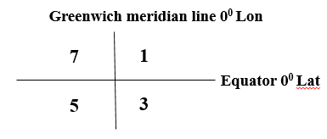
How to Code Longitude:
Always coded with four digits, with the leading (hundreds) figure coded as 0 or 1.
The first three digits are actual degrees, the last digit for tenths of a degree. For example:-
    when ship’s position Lon. 142˚ 55’ 30’’ it is coded as (142˚ is coded as is, 55’ divided by 6 is 9.166, .166 is disregarded we take 9 only and 30’’ become ignored) =1429;
    when ship’s position Lon. 60˚ 35’ 50’’ it is coded as (60˚ is coded as 060, 35 divided by 6 = 5.833, .833 is disregarded we take 5 only and 50’’ become ignored) L_{o}L_{o}L_{o}L_{o} = 0605;

Slide 11
i_{R}i_{x}hVV
Section 0 — Identification data
BBXX D.....D YYGGi_{w} 99L_{a}L_{a}L_{a} Q_{c}L_{o}L_{o}L_{o}L_{o}
Section 1 — Meteorological data
i_{R}i_{x}hVV Nddff 00fff 1s_{n}TTT 2s_{n}T_{d}T_{d}T_{d} 4PPPP 5appp 7wwW₁W₂ 8N_{h}C_{L}C_{M}C_{H}
Section 2 — Oceanographic data
222D_{s}v_{s} 0s_{s}T_{w}T_{w}T_{w} 2P_{w}P_{w}H_{w}H_{w} 3d_{w1}d_{w1}d_{w2}d_{w2} 4P_{w1}P_{w1}H_{w1}H_{w1} 5P_{w2}P_{w2}H_{w2}H_{w2} 6I_{s}E_{s}E_{s}R_{s} 8s_{w}T_{b}T_{b}T_{b} ICE c_{i}S_{i}b_{i}D_{i}z_{i}
i_{R} - Indicator for Inclusion or Omission of Precipitation (4)
How to Code: Always coded as 4 for U.S. VOS program ships. This indicates that the precipitation group is omitted.
i_{x} - Is coded as 1 or 3

Slide 12
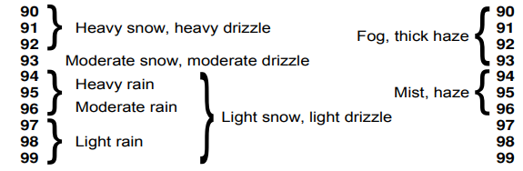
VV - Visibility is the greatest distance an object can be seen and identified.
Code fig. | Visibility in m/km
90 | less than 50 m
91 | 50 but less than 200 m
92 | 200 but less than 500 m
93 | 500 but less than 1000 m
94 | 1 but less than 2 km
95 | 2 but less than 4 km
96 | 4 but less than 10 km
97 | 10 but less than 20 km
98 | 20 but less than 50 km
99 | 50 km or more
The visibility ranges corresponding to various weather types are as follows:

Slide 13
Section 0 — Identification data
BBXX D.....D YYGGi_{w} 99L_{a}L_{a}L_{a} Q_{c}L_{o}L_{o}L_{o}L_{o}
Section 1 — Meteorological data
i_{R}i_{x}hVV Nddff 00fff 1s_{n}TTT 2s_{n}T_{d}T_{d}T_{d} 4PPPP 5appp 7wwW₁W₂ 8N_{h}C_{L}C_{M}C_{H}
Section 2 — Oceanographic data
222D_{s}v_{s} 0s_{s}T_{w}T_{w}T_{w} 2P_{w}P_{w}H_{w}H_{w} 3d_{w1}d_{w1}d_{w2}d_{w2} 4P_{w1}P_{w1}H_{w1}H_{w1} 5P_{w2}P_{w2}H_{w2}H_{w2} 6I_{s}E_{s}E_{s}R_{s} 8s_{w}T_{b}T_{b}T_{b} ICE c_{i}S_{i}b_{i}D_{i}z_{i}
Code Figures (D_{S}) | True Direction
0 | Ship hove to
1 | NE
2 | E
3 | SE
4 | S
5 | SW
6 | W
7 | NW
8 | N
9 | Unknown
/ | Not reported
Code procedure of Oceanographic data
222D_{s}v_{s}
2 2 2 - Section indicator for maritime data
D_{s} Ship's course made good during the past 3 hours
Units: Compass directions.

Slide 14
Vs - Ship's average speed during the past 3 hours
Units: Knots.
Code Figures(Vs) | Average speed (knots) | Average speed (km/hrs)
0 | 0 knot | 0 km h^{–1}
1 | 1 to 5 knots | 1-10 km h⁻¹
2 | 6 to 10 knots | 11-19 km h⁻¹
3 | 11 to 15 knots | 20-28 km h⁻¹
4 | 16 to 20 knots | 29-37 km h⁻¹
5 | 21 to 25 knots | 38-47 km h⁻¹
6 | 26 to 30 knots | 48-56 km h⁻¹
7 | 31 to 35 knots | 57-65 km h⁻¹
8 | 36 to 40 knots | 66-75 km h ⁻¹
9 | Over 40 knots | Over 75 km h⁻¹
/ | Not applicable (report from a coastal land station) or not reported

Slide 15
Section 0 — Identification data
BBXX D.....D YYGGi_{w} 99L_{a}L_{a}L_{a} Q_{c}L_{o}L_{o}L_{o}L_{o}
Section 1 — Meteorological data
i_{R}i_{x}hVV Nddff 00fff 1s_{n}TTT 2s_{n}T_{d}T_{d}T_{d} 4PPPP 5appp 7wwW₁W₂ 8N_{h}C_{L}C_{M}C_{H}
Section 2 — Oceanographic data
222D_{s}v_{s} 0s_{s}T_{w}T_{w}T_{w} 2P_{w}P_{w}H_{w}H_{w} 3d_{w1}d_{w1}d_{w2}d_{w2} 4P_{w1}P_{w1}H_{w1}H_{w1} 5P_{w2}P_{w2}H_{w2}H_{w2} 6I_{s}E_{s}E_{s}R_{s} 8s_{w}T_{b}T_{b}T_{b} ICE c_{i}S_{i}b_{i}D_{i}z_{i}
0s_{s}T_{w}T_{w}T_{w} :
0 - Group indicator for sea surface temperature
s_{s} - Sign and type of measurement of sea surface temperature
T_{w}T_{w}T_{w} - Sea surface temperature in whole degrees and tenths

Slide 16
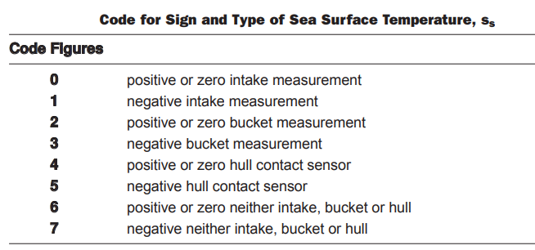
Coding procedure for s_{s} - Sign and type of measurement of sea surface temperature
Method of Measurement:
    Engine room intake thermometer,
    hull mounted contact sensor thermometer,
    bucket thermometer.

Slide 17
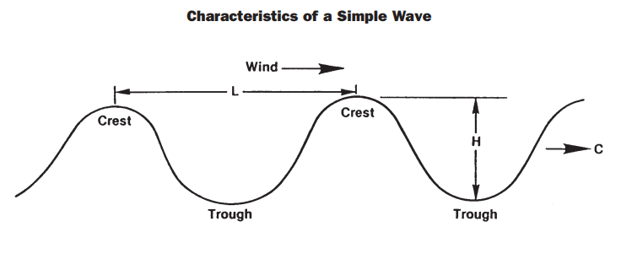
2P_{w}P_{w}H_{w}H_{w} wind wave period and height
SECTION 2 — OCEANOGRAPHIC DATA
222D_{s}v_{s} 0s_{s}T_{w}T_{w}T_{w} 2P_{w}P_{w}H_{w}H_{w} 3d_{w1}d_{w1}d_{w2}d_{w2} 4P_{w1}P_{w1}H_{w1}H_{w1} 5P_{w2}P_{w2}H_{w2}H_{w2} 6I_{s}E_{s}E_{s}R_{s} 8s_{w}T_{b}T_{b}T_{b} ICE c_{i}S_{i}b_{i}D_{i}z_{i}
2P_{w}P_{w}H_{w}H_{w} :
2 - Group indicator for wind waves.
P_{w}P_{w} - Period of wind waves in seconds.
Wave period is the time between the passage of two successive wave crests (or successive troughs) and Units: Seconds.
H_{w}H_{w} - The vertical distance between trough and crest for wind waves in units of half meter .

Slide 18
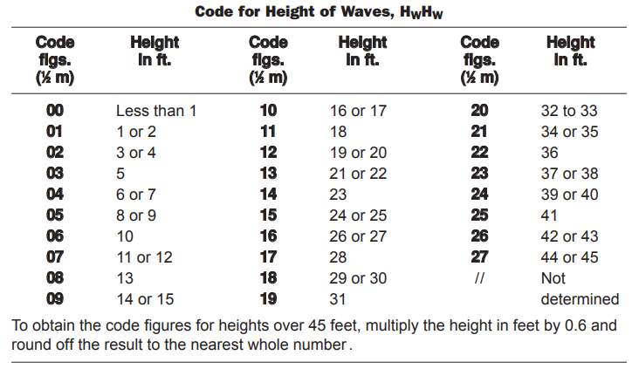
Cont’d
Method of Measurement:
Visual estimate.
How to Code:
The code is in units of half meters e.g. code figure 08 is 8 half meters = 4 meters = 13 feet:

Slide 19
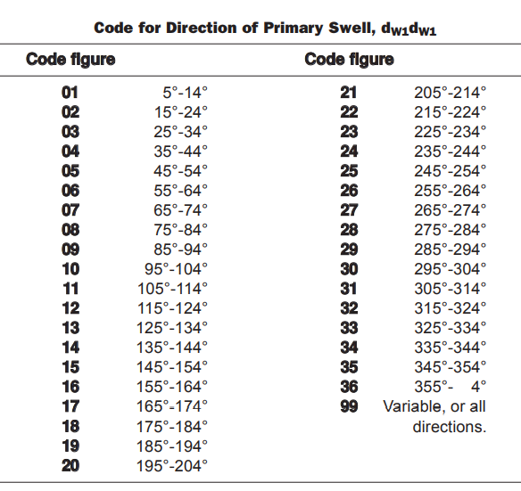
3d_{w1}d_{w1}d_{w2}d_{w2} swell directions
SECTION 2 — OCEANOGRAPHIC DATA
222D_{s}v_{s} 0s_{s}T_{w}T_{w}T_{w} 2P_{w}P_{w}H_{w}H_{w} 3d_{w1}d_{w1}d_{w2}d_{w2} 4P_{w1}P_{w1}H_{w1}H_{w1} 5P_{w2}P_{w2}H_{w2}H_{w2} 6I_{s}E_{s}E_{s}R_{s} 8s_{w}T_{b}T_{b}T_{b} ICE c_{i}S_{i}b_{i}D_{i}z_{i}
3d_{w1}d_{w1}d_{w2}d_{w2}
  3 - Group indicator for swell directions
  d_{w1}d_{w1} - Direction in tens of degree from which the predominant swell is coming
  d_{w2}d_{w2} Direction of secondary Swell Waves in degrees.

Slide 20
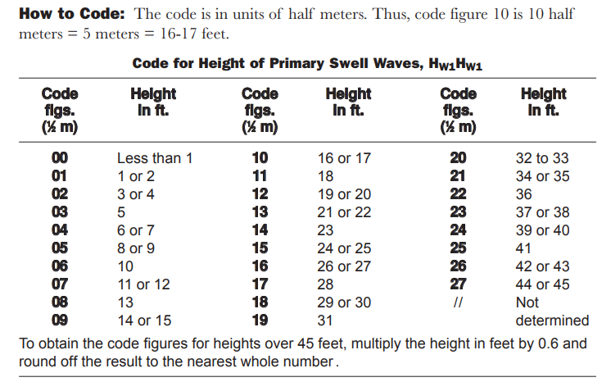
4P_{w1}P_{w1}H_{w1}H_{w1} period and height of the predominant swell
Section 2 — Oceanographic data
222D_{s}v_{s} 0s_{s}T_{w}T_{w}T_{w} 2P_{w}P_{w}H_{w}H_{w} 3d_{w1}d_{w1}d_{w2}d_{w2} 4P_{w1}P_{w1}H_{w1}H_{w1} 5P_{w2}P_{w2}H_{w2}H_{w2} 6I_{s}E_{s}E_{s}R_{s} 8s_{w}T_{b}T_{b}T_{b} ICE c_{i}S_{i}b_{i}D_{i}z_{i}
4P_{w1}P_{w1}H_{w1}H_{w1}
4 - Group indicator
P_{w1}P_{w1} - Period of the first (predominant) swell in seconds
H_{w1}H_{w1} - Height of the first (predominant) swell in units of half meter
How to Code: for P_{w1}P_{w1} Coded directly in seconds. Thus, if the period of the primary swell waves is 12 seconds, P_{w1}P_{w1} is coded as 12. If the period is 7 seconds, P_{w1}P_{w1} is coded as 07.

Slide 21
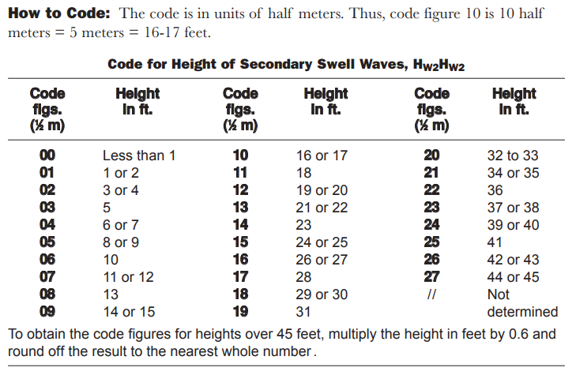
5P_{w2}P_{w2}H_{w2}H_{w2} Secondary Swell Waves Period and height
Section 2 — Oceanographic data
222D_{s}v_{s} 0s_{s}T_{w}T_{w}T_{w} 2P_{w}P_{w}H_{w}H_{w} 3d_{w1}d_{w1}d_{w2}d_{w2} 4P_{w1}P_{w1}H_{w1}H_{w1} 5P_{w2}P_{w2}H_{w2}H_{w2} 6I_{s}E_{s}E_{s}R_{s} 8s_{w}T_{b}T_{b}T_{b} ICE c_{i}S_{i}b_{i}D_{i}z_{i}
5P_{w2}P_{w2}H_{w2}H_{w2}
5 - Group indicator
P_{w2}P_{w2} - Period of Secondary Swell Waves (Units: Seconds).
H_{w2}H_{w2} - Height of secondary swell waves, in units of half meter.
The secondary swell system has lower waves than the primary swell.

Slide 22
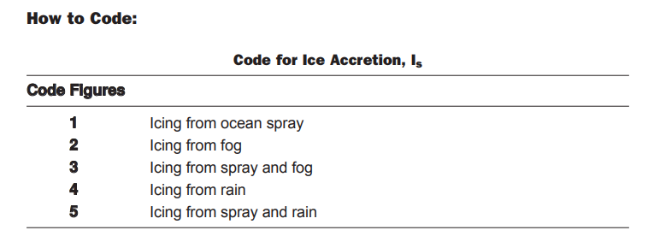
6I_{s}E_{s}E_{s}R_{s} - ice deposit on ship
Section 2 — Oceanographic data
222D_{s}v_{s} 0s_{s}T_{w}T_{w}T_{w} 2P_{w}P_{w}H_{w}H_{w} 3d_{w1}d_{w1}d_{w2}d_{w2} 4P_{w1}P_{w1}H_{w1}H_{w1} 5P_{w2}P_{w2}H_{w2}H_{w2} 6I_{s}E_{s}E_{s}R_{s} 8s_{w}T_{b}T_{b}T_{b} ICE c_{i}S_{i}b_{i}D_{i}z_{i}
6I_{s}E_{s}E_{s}R_{s}
6 - Group indicator
I_{s}, Cause of Ice Deposit on Ship
E_{s}E_{s}, Thickness of Ice Deposit on Ships
R_{s}, Rate of Ice Deposit on Ships

Slide 23
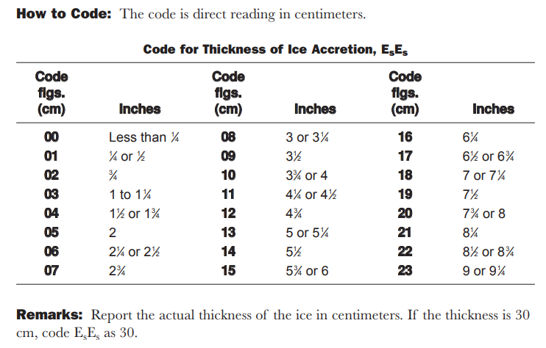
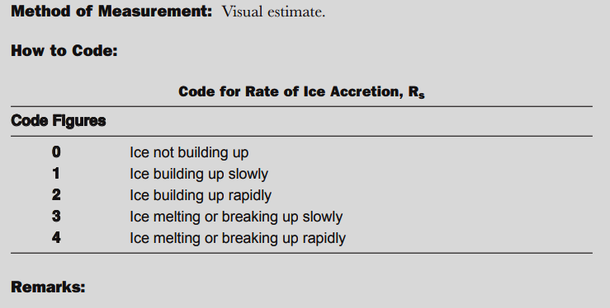

Slide 24
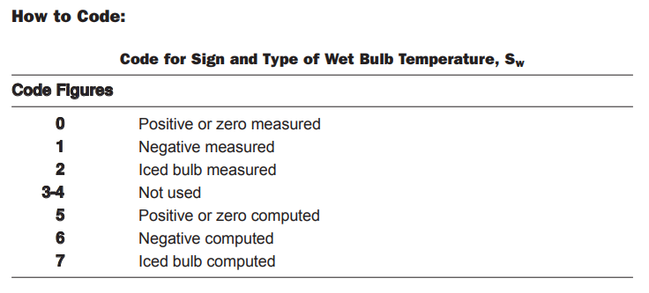
8s_{w}T_{b}T_{b}T_{b} - Wet Bulb Temperature
Section 2 — Oceanographic data
222D_{s}v_{s} 0s_{s}T_{w}T_{w}T_{w} 2P_{w}P_{w}H_{w}H_{w} 3d_{w1}d_{w1}d_{w2}d_{w2} 4P_{w1}P_{w1}H_{w1}H_{w1} 5P_{w2}P_{w2}H_{w2}H_{w2} 6I_{s}E_{s}E_{s}R_{s} 8s_{w}T_{b}T_{b}T_{b} ICE c_{i}S_{i}b_{i}D_{i}z_{i}
8s_{w}T_{b}T_{b}T_{b}
8 - Group indicator for wet bulb temperature
s_{w} - Sign and type of wet bulb temperature
T_{b}T_{b}T_{b} - Wet bulb temperature in whole degrees and tenths

Slide 25
ICE c_{i}S_{i}b_{i}D_{i}z_{i} - Concentration or arrangement of sea ice
Section 2 — Oceanographic data
222D_{s}v_{s} 0s_{s}T_{w}T_{w}T_{w} 2P_{w}P_{w}H_{w}H_{w} 3d_{w1}d_{w1}d_{w2}d_{w2} 4P_{w1}P_{w1}H_{w1}H_{w1} 5P_{w2}P_{w2}H_{w2}H_{w2} 6I_{s}E_{s}E_{s}R_{s} 8s_{w}T_{b}T_{b}T_{b} ICE c_{i}S_{i}b_{i}D_{i}z_{i}
ICE c_{i}S_{i}b_{i}D_{i}z_{i}
ICE, Indicator for Sea Ice Concentration
Method of Measurement: Visual determination.
How to Code: Code in accordance with the table on the following
c_{i} Sea ice concentration 0-9, /
S_{i} Sea ice development 0-9, /
b_{i} Ice of land origin 0-9, /
D_{i} Ice edge bearing 0-9, /
z_{i} Ice trend 0-9, /

Slide 26
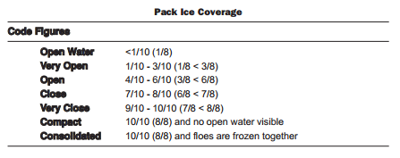
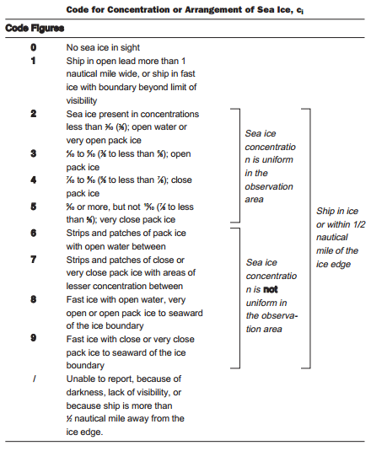
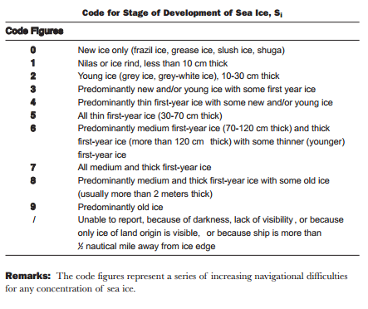

Slide 27
