Slide 1
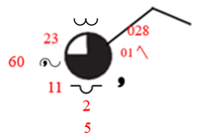
UNDERSTANDING SYNOPTIC CHARTS
Cloud type C_{M}
Wind direction NE
Air temperature
Wind speed 5 m/s or 10 knots
Total amount of cloud that covers the sky
Sea level pressure
Visibility
Pressure tendency character
3 hours pressure change
Present weather ww
Past weather W₁
Cloud type C_{L}
Dew-point temperature
Amount of Low cloud N_{S}
The lowest cloud base height from the surface

Slide 2
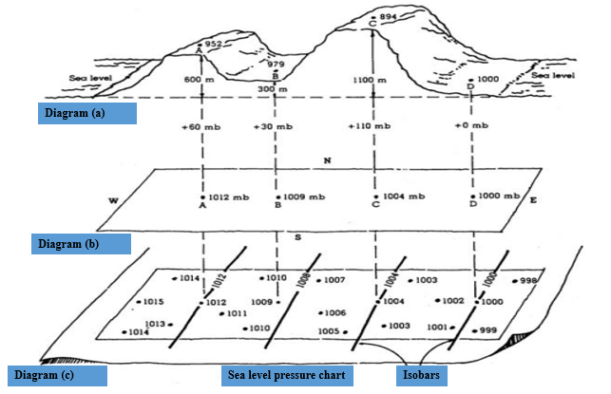
An explanation of how a "surface“ pressure pattern map is constructed

Slide 3
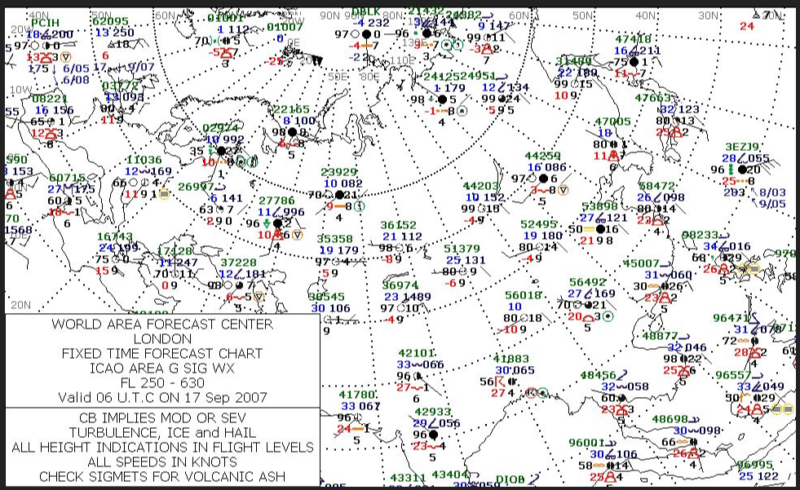

Slide 4
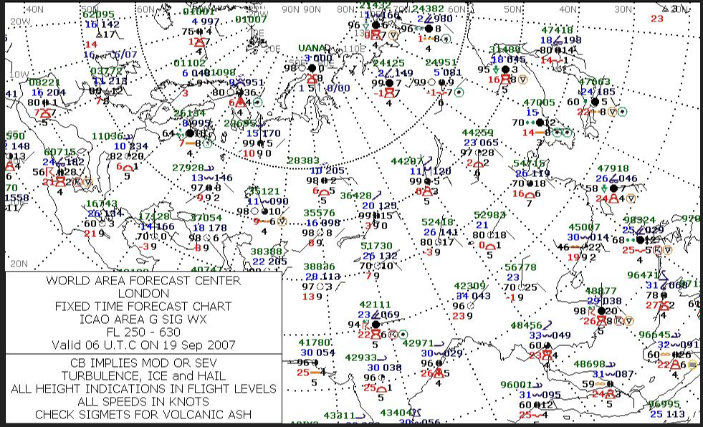

Slide 5
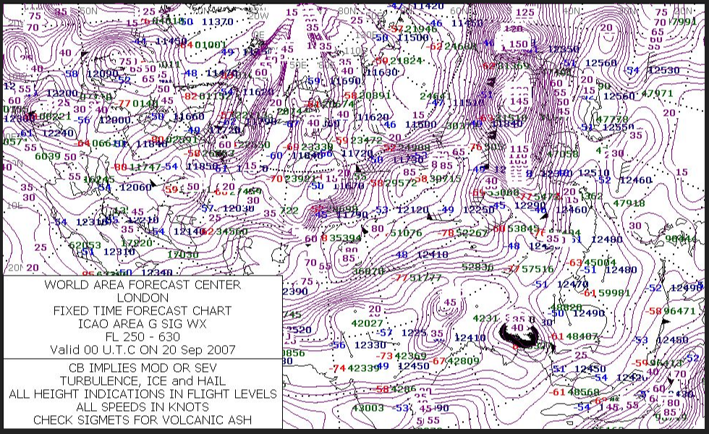

Slide 6
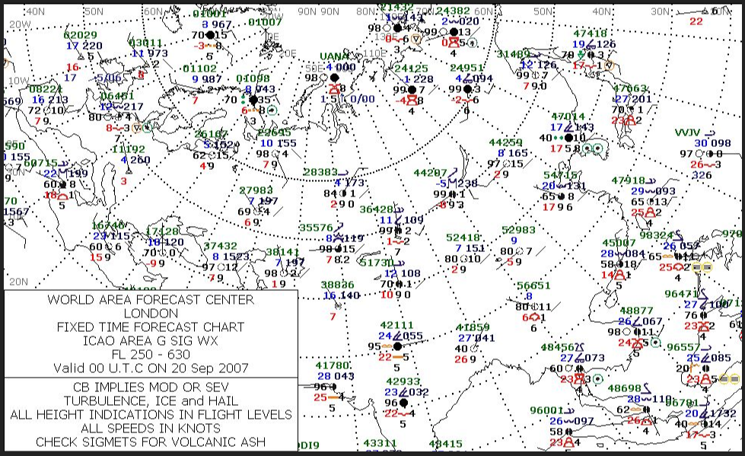

Slide 7
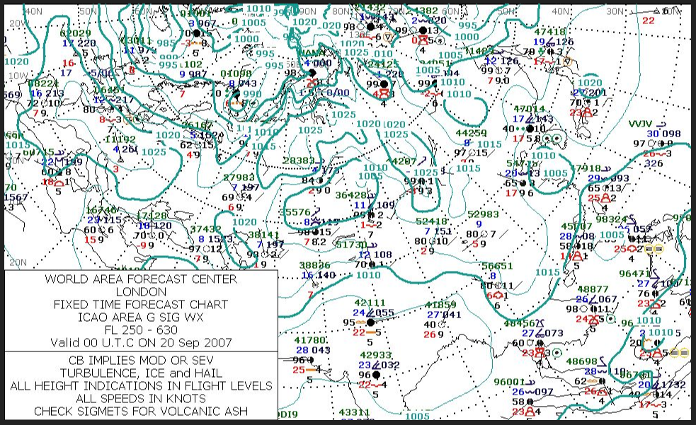

Slide 8
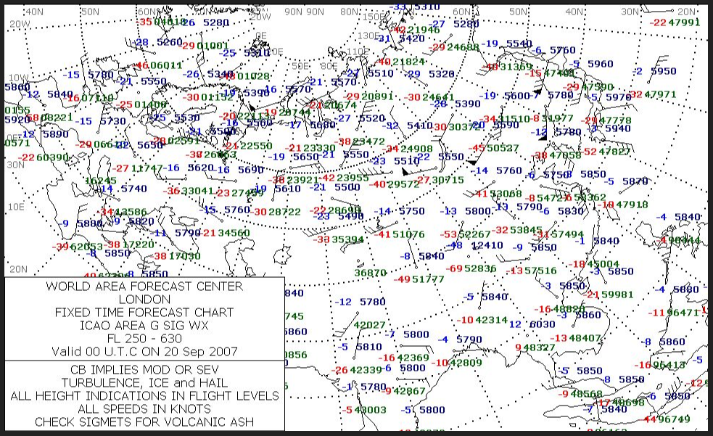

Slide 9
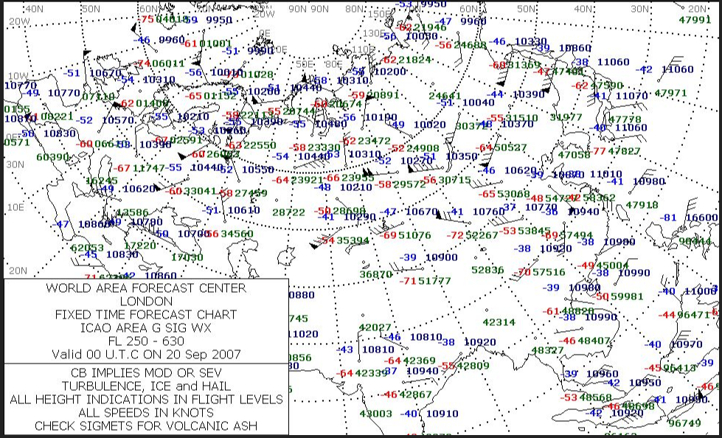

Slide 10
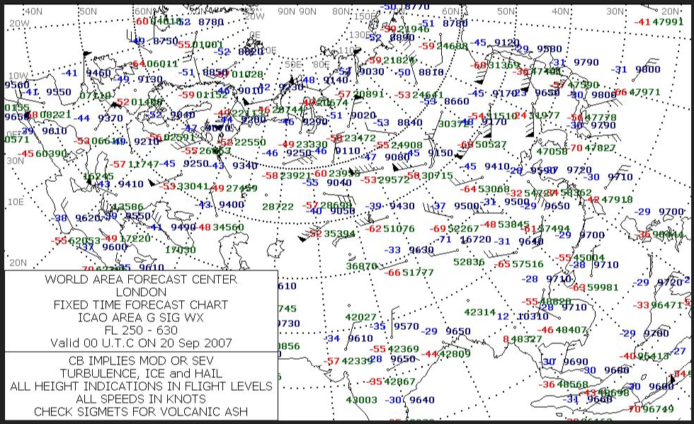

Slide 11
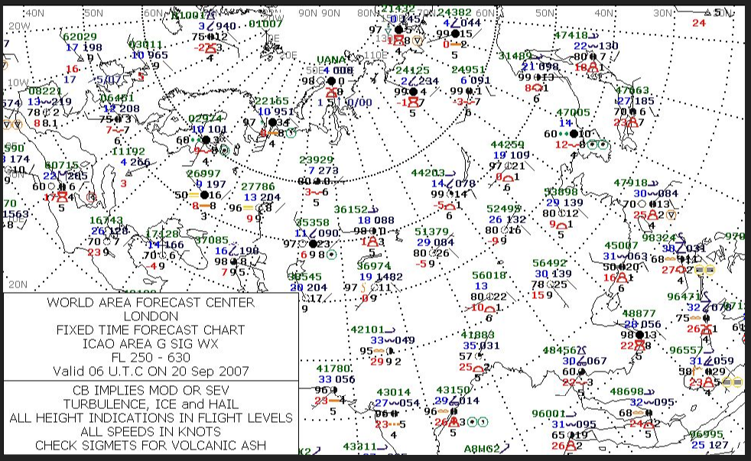

Slide 12
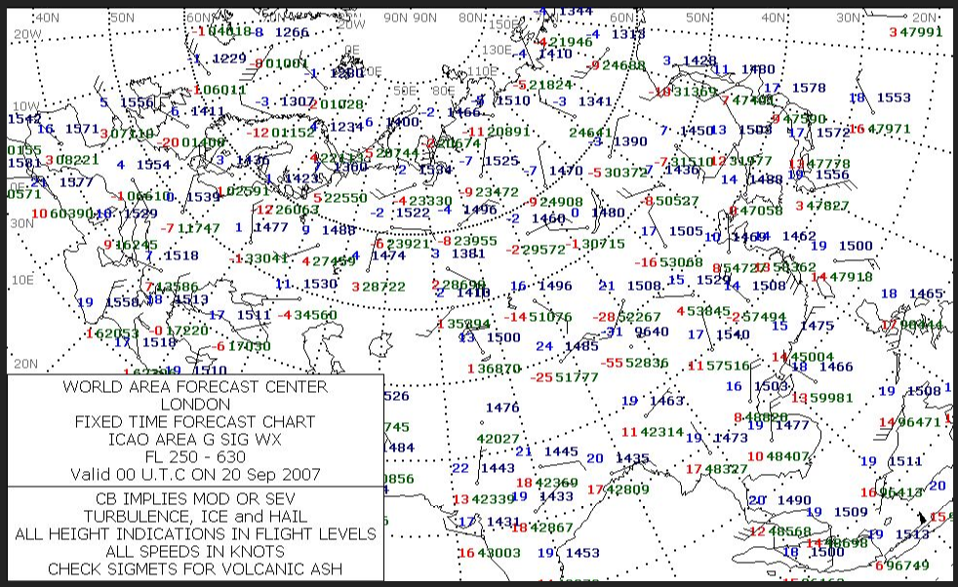

Slide 13
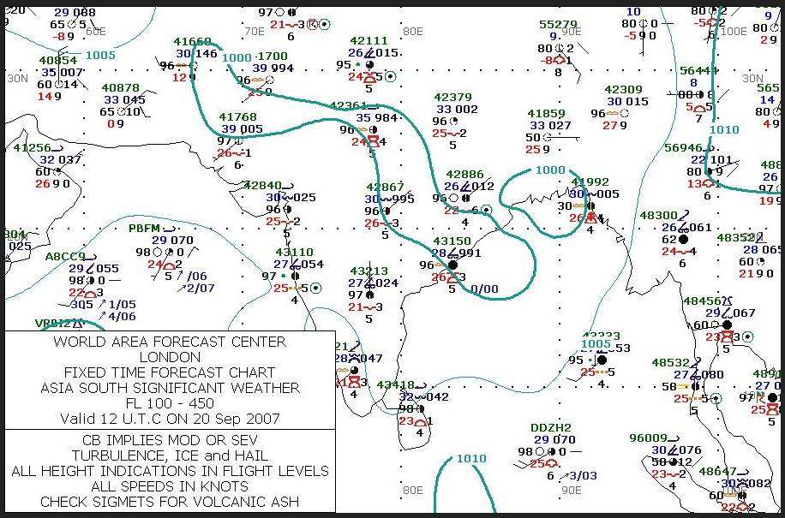

Slide 14
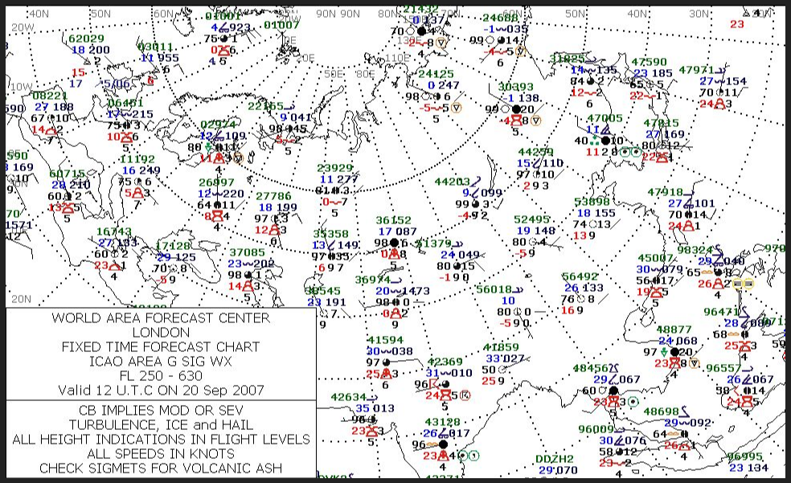

Slide 15
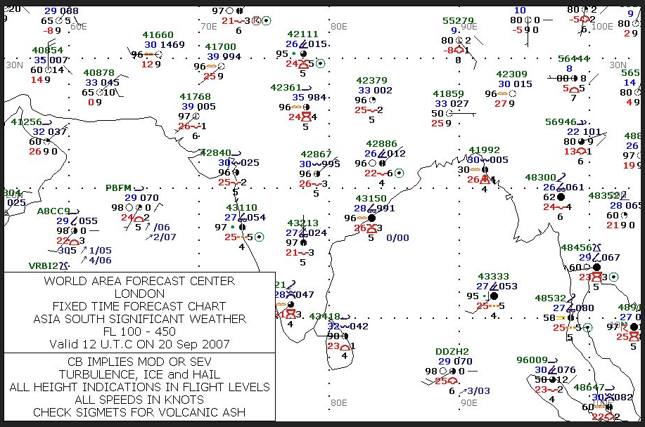

Slide 16
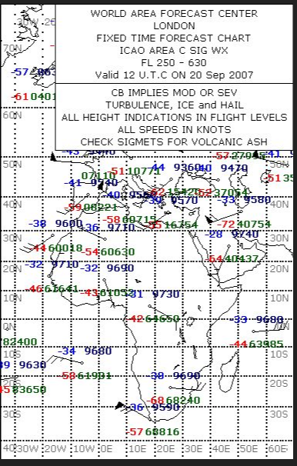

Slide 17
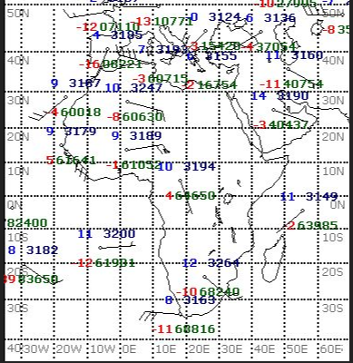

Slide 18
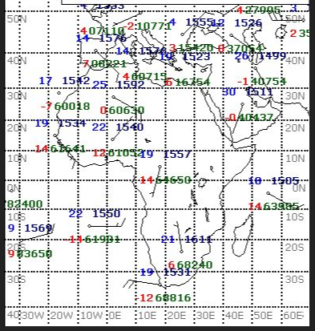

Slide 19
