Slide 1
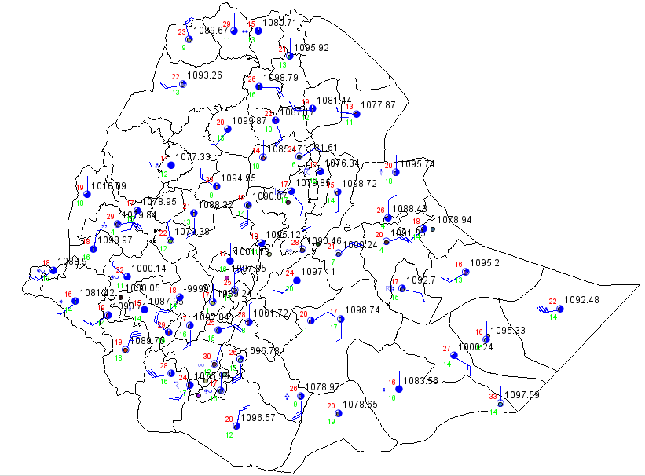

Chapter Three:
Display of synoptic data on weather charts
Fig. 1 plotted surface stations data of Ethiopia with MeteoInfo software

Slide 2










Chapter Three:
Display of synoptic data on weather charts
3.1 Plotting models for surface and upper-air synoptic data
Plotting models for surface Synoptic data (FM-12)
The first procedure in plotting weather data on weather map is identifying the station and plotting total cloud coverage.
Plotting figure for cloud amounts are
In Nddff group if the value of N =
N = 0 N = 1 N = 2 N = 3 N = 4 N = 5 N = 6 N = 7 N = 8
Obscured
Overcast

Slide 3
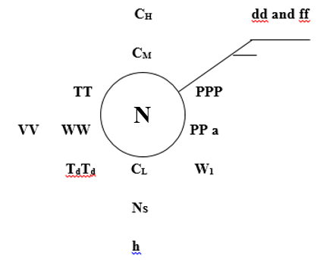
Plotting model of surface SYNOP FM-12 surface data
Fig. 2 plotting model of SYNOP surface data

Slide 4
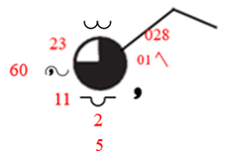
UNDERSTANDING SYNOPTIC CHARTS
Cloud type C_{M}
Wind direction NE
Air temperature
Wind speed 5 m/s or 10 knots
Total amount of cloud that covers the sky
Sea level pressure
Visibility
Pressure tendency character
3 hours pressure change
Present weather ww
Past weather W₁
Cloud type C_{L}
Dew-point temperature
Amount of Low cloud N_{S}
The lowest cloud base height from the surface

Slide 5
Plotting procedure of surface synoptic data FM - 12
By identifying the region and station number then find the station from the synop weather chart.
From the given data go to the 3rd group which is (Nddff) then take the 1st number or the value of N then shade the station model according to the written number.
AAXX 06151
63403 41560 60505 10228 20116 39974 40028 58001 75654 82530 333 82625 85360 555 10260=

Slide 6

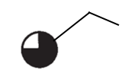
AAXX 06151
63403 41560 60505 10228 20116 39974 40028 58001 75654 82530 333 82625 85360 555 10260=
3. Plot the direction of the wind by taking the next two numbers and write 0 at the end then Plot the direction starting from the circumference according to wind direction data of the station.
050 means that wind is blowing from 50 degree
4. Plot the wind speed by taking the last two numbers from the 3rd group of surface SYNOP data then set the wind speed by drawing wind barb at the head of the wind direction.

Slide 7
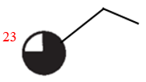
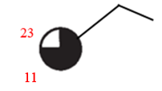
AAXX 06151
63403 41560 60505 10228 20116 39974 40028 58001 75654 82530 333 82625 85360 555 10260=
5. Write the amount of air T⁰ of the station excluding the decimal to the nearest 10th of ⁰c at NW direction of the station model.
6. Write the amount of air T_{d}⁰ of the station excluding the decimal to the nearest 10th of ⁰c at SW direction of the station model.

Slide 8
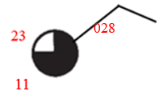
AAXX 06151
63403 41560 60505 10228 20116 39974 40028 58001 75654 82530 333 82625 85360 555 10260=
7. Write the mean sea level pressure amount of the station by taking the last 3 numbers at NE direction of the station model.

Slide 9
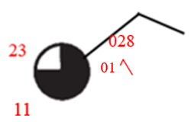
AAXX 06151
63403 41560 60505 10228 20116 39974 40028 58001 75654 82530 333 82625 85360 555 10260=
8. From 5appp group according to the 3 P (PPP) value write the actual change in the pressure during the three hours of the station and also according to the value of a from the same group plot pressure tendency character in the East direction station model.

Slide 10
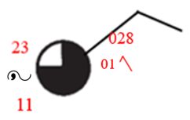
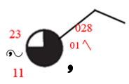
AAXX 06151
63403 41560 60505 10228 20116 39974 40028 58001 75654 82530 333 82625 85360 555 10260=
9. Plot the present WX type which is written in group 7wwW₁W₂ according to the value of ww by finding the actual present wx symbol in middle of the T⁰ & T_{d} position.
10. Plot the actual plotting figure of past WX type (W₁) from this group according to the value of (W₁) in the bottom of pressure tendency.

Slide 11
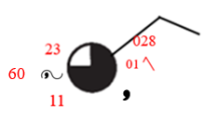
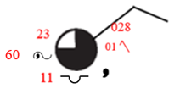
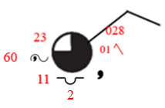
AAXX 06151
63403 41560 60505 10228 20116 39974 40028 58001 75654 82530 333 82625 85360 555 10260=
11. Write the visibility (VV) code value the by taking the last 2 numbers from the 2nd group at the left of present WX.
12. Plot the low cloud type (C_{L}) in south position of station model.
13. Write the amount of low cloud (N_{S}) below low cloud type.

Slide 12
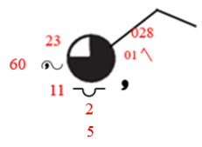
AAXX 06151
63403 41560 60505 10228 20116 39974 40028 58001 75654 82530 333 82625 85360 555 10260=
14. Write the value of the lowest cloud base height (h) in the bottom of (N_{S}) amount of low cloud.
15. Plot the middle cloud type (C_{M}) in north position of station model.

Slide 13
AAXX 06151
63403 41560 60505 10228 20116 39974 40028 58001 75654 82530 333 82625 85360 555 10260=
16. Plot the high cloud type (C_{H}) above (C_{M}) position.
In this case according to the wx report above (C_{H}) = 0 this means that there is no high cloud so, no plotting figure for this.

Slide 14
AAXX 26061
63330 11975 43402 10166 20139 37795 40260 60074 7101/ 80001 333 20132 59014 84070=
63331 11370 60000 10176 20154 38076 4//// 69934 7216/ 83650 333 20148 59010 81709 82820 86358=
63332 NIL=
63333 11970 70103 10237 20150 38148 40109 60144 7052/ 87030 333 20150 59023 87360=
63334 11450 82703 10140 20135 37638 40148 60024 7102/ 8581/ 333 20120 59016 82714 82826 84628 85457=
63340 11565 80000 10170 20154 60014 7102/ 8551/ 333 20148 85624 87457=
63402 31550 80000 10175 20167 38366 4//// =
63403 NIL=
63450 11256 72605 10158 20128 37740 40136 60054 71022 86670 333 20132 59014 83705 85622 85358=
63451 31260 82003 10175 20147 38151 40159 71022 8653/ 333 20153 59014 82704 84624 83357=
63453 31865 41804 10266 20153 39050 7051/ 84030 333 20225 59025 84358=
63460 32380 81801 10172 20139 86870 333 20156 83710 84620 85458 84359=
63471 32480 71805 10222 20146 38830 40091 81678 333 20210 59027 81716 86358=
63474 12180 61802 10151 20099 69904 82134 333 20111 81702 81820 83357 85070=
63478 NIL=
63500 11475 80000 10182 20168 69944 7152/ 8587/ 333 20176 82714 83625 86357=
63533 11/04 92207 10154 20154 60014 7456/ 333 20145=
NNNN

Slide 15
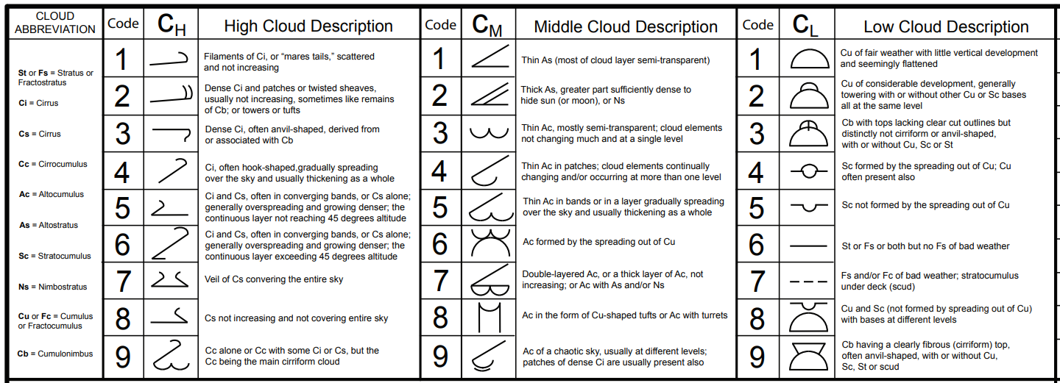

Slide 18
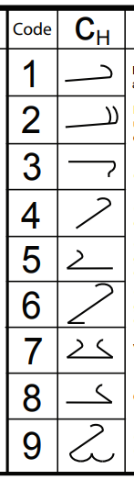
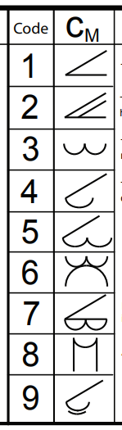
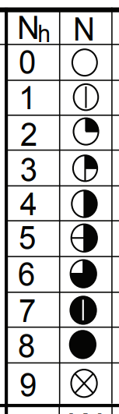

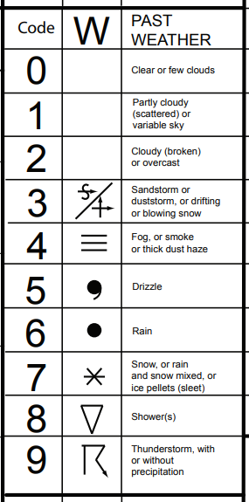
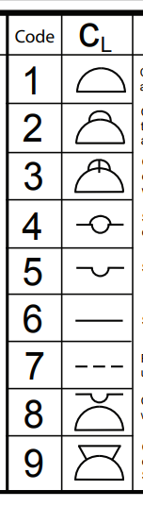
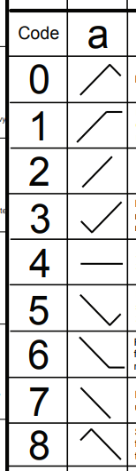

Slide 19
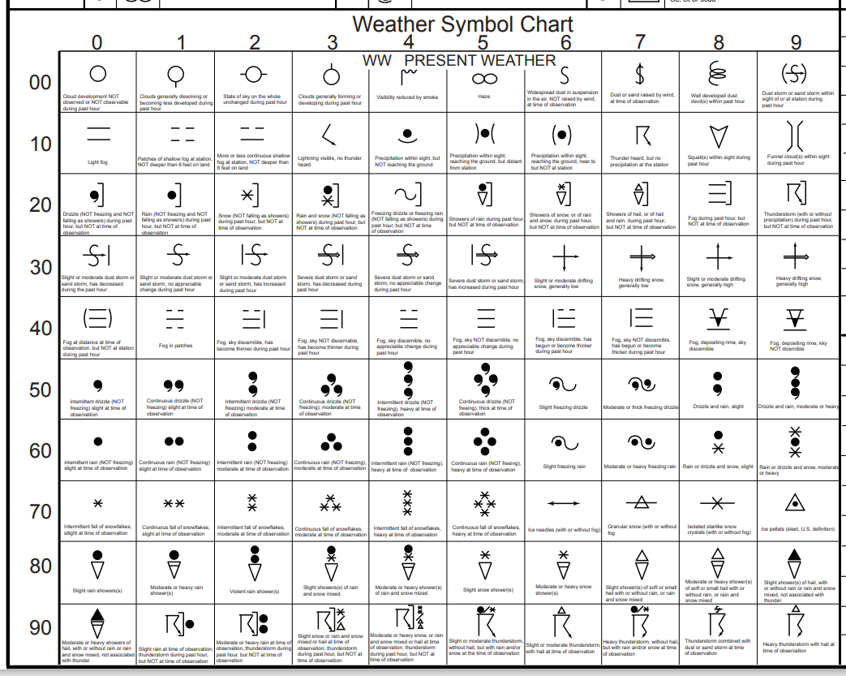

Slide 21
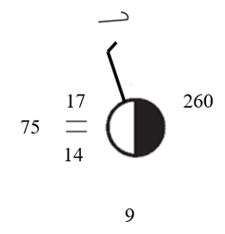
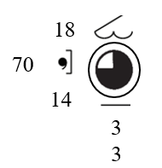
Plotting Example 1
AAXX 26061
63330 11975 43402 10166 20139 37795 40260 60074 7101/ 80001 333
Plotting Example 2
63331 11370 60000 10176 20154 38076 4//// 69934 7216/ 83650 333

Slide 22
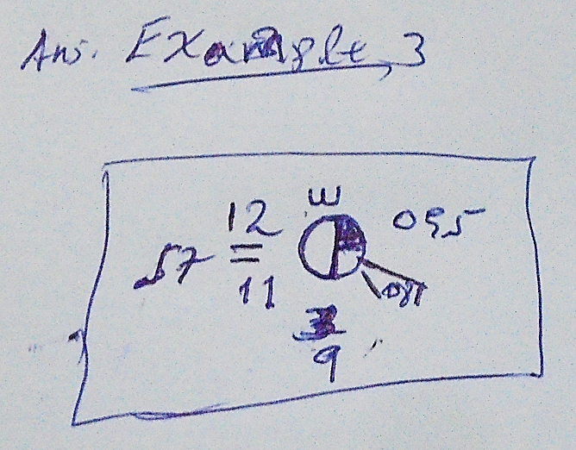
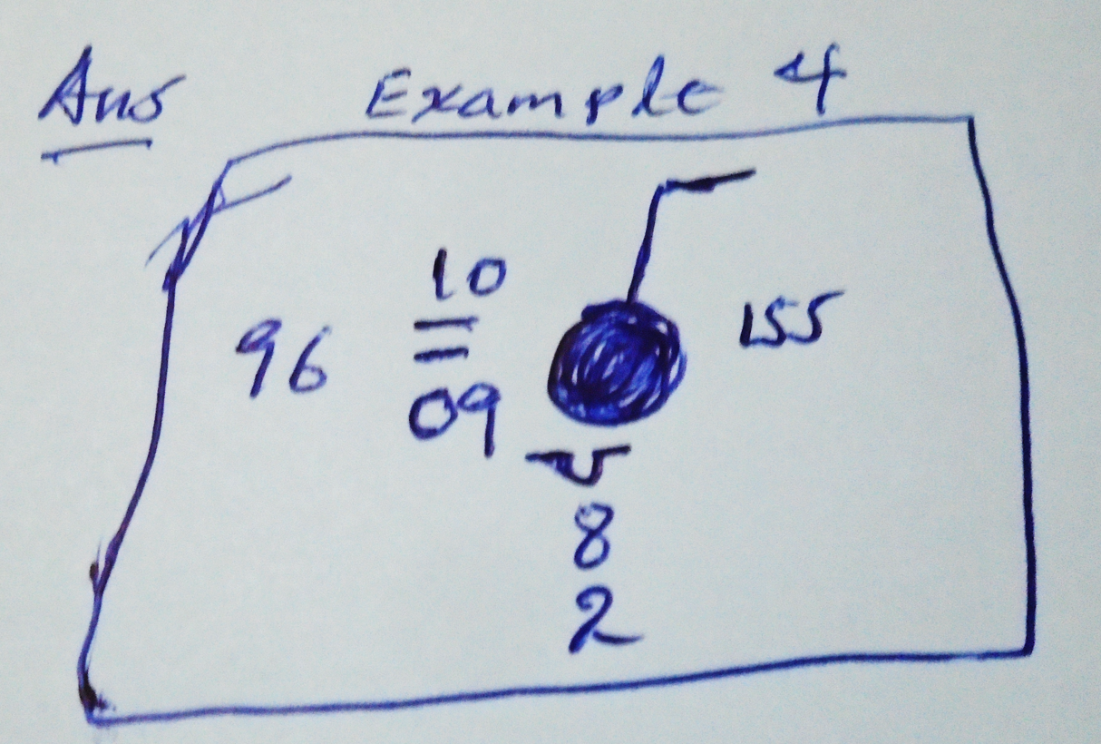
Plotting Example 3
SMAR20 OEJD 190600
AAXX 19061
26997 31957 31202 10123 20107 39884 40095 57008 71000 83030 333 20108=
27595 31296 80204 10103 20093 30002 40155 52009 71022 885// 333 20082 88705=
Plotting Example 4

Slide 23
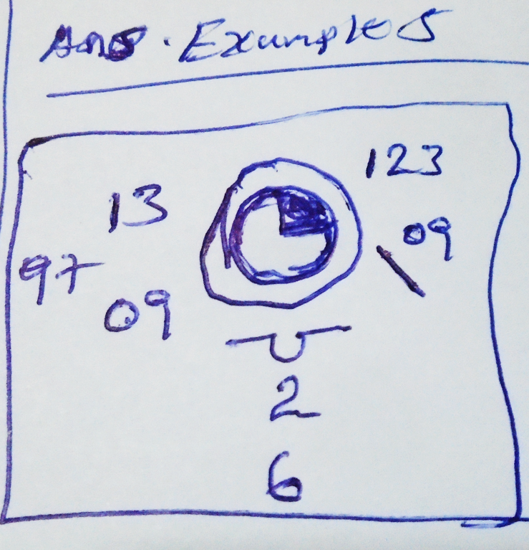
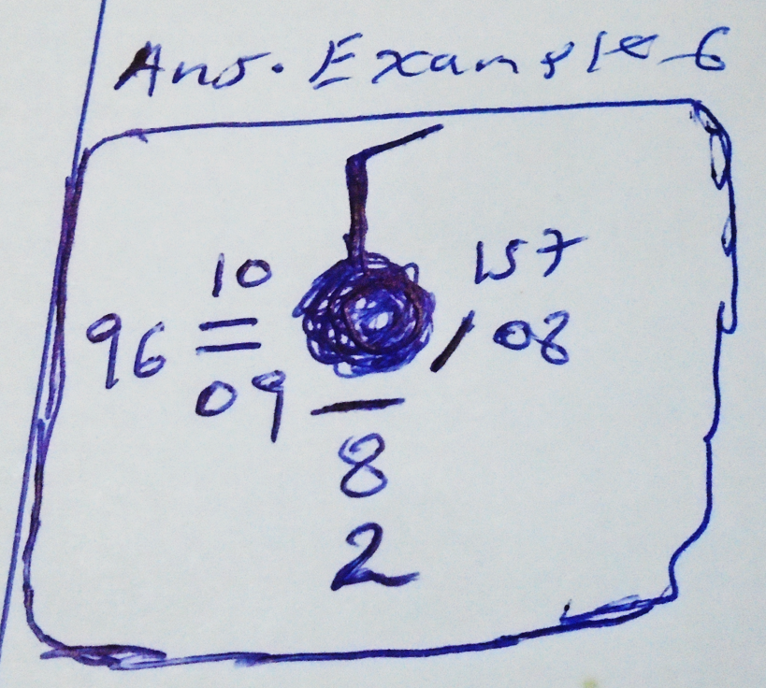
Plotting Example 5
SMAR20 OEJD 190600
AAXX 19061
27612 32697 20000 10127 20092 39936 40123 57009 82500 333 20091=
Plotting Example 6
27786 11296 83604 10102 20092 30001 40157 52008 69900 71011 886// 333 20093 88705=

Slide 24
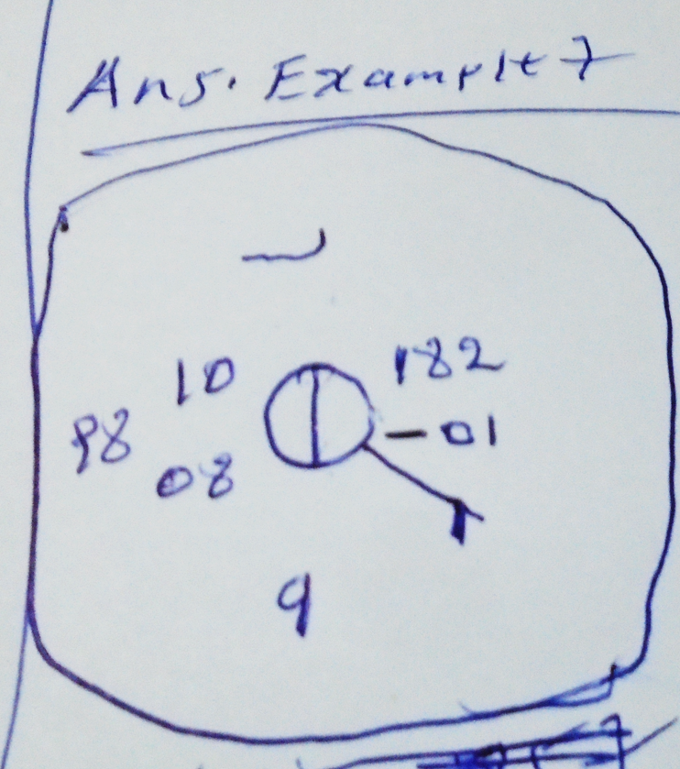
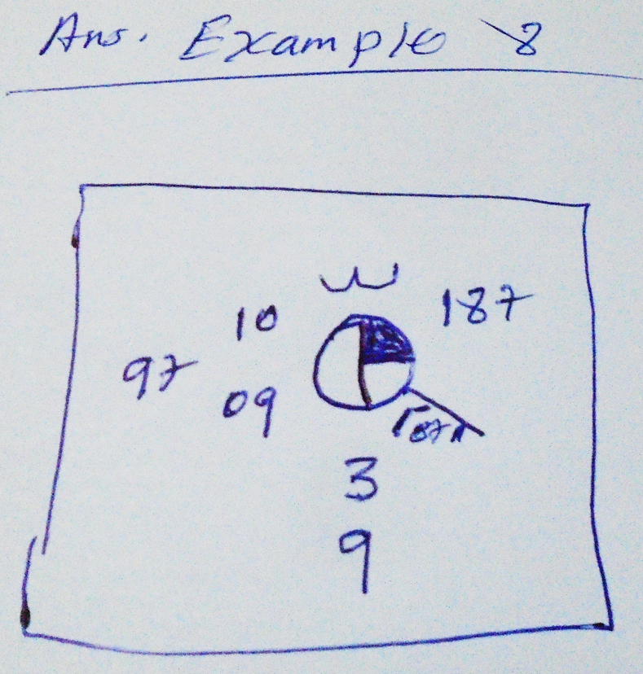
Plotting Example 7
SMAR20 OEJD 190600
AAXX 19061
27857 32998 11403 10095 20082 30023 40182 54000 80001 333 20016=
27947 32997 31502 10097 20085 30030 40187 51007 83030 333 20051=
Plotting Example 8

Slide 25
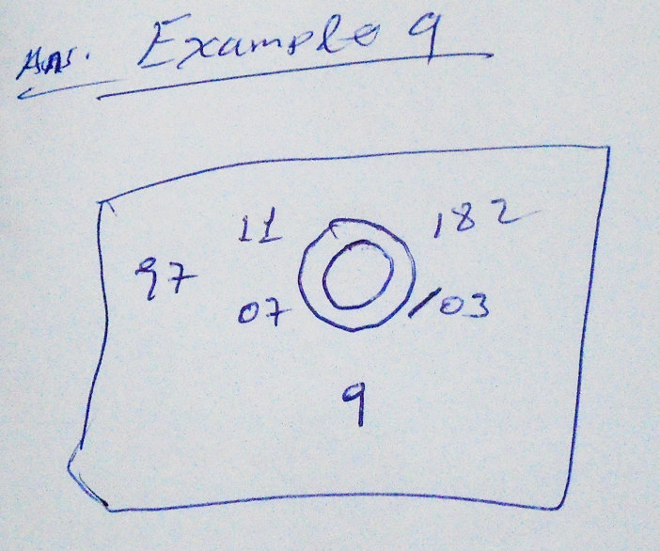
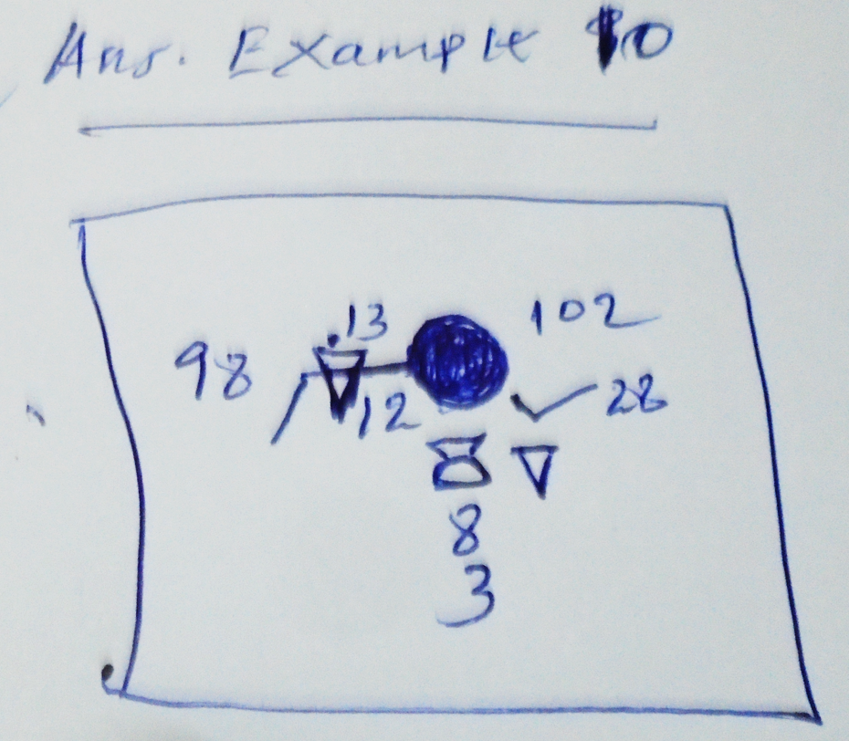
Plotting Example 9
SMAR20 OEJD 190600
AAXX 19061
27962 32997 00000 10112 20074 40182 52003 333 20036=
Plotting Example 10
AAXX 19061
33317 11398 82704 10133 20120 39776 40102 53028 69992 78088 889// 333 20131 87710=

Slide 26
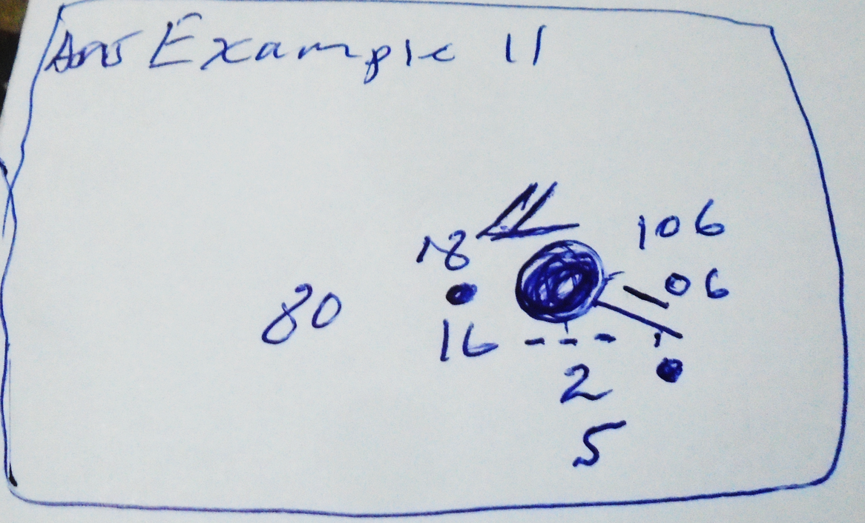
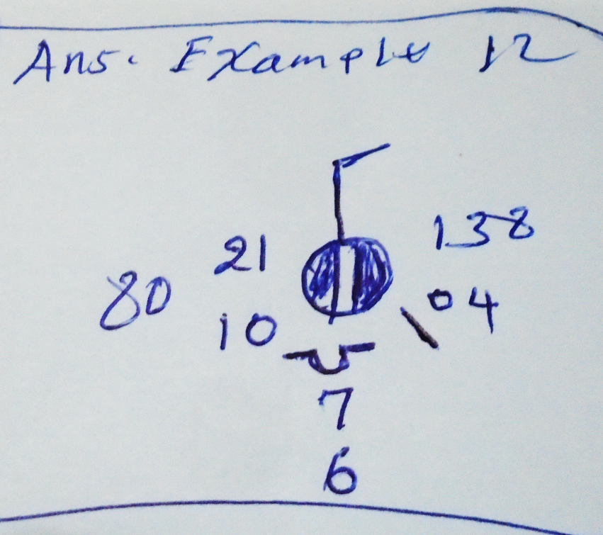
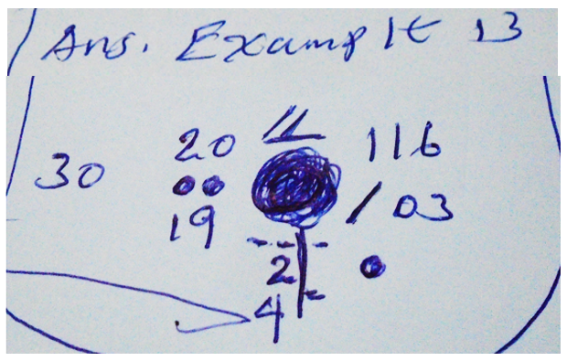
Plotting Example 11
SMCI05 BABJ 190600
AAXX 19061
50978 11580 82502 10177 20164 39776 40106 57006 60051 76060 8272/ 333 20154=
Plotting Example 12
54236 32680 73604 10211 20097 30039 40138 57004 875// 333 20157=
Plotting Example 13
54857 11430 81801 10204 20185 30028 40116 52003 60071 76166 8272/ 333 20191=

Slide 27
Plotting Assignment
Plot the following 10 surface synoptic stations observation report code based on
station model plotting procedure
SMBY01 UMMN 190600
AAXX 19061
Q#1 26554 11460 72804 10130 20117 39855 40011 53025 60022 72582 879// 333
Q#2 26666 11540 71903 10134 20118 39809 40014 57009 69972 78086 879// 333
Q#3 26941 11460 82804 10114 20098 39851 40081 52041 60032 70282 887// 333
Q#4 26951 11462 83109 10126 20109 39866 40058 53030 60022 76062 8472/ 333
Q#5 33008 11460 72803 10105 20085 39953 40128 52030 60032 72162 87500 333
Q#6 33036 11357 71901 10158 20146 39829 40049 53003 69912 76186 875// 333
Q#7 33041 11560 71603 10154 20127 39906 40055 57005 69902 72511 8337/ 333
SMCR01 GCLP 190600
AAXX 19064
Q#8 060030 02560 13513 10208 20153 30107 40162 53001 60004 81800 333
Q#9 060040 02560 20207 10203 20151 30144 40169 53001 60004 82500 333
Q#10 060338 12570 12802 10198 20165 30112 40177 53005 60004 81500 333

Slide 28
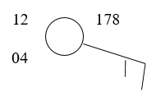
Plotting procedure of Upper air sonding data FM - 35
USET01 HAAB 291200
TTAA 79121 63450
99774 23465 11017 00046 ///// ///// 92754 ///// ///// 85505 ///// ///// 70178 12058 11515 50590 03183 09043 40763 15380 06516 30973 32175 30522 25099 41977 30517 20247 51973 05514 15428 64170 07504 10665 80162 08510 88206 61929 27080 77215 26095 31313 48008 81132=
Plotting procedure
First write the pressure level on space provide to the level and find the station using region and station number then droaw the wind direction and speed starting from circumference of station model, write the geo-potential height code number in north east direction of the circle, write the temperature of the level in north west direction of the circle and write the dew-point temperature of the level in south west direction of the circle.
level = 700 mb

Slide 29





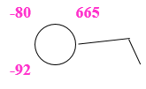

USET01 HAAB 291200
TTAA 79121 63450
99774 23465 11017 00046 ///// ///// 92754 ///// ///// 85505 ///// ///// 70178 12058 11515 50590 03183 09043 40763 15380 06516 30973 32175 30522 25099 41977 30517 20247 51973 05514 15428 64170 07504 10665 80162 08510 88206 61929 27080 77215 26095 31313 48008 81132=
level = 500 mb
level = 400 mb
level = 300 mb
level = 250 mb
level = 200 mb
level = 150 mb
level = 100 mb

Slide 30
Chapter Four
Weather Analysis Techniques
Contents
Analysis of surface and upper-air weather charts by drawing
  Isobars,
  Contours,
  Isotachs and
  Isotherms
Identifying different weather systems
  Troughs,
  Ridges,
  Cyclones and anticyclones,
Reading assignment
  Jet streams and
  Fronts

Slide 31
Function of contour
Contour maps organize all the available data so we can make sense of it
We have all that station map data!!!!
    Let’s use it.
    Let’s be able to forecast from it!
Once contoured, you can determine
  wind direction,
  high and low pressure systems,
  locations of possible
              precipitation,
              fronts,
              regions of strong winds and
              changing temperatures --- ALL FROM A MAP!

Slide 32
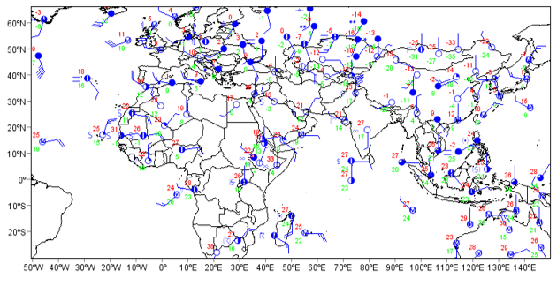
Plotted stations level data
This is the first step before analysis.
The above map is plotted by using plotting software

Slide 33
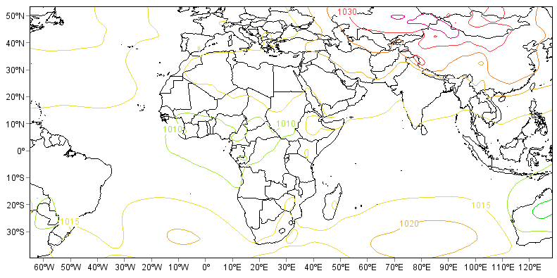
Analysis After plotting
Mean sea level pressure contour 2024 02 01 03:00

Slide 34
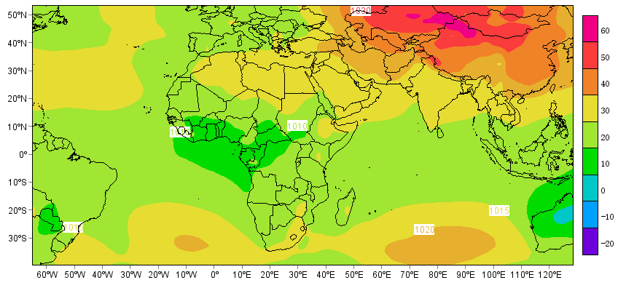
After
Mean sea level pressure contour and shaded 2024 02 01 03:00

Slide 35
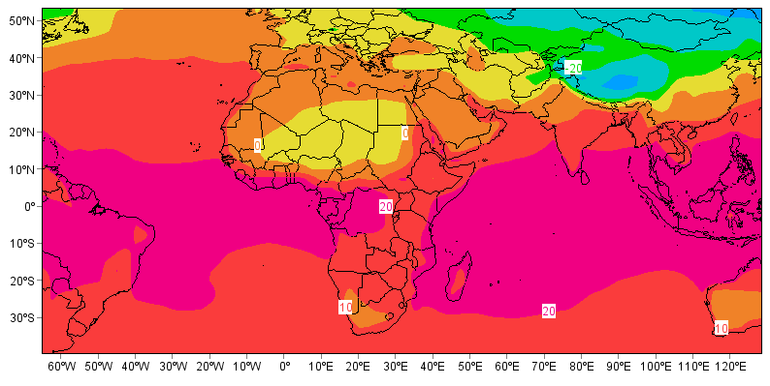
After
2 meters height dew-point temperature 2024 02 01 03:00

Slide 36
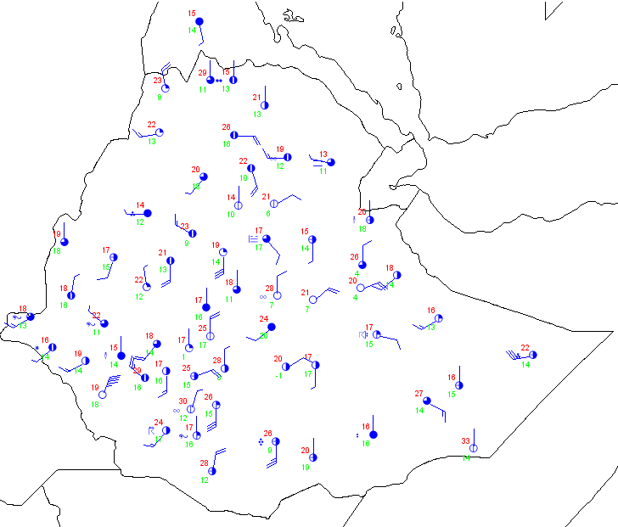
Plotted stations level data of Ethiopia using plotting software
Date of observation 2024 02 10 03:00

Slide 37
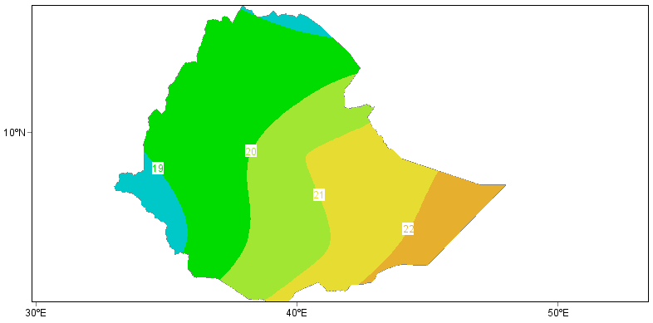
Contoured and shaded air temperature data of Ethiopia using plotting software
2024 02 10 03:00

Slide 38
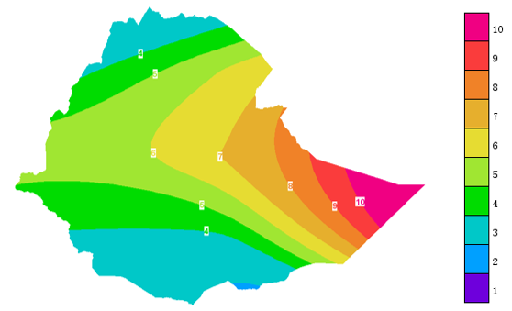
Wind speed spatial distribution of Ethiopia
date of observation 2024 02 13 03:00

Slide 39
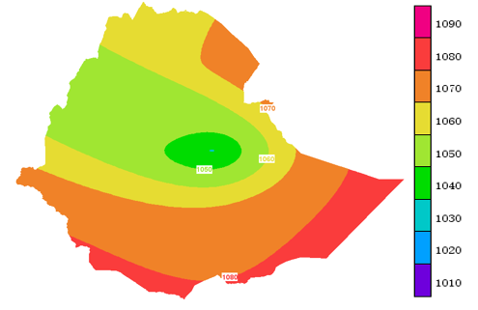
Mean sea level pressure spatial distribution of Ethiopia
date of observation 2024 02 18 03:00

Slide 40
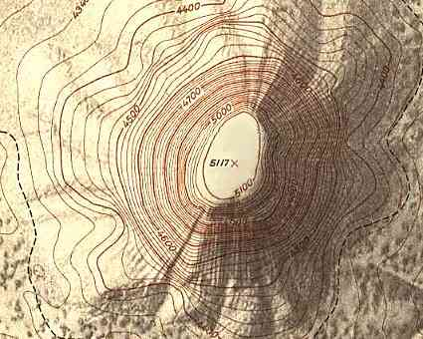
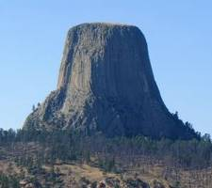
How to Think about Contouring
Like topographic map
Lines of constant height in this picture
Walk along one of these lines -- stay at exactly the same altitude the ENTIRE time

Slide 41
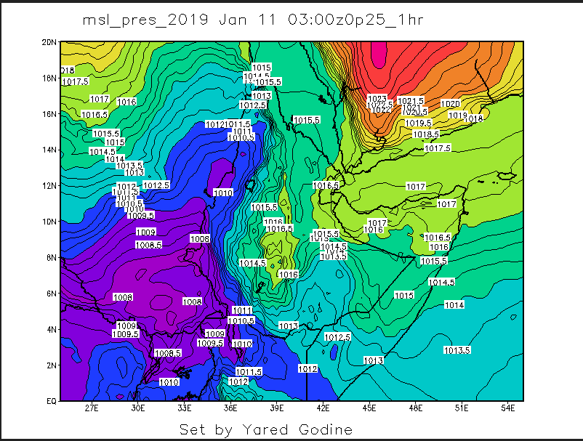
High pressure gradient area (windy)
Low pressure gradient area (calm)

Slide 42
What Else Do We Contour?
Isopleth is a line on a map that connects all the points of a given variable with the same specified value
Isobar - line of constant pressure
Isotherm - line of constant temperature
Isotach - line of constant wind speed
Isodrosotherm - a line of constant dewpoint
Isohyet - a line of constant precipitation accumulation
Isoneph - a line of constant cloudiness
Isohaline - a line of constant salinity (saltiness in the ocean)
Isoheight - a line of constant height

Slide 43
Isobars
The distribution of air pressure is important for determining weather patterns
  Air always tries to move from higher pressure to lower pressure
  The greater the pressure difference between high and low pressure, the greater the force trying to move the air
  Isobars = lines of equal air pressure
    Pressure gradient = change in pressure with distance
    Steep pressure gradients are represented by closely spaced isobars

Slide 44
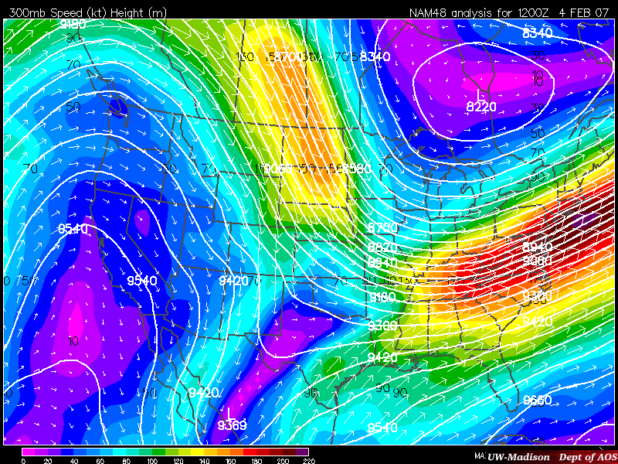
Isotachs (wdsp) and Isoheights

Slide 45
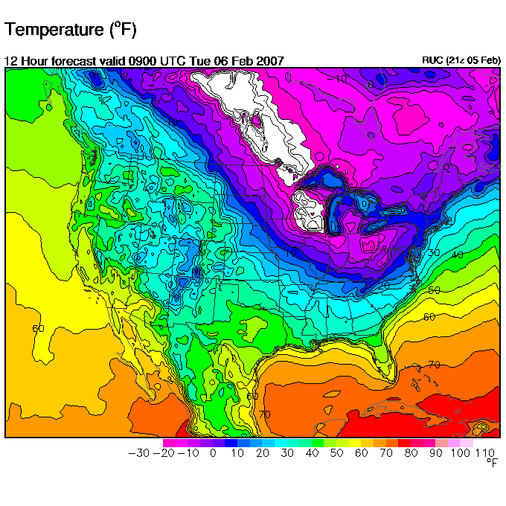
Isotherms

Slide 46
Contouring Rules
Contours never cross each other
A contour line has values higher than the line value on one side and values lower on the other side of it
Isotherm of 10°F has temps below 10°F on one side and temps above 10°F on the other
Contours are only drawn where there is data!
Evenly spaced increments are always used (say every 5 degrees and every 4 mb for pressure)
Easiest to find a high or low value first and work from there

Slide 47


Examples
Temperature observations
Where do we draw the 15°F isotherm????
Temperature observations
Where should we draw the 75ºF and 80ºF isotherms?

Slide 48

Answer

Slide 49
Weather systems
Cyclones, Anticyclones, Troughs, and Ridges
  High pressure areas (anticyclones)
    Clockwise motion in northern hemisphere
    Descending air
    Clear skies
  Low pressure areas (cyclones)
    Counterclockwise motion in northern hemisphere
    Ascending air
    Clouds
  Upper atmosphere
    Ridges = surface anticyclones
    Troughs = surface cyclones

Slide 50

High Pressure System
Northern and Southern Hemisphere anticyclonic air patterns
The wind rotates clockwise around anticyclones in the NH as Coriolis deflects the air to the right and the PGF directs it outward.
Because the air in the boundary layer is diverging in anticyclones, this surface air is being constantly replaced by air from above it → sinking air.

Slide 51

Low Pressure System
Northern and Southern Hemisphere cyclonic air patterns
The wind rotates anticlockwise (counterclockwise) around cyclones in the NH as Coriolis deflects the air to the right and the PGF directs it inward.
Because the air in the boundary layer is converging in cyclones, this surface air is being forced upwards → rising air.

Slide 52

Ridges and troughs in the northern hemisphere
Many pressure systems occur not as closed cells, but as elongated “waves” called troughs (low pressure) and ridges (high pressure).

Slide 53

Maps depicting troughs, ridges, cyclones, and anticyclones

Slide 54

Winds in the upper atmosphere…
Troughs:-
Winds turn anticlockwise around troughs in the NH
Winds follow isobars (gradient balance)
Ridges:-
- Winds turn clockwise around ridges in the NH
- Winds follow isobars (gradient balance)

Slide 55

weather front identification example
A cold front indicates the boundary between relatively warmer and colder air masses, where the colder air is advancing.
A warm front indicates the boundary between a warm and a cooler air mass, where the warm air is advancing.
The front itself is not a precise boundary, but rather a transition zone. This zone is called a frontal zone.
A frontal zone is defined by a relatively strong horizontal temperature gradient.
An idealized cold front.
The dashed lines are isotherms. The grey arrow indicates the direction of the front's movement. The frontal zone is the region between the cold front (line with black triangles) and the grey line. Note the relatively strong temperature gradient within the frontal zone. (Credit: Stull)

Slide 56

An idealized warm front.
As for the cold front, the dashed lines are isotherms, and the grey arrow indicates the direction of the front's movement. The frontal zone is the region between the warm front (line with black semicircles) and the grey line. Note the relatively strong temperature gradient within the frontal zone. (Credit: Stull)

Slide 57




Weather map analysis to identify the front boundary
Step 1
a) temperature field, with temperature in (°C)
Step 2
b) isotherm analysis
Step 3
c) frontal zone analysis
Step 4
d) frontal symbols added

