Slide 1
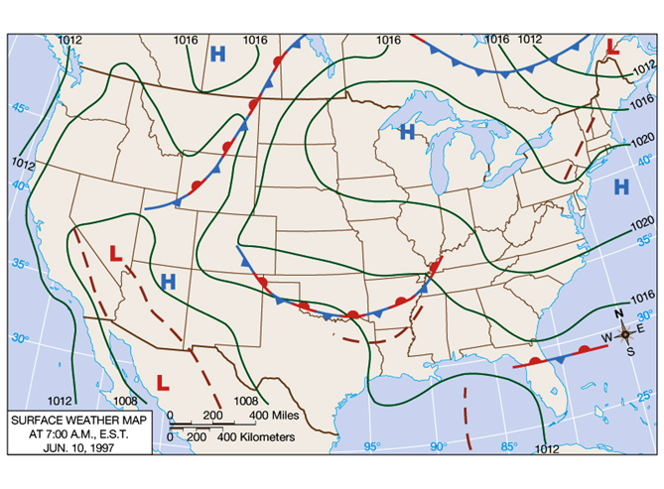
Weather Analysis and Forecasting
MH-4091
G4MHS

Slide 2
Outline
1.1 Subjective, statistical and numerical weather prediction
1.2 Problem and progress of weather forecasting
1.3 Types of forecasts - time scale, content, performance and data observations techniques.

Slide 3
What steps are being taken to improve the forecasting art?
How are forecasts made?
What are major steps in the forecast process?
What are variety of products that created at NWS?
  What are the problem and progress of weather forecasting?
These are just a few of the questions we will address in this chapter.

Slide 4
Major Steps in the Forecast Process
Data Collection
Quality Control
Data Assimilation/ Objective Analysis
Model Integration/ Numerical Weather prediction
Post-Processing of Model Forecasts
Human Interpretation (sometimes)
Product and graphics generation

Slide 5
Data Collection
Weather is observed throughout the world and the data is distributed in real time.
Many types of data and networks, including:
  Surface observations from many sources
  Radio sondes and radar profilers
  Fixed and drifting buoys
  Ship observations
  Aircraft observations
  Satellite soundings
  Cloud and water vapor track winds
  Radar and satellite imagery

Slide 6
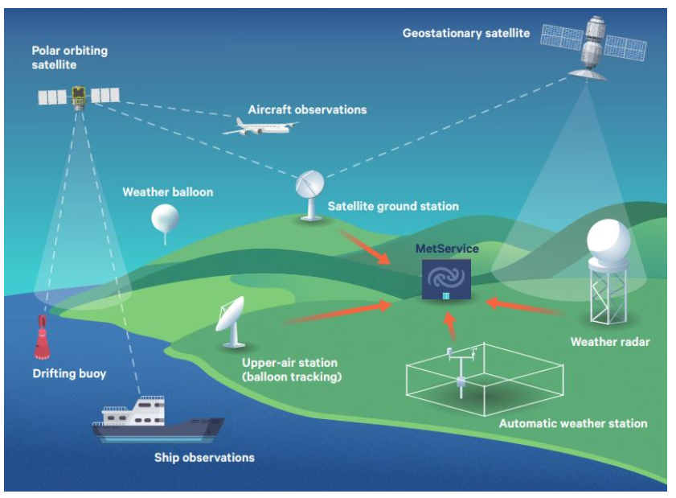
Fig. 1. Global Weather Observation System

Slide 7
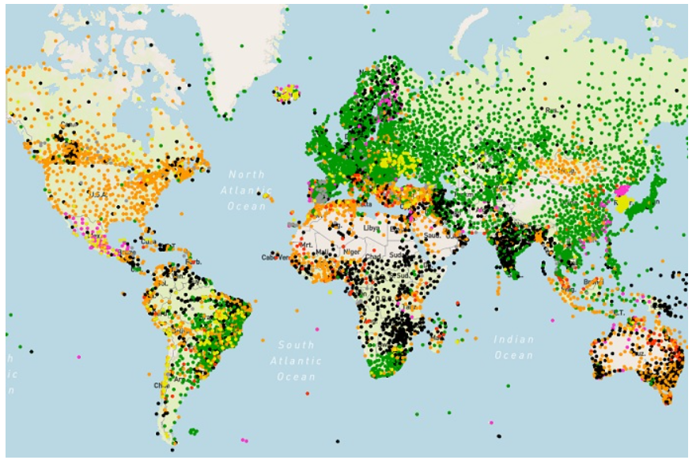
Fig. 2. Six-hour WDQMS land-surface observation availability map on 8 March 2020 (green means fully reporting).

Slide 8
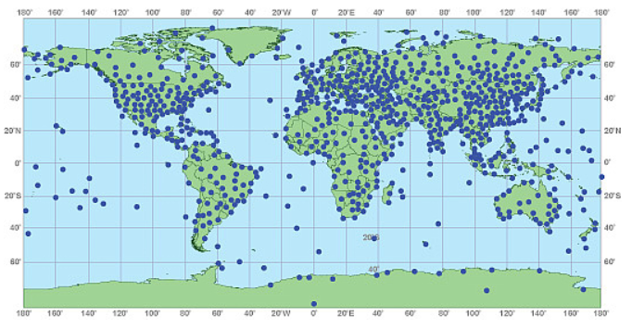
Fig. 3. Map of locations of radiosonde observations worldwide
(Source:- National Oceanic and Atmospheric Administration NOAA)

Slide 9
Cont. . .
Satellite data is now the dominant data source (perhaps 90%).
Huge increases in the numbers of surface stations and aircraft reports.

Slide 10

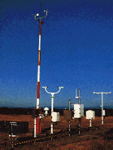
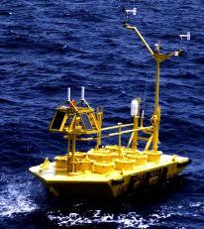

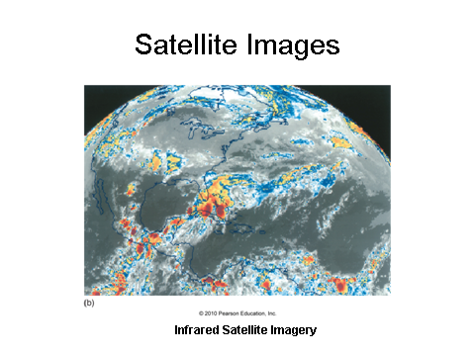
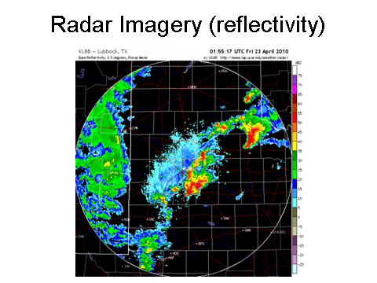
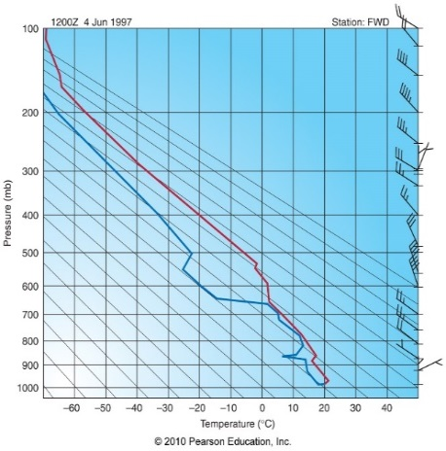
Observation and Data Collection

Slide 11
National Weather Service
The National Weather Service (NWS) is responsible for forecasts several times daily
    Different weather forecast offices (WFOs) are responsible for their specific region
    WFOs are also responsible for warnings in their specific region

Slide 12
Cont. . .
A variety of products are created at NWS WFOs
    Short-term forecasts
    7-day zone forecasts
    Aviation forecasts
    Marine forecasts
    Forecast discussions

Slide 13
  Weather forecasting techniques
Numerical weather forecasting
Climatological forecasts
    Persistence forecasts
    Analog approach

Slide 14
Numerical Weather Prediction
Numerical weather prediction is the technique used to forecast weather using mathematical models designed to represent atmospheric processes.
Numerical weather prediction relies on the fact that the behavior of atmospheric gases is governed by a set of physical principles or laws that can be expressed as mathematical equations.

Slide 15
Numerical Weather Forecasting(NWF)
The computer not only plots and analyzes data, it also predicts the weather.
NWF involves using mathematical equations which describe the processes occurring in the atmosphere that causes changes to weather elements; such as,
  Temperature, pressure, wind speed, wind direction, moisture content, etc., those elements used to describe the state of the atmosphere (picture).

Slide 16
Cont. . .
Numerical weather forecasting begins by entering current atmospheric variables (temperature, wind speed, humidity, and pressure) into a computer simulation.
This set of values represents the atmosphere at the start of the forecast.
After literally billions of calculations, a forecast of how these basic elements are expected to change over a short time frame (perhaps only 5 to 10 minutes) is generated.

Slide 17
Cont. . .
When the new values have been calculated, the process begins again with the next 5 to 10 minute forecast being established. By repeating this procedure many times over, a forecast for six or more days is created.
Using mathematical models, the NWS produces a variety of generalized forecast charts.
Because these machine-generated maps predict atmospheric conditions at some future time, they are called prognostic charts, or simply progs.

Slide 18
Cont. . .
Most numerical models are designed to generate prognostic charts that predict changes in the flow pattern aloft.
Numerical weather models operate in 3 main phases
    Analysis
    Prediction
    Post-processing

Slide 19
Ensemble Forecasting
Ensemble forecasting method involves producing a number of forecasts using the same computer model but slightly altering the initial conditions, while remaining within an error range of the observational instruments.
Essentially, ensemble forecasting attempts to assess how the certain errors and omissions in weather measurements might affect the result.
One of the most important outcomes of ensemble forecasts is the information they provide about forecast uncertainty.

Slide 20
statistical forecasts
Statistical forecasts are made routinely of weather elements based on the past performance of computer models known as Model Output Statistics, or MOS.
These predictions, in effect, are statistically weighted analogue forecast corrections incorporated into the computer model output.
For example, a forecast of tomorrow’s maximum temperature for a city might be derived from a statistical equation that uses a numerical model’s forecast of relative humidity, cloud cover, wind direction, and air temperature.

Slide 21
Cont. . .
When the Weather Service issues a forecast calling for rain, it is usually followed by a probability. For example: “The chance of rain is 60 percent.”
The expression means that there is a 60 percent chance that any random place in the forecast area.
the forecast in another way, if the forecast for 10 days calls for a 60 percent chance of rain, it should rain where you live on 6 of those days.

Slide 22
Cont. . .
The verification of the forecast (as to whether it actually rained or not) is usually made at the Weather Service office, but remember that the computer models forecast for a given region, not for an individual location.

Slide 23
NWF-Analysis Phase
Create or update a computer code of a numerical model of the atmosphere
  Numerical model: - mathematical model of atmospheric circulation and moisture; includes equations of motion, continuity, energy, etc.
A gridded, 3-dimensional analysis is produced with
  A previous forecast
  Observations
The process by which the above are combined is called data assimilation

Slide 24
Data Assimilation
Gridded atmospheric analyses are produced by combining the following:
  A previous forecast
  Forecast uncertainty
  Observations
  Observation uncertainty

Slide 25
NWF- Prediction Phase
Start by inputting current and recent atmospheric conditions into the model/computer program
Solve equations to obtain prediction of future atmospheric conditions
Output maps and other prediction products
After some time elapses (hours or days), repeat the process with the latest current data

Slide 26
Cont. . .
The prediction phase of NWP involves calculating the future state of the atmosphere (starting point = the analysis) under the following governing equations:
  Conservation of momentum
  Conservation of mass
  Conservation of energy
NWF takes massive amounts of computing power!!!

Slide 27
Cont. . .
NWF can be classified in two ways:
    Deterministic – a single forecast is produced
    Probabilistic – many forecasts are produced and forecast probabilities can be generated (ensemble forecasting)

Slide 28
Prediction Phase – How Can Forecasts Go Bad?
There are two main sources of error in NWP forecasts:
    Initial condition error – errors in the analysis of a NWP model
    Physics errors – physics that are wrong in the NWP model (mostly associated with surface processes)

Slide 29
Physics Errors
  The physics in NWP models aren’t perfect in
    Surface radiation processes
    Frictional turbulence of surface winds
    Convection
    Cloud processes
  Physics errors frequently lead to model biases
    Consistent errors in certain model variables (e.g. surface temperature)

Slide 30
NWF – Post-processing Phase
The systematic biases of numerical model output are corrected by post processing of model forecasts.
The post-processing phase of NWF involves creating graphics of the forecast:
1) 500-mb height
2) Sea level pressure
3) Surface wind
4) 3-hr precipitation
5) 1000-500mb thickness

Slide 31
Cont. . .
The final forecast product includes the human factor
  judgments based on both a forecaster’s experience and NWP
Model Output Statistics (MOS) is an objective weather forecasting technique which consists of determining a statistical relationship between the element being forecast and values calculated by a numerical model
MOS produces a forecast incorporating these statistical relationships

Slide 32
1.2 Problem and progress of weather forecasting
Why do forecasts sometimes go wrong?
There are a number of reasons for this unfortunate situation. For one, computer models have inherent flaws that limit the accuracy of weather forecasts.
For example, computer forecast models idealize the real atmosphere, meaning that each model makes certain assumptions about the atmosphere.
These assumptions may be on target for some weather situations and be way off for others.

Slide 33
Cont. . .
Another forecasting problem arises because the majority of models are not global in their coverage, and errors are able to creep in along the model’s boundaries.
For example, a model that predicts the weather for North America may not accurately treat weather systems that move in along its boundary from the western Pacific.
Even though many thousands of weather observations are taken worldwide each day, there are still regions where observations are sparse, particularly over the oceans and at higher latitudes.

Slide 34
Cont. . .
To help alleviate this problem, the newest GOES satellite, with advanced atmospheric sounders, is providing a more accurate profile of temperature and humidity for the computer models.
Wind information now comes from a variety of sources, such as Doppler radar, commercial aircraft, and satellites that translate ocean surface roughness into surface wind speed
Earlier, we saw that the computer solves the equations that represent the atmosphere at many locations called grid points, each spaced from 100 km to as low as 0.5 km apart.

Slide 35
Cont. . .
As a consequence, on computer models with large spacing between grid points (say 60 km), weather systems, such as extensive mid-latitude cyclones and anticyclones, show up on computer progs, whereas much smaller systems, such as thunderstorms, do not.
In summer, when much of the precipitation falls as local showers, a computer prog may have indicated fair weather, while outside it is pouring rain.

Slide 36
Cont. . .
To capture the smaller-scale weather features as well as the terrain of the region, the distance between grid points on some models is being reduced. For example, the forecast model known as MM5 has a grid spacing as low as 0.5 km.
This model predicts mesoscale atmospheric conditions over a limited region, such as a coastal area where terrain might greatly impact the local weather.
The problem with models that have a small grid spacing (high resolution) is that, as the horizontal spacing between grid points decreases, the number of computations increases.

Slide 37
1.3 Types of forecasts - time scale, content, performance and data observations techniques.
Climatological Forecast
A forecast that is based on "climatology" or average weather
Example: -
  Lets say the climatological records show that it rains only 1 day out of 100 during the summer months.
  Then, if you forecast "no rain" for any day in July and August, the probability you will be wrong is 1/100.
  Therefore, the probability you will be right is about 99%

Slide 38
Cont. . .
NOTE: precipitation forecasts are usually given as probabilities
ex: "there is a 60% chance of rain today"
  This means that there is a 60% chance of measurable precipitation at any random place in the forecast area

Slide 39
Persistence forecasting
A prediction that the weather in the future will be the same as it currently;
  that there will be no change to the weather conditions
Good only for short periods of a few hours and become less accurate as the time period lengthens
A forecast identical to the previous day’s conditions

Slide 40
Cont. . .
Example:-
If it is raining now, a forecast that it is going to rain for another three hours would be a persistence forecast.
In the tropics, especially at island stations, where day after day the weather is basically the same because the station is affected by the same air mass with no passages of fronts, a persistence forecast that tomorrow is going to be the same as today is usually quite accurate.

Slide 41
      Analog approach
A slightly more complicated method of producing a forecast
This technique utilizes the fact that existing weather patterns on weather charts which resemble previous weather patterns on previous weather charts should produce the same type of weather elements, or phenomena, that the previous patterns produced
  These previous patterns can then be used as a guide for making forecasts of weather elements

Slide 42
Cont..
For example : -
suppose today is very warm, but a cold front is approaching your area. You remember similar weather conditions one last week, also a warm day with cold front approaching. You also remember how heavy thunderstorms developed in the afternoon as the cold front pushed through the area.
  Therefore, using the analog method, you would predict that this cold front will also produce thunderstorms in the afternoon.

Slide 43
Cont. . .
This method is difficult to use because it is virtually impossible to find a perfect analog.
Various weather features rarely align themselves in the same locations they were in the previous time.
Even small differences between the current time and the analog can lead to very different results

Slide 44
  Why Forecasts go awry and steps to improve them
Model limitations:
  Models represent a "simplified" atmosphere
  not every real process in atmosphere can be resolved in the models
  The model equations compute quantities at grid points. Currently, grid spacing ranges from 30-50 km apart. Any phenomena smaller in size that grid spacing will not be resolved in models (e.g., thunderstorm)
  models can not resolve boundary layer very well.
Boundary condition errors
  Many are not global in coverage
1.2 Problem and progress of weather forecasting

Slide 45
Cont. . .
Initial condition errors
  Initial atmospheric state is not well-known - want a dense, global network of observations
  Have many data - analyze regions, particularly over the oceans.
  The data may also have errors in it.
Local impacts-not represent in model
  small-scale terrain features will not be handled properly

Slide 46
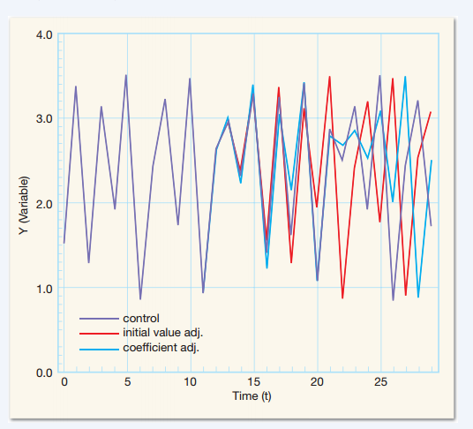
Cont. . .
Tiny errors may not significantly influence the early stages of a prediction, but with time, such errors amplify dramatically.

Slide 47
Cont. . .
The chaotic nature of atmosphere
  small differences in the model initial conditions can produce radically different results later in time
Each model can produce different predictions.... which do you believe?
Solution: -
  Improve models and observations
  Ensemble forecasting

Slide 48
Types of Forecasts
Forecasting : -
A process of estimating a future event by casting forward past data.
  The past data are systematically combined in a predetermined way to obtain the estimate of the future.

Slide 49
Cont. . .
A very short-range forecast (now cast): up to few hours(usually not more than 6 hours)
  The techniques used in making such a forecast normally involve subjective interpretations of
    Surface observations, satellite imagery and Doppler radar information
  With human experience and pattern recognition.

Slide 50
Cont. . .
A short-range forecast: six hours to a few days(generally 2.5 days or 60 hours
  The forecaster may incorporate a variety of techniques in making a short-range forecast, such as
    Satellite imagery, Doppler radar, surface weather maps, upper-air winds and pattern recognition.
  The forecaster tends to weight the forecast heavily on computer-drawn progs and statistical information, such as Model Output Statistics (MOS)

Slide 51
Cont. . .
A medium-range forecast: from 3 to 8.5 days (200 hours) into the future.
  Based on computer derived products, such as
    forecast progs and statistical forecasts (MOS).
  A forecast that extends beyond 3 days is often called an extended forecast.
A long-range forecast: beyond about 8.5 days.
  based computer progs are available for up to 16 days into the future.

Slide 52
Forecast Verification
What is verification?
Verification is the process of comparing forecasts to relevant observations
  Verification is one aspect of measuring forecast goodness
Verification measures the quality of forecasts
For many purposes a more appropriate term is “evaluation”

Slide 53
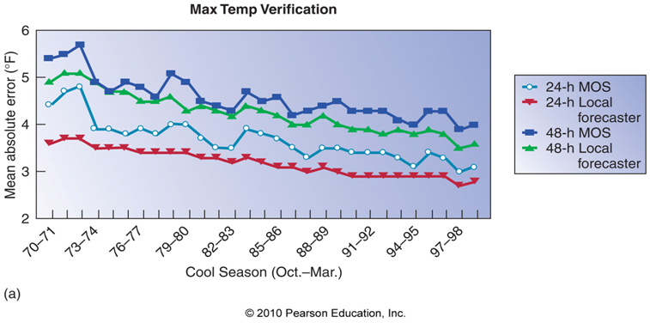
Cont. . .
Forecast verification is the process of measuring the skill of a forecast (model, human forecaster, MOS…)

Slide 54
Evaluating forecast accuracy
It is important to evaluate forecast accuracy using genuine forecasts.
The accuracy of forecasts can only be determined by considering how well a model performs on new data that were not used when fitting the model.
When choosing models, it is common to use a portion of the available data for testing, and use the rest of the data for fitting the model.

Slide 55
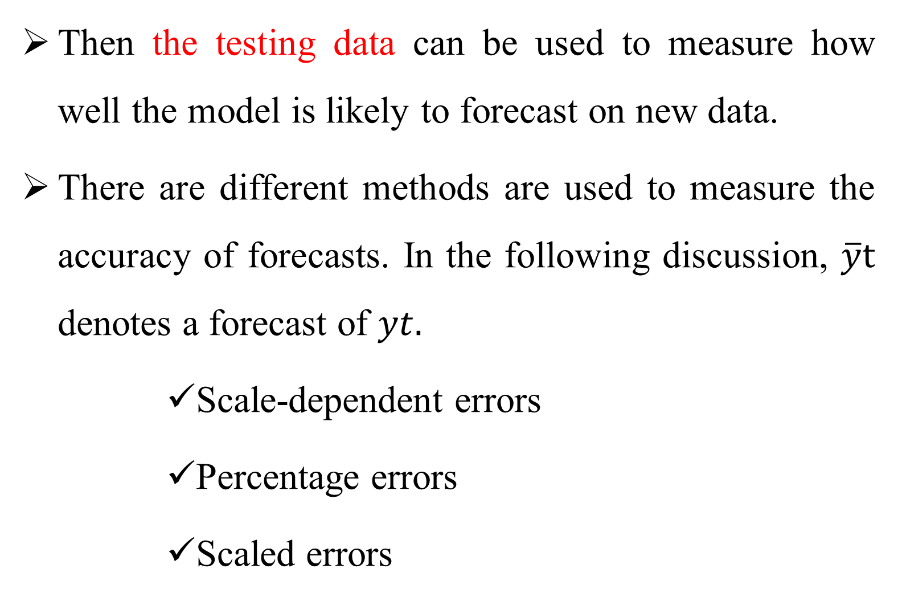
Cont. . .
Then the testing data can be used to measure how well the model is likely to forecast on new data.
There are different methods are used to measure the accuracy of forecasts. In the following discussion, $\overline{y}t$ denotes a forecast of $yt.$
      Scale-dependent errors
      Percentage errors
      Scaled errors

Slide 56
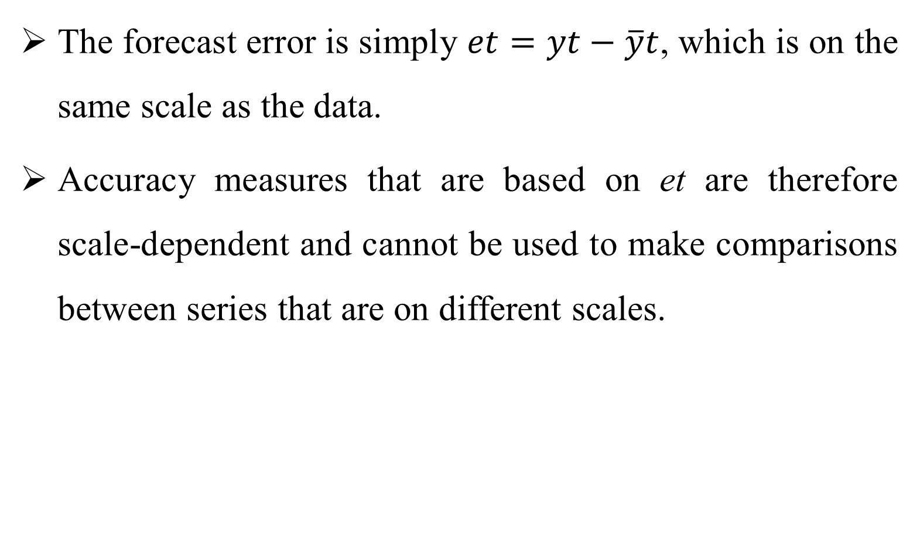
Scale-dependent errors
The forecast error is simply $et=yt−\overline{y}t$, which is on the same scale as the data.
Accuracy measures that are based on et are therefore scale-dependent and cannot be used to make comparisons between series that are on different scales.

Slide 57
Cont. . .
The two most commonly used scale-dependent measures are based on the absolute errors or squared errors:
    Mean absolute error (MAE) = mean(|et|)
    Mean squared error (MSE) = mean(et ²)
When comparing forecast methods on a single series, the MAE is popular as it is easy to understand and compute.

Slide 58
Percentage errors (pt)
The percentage error (pt) is given by pt = 100et/yt.
pt have the advantage of being scale-independent, and so are frequently used to compare forecast performance between different data sets. The most commonly used measure is:
    Mean absolute percentage error (MAPE) = mean(|pt|)

Slide 59
Cont. . .
Measures based on pt have the disadvantage of being infinite or undefined if yt = 0 for any t in the period of interest, and having an extremely skewed distribution when any yt is close to zero.
They also have the disadvantage that they put a heavier penalty on positive errors than on negative errors. This observation led to the use of the so-called “symmetric” MAPE proposed by Armstrong. It is defined by
    Symmetric mean absolute percentage error (sMAPE) = mean(200 |yt − yˆt|/(yt + yˆt)) .

Slide 60
Cont. . .
However, if yt is zero, yˆt is also likely to be close to zero. Thus, the measure still involves division by a number close to zero.
Also, the value of sMAPE can be negative, so it is not really a measure of “absolute percentage errors” at all. Hyndman & Koehler (2006) recommend that the sMAPE not be used.

Slide 61
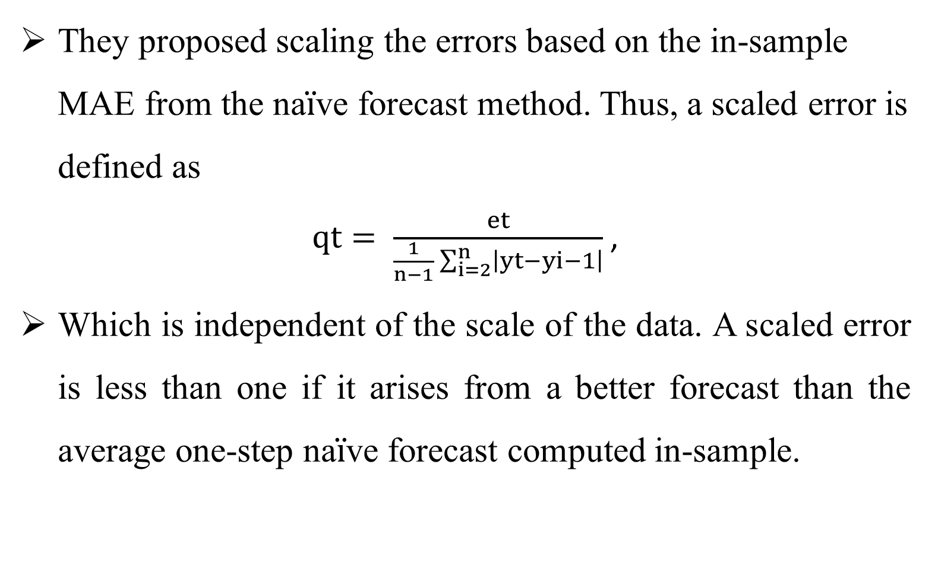
Scaled errors
They proposed scaling the errors based on the in-sample MAE from the na$\ddot{i}$ve forecast method. Thus, a scaled error is defined as
$qt= \frac{et}{\frac{1}{n−1}\sum_{i=2}^{n}{\left|yt−yi−1\right|}}$,
Which is independent of the scale of the data. A scaled error is less than one if it arises from a better forecast than the average one-step na$\ddot{i}$ve forecast computed in-sample.

Slide 62
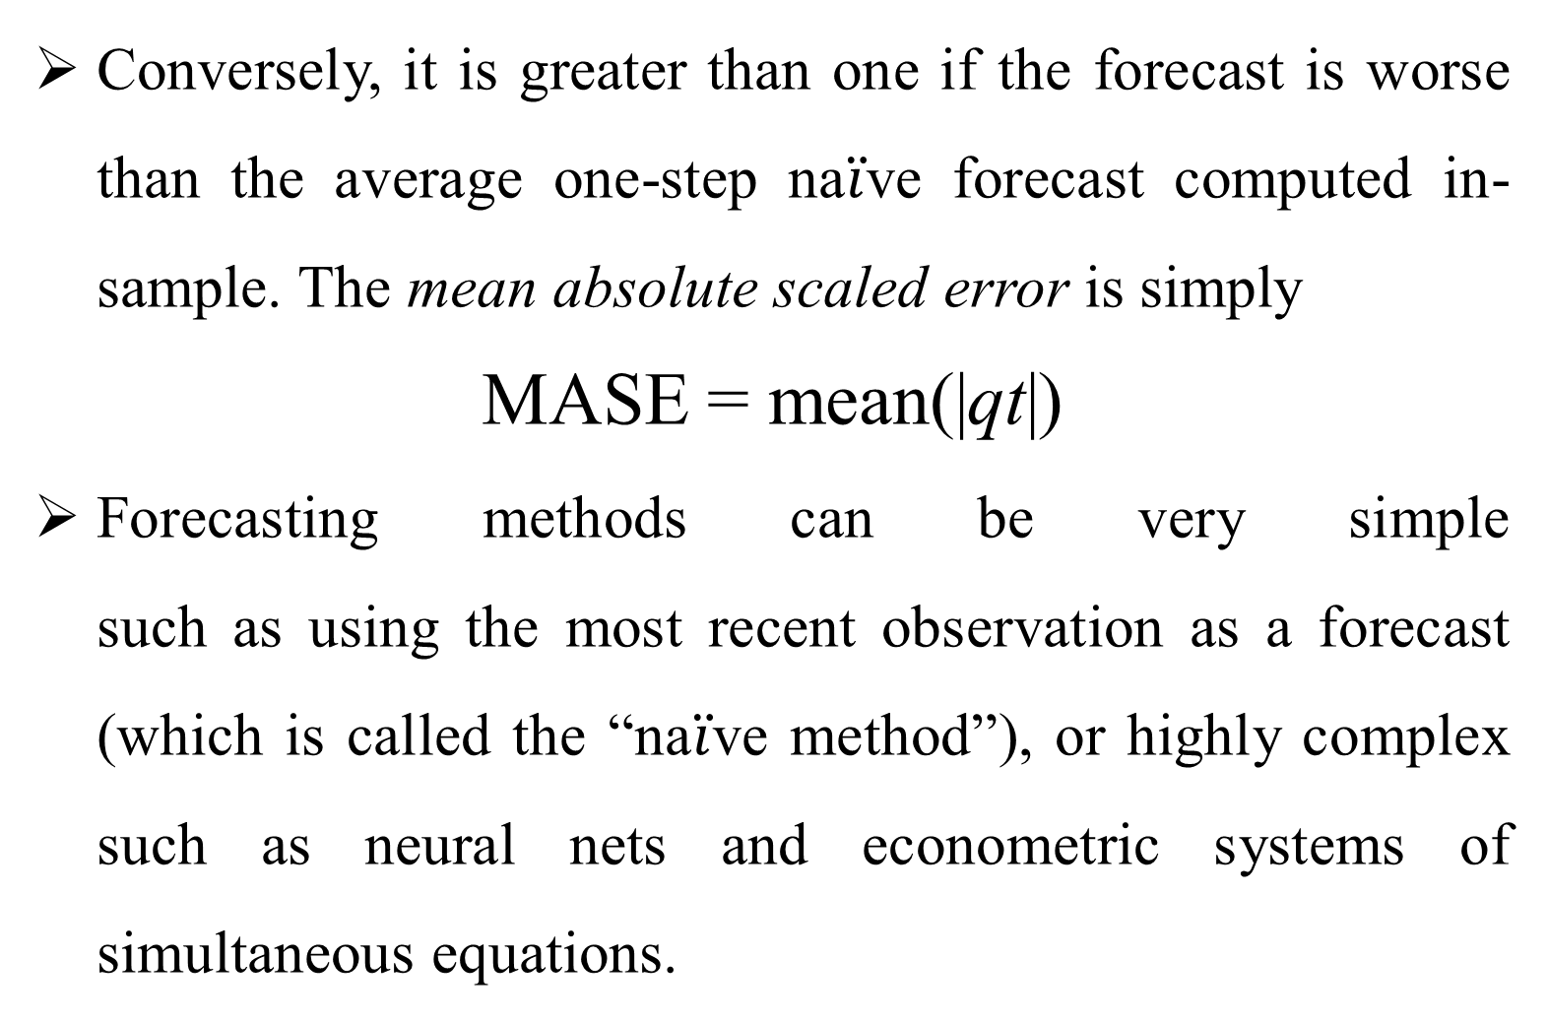
Cont. . .
Conversely, it is greater than one if the forecast is worse than the average one-step na$\ddot{i}$ve forecast computed in-sample. The mean absolute scaled error is simply
MASE = mean(|qt|)
Forecasting methods can be very simple
such as using the most recent observation as a forecast (which is called the “na$\ddot{i}$ve method”), or highly complex such as neural nets and econometric systems of simultaneous equations.

