Slide 1
Teaching English Using ICT Tools
Sawla Secondary & preparatory school

Slide 2
Google Group for e-learning

Slide 3
Introduction
Groups is a free, online service that helps groups of people easily share information and communicate effectively.
Groups are public or private places where members
share files, post ideas, and conduct discussions via email.
All emails sent to the group are archived for future reference and are easily searchable
Google Groups is a mailing list service that is part of the Google Apps suite.

Slide 4
Introduction
Allows users to create and manage groups among other users.
Users can manage and archive their mailing lists, as well as manage group members
Google Groups allows users who are members of a group to effectively collaborate and communicate together

Slide 5
Google Groups
You do not have to have a Google account in order to utilize some of the features
Some of the things you can do without a Google account are:
Read posts in public groups
Join a public group through email
Post to groups via email if they are unrestricted, or if you are a member
Search for groups, posts, authors, etc.

Slide 6
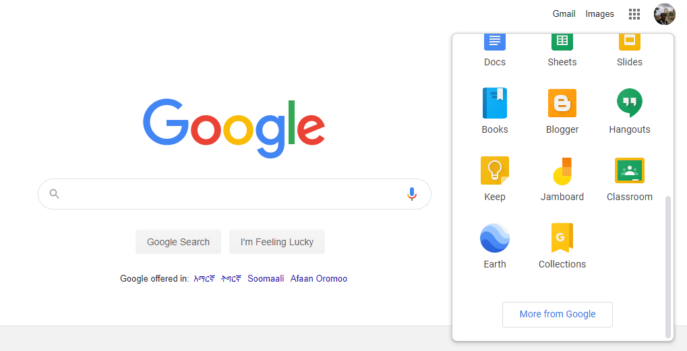
Create Google Group

Slide 7
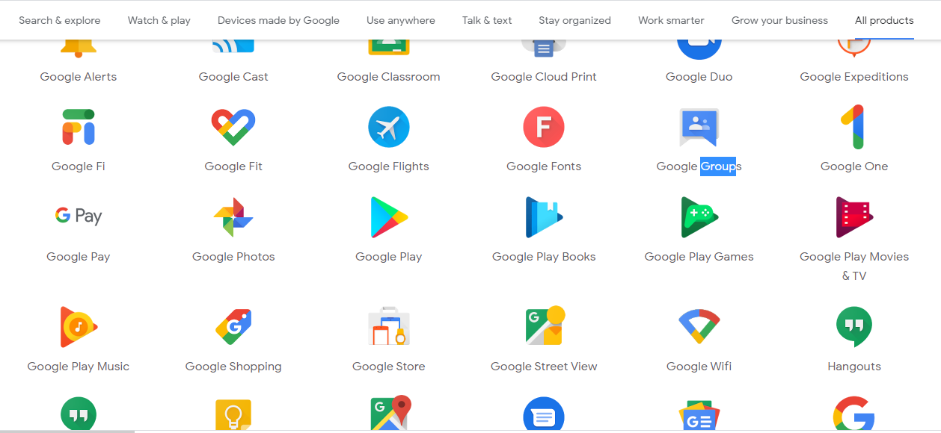
Create Google Group

Slide 8
Create Google Group
Go to
https://groups.google.com/ in computer's web browser.
Sign into your Google Account if necessary

Slide 9
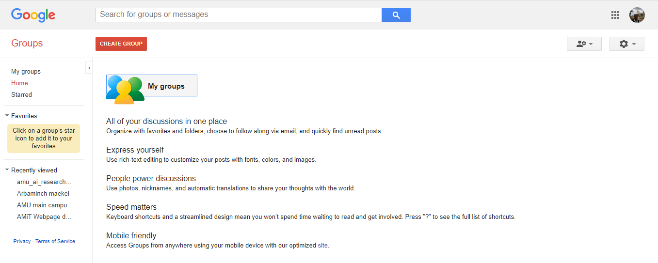
Create Google Group

Slide 10
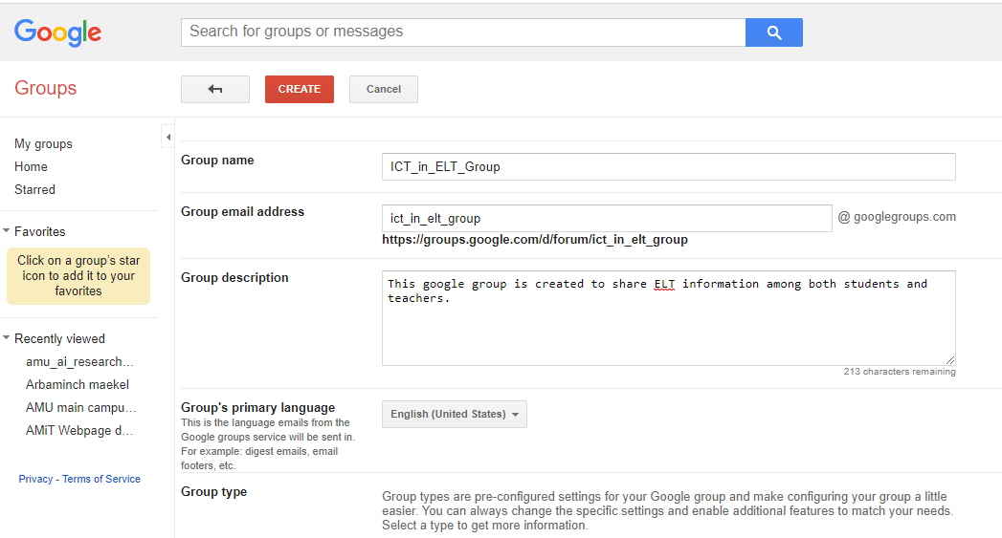
Create Google Group

Slide 11
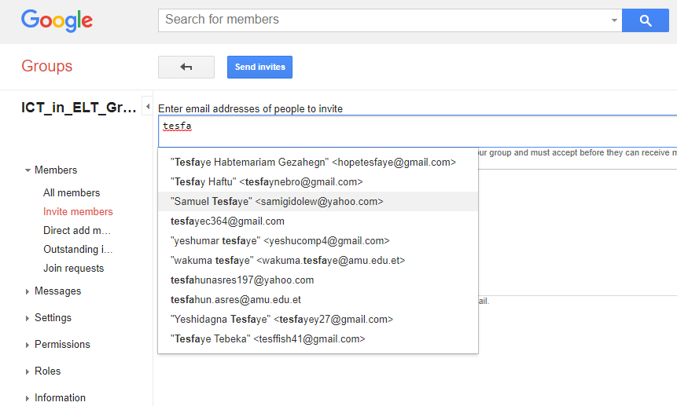
Invite friends

Slide 12
Create Google Group

Slide 13
Any Question
???

