Slide 1
ICT-Assisted English Language Proficiency Training
for Secondary Schools English Language Teachers
Arba Minch Secondary and Community School
May 2021

Slide 2
Introduction
Various language learning activities which can be done both online and using the Module
Materials that can be accessed from various online sources which can provide additional materials in the form of
text, video, and audio just for free
Delivery mode of the Training:
face-to-face, mainly practical, ICT-supported, active, and task-based

Slide 3
Introduction…
What we did thus far
Basic ICT skills
Facebook
Gmail
Google group
Mobile apps, etc.
What do we have for you now?
ICT Assisted English Language Improvement training
ICT Assisted Methodology training
ICT Integration with ELT lessons

Slide 4
Objectives of the Session
At the end of this training you will be able to:
Practice ICT assisted
speaking, listening, reading, writing, grammar and vocabulary by using ICT tools’
Be familiar with various recent ICT tools for finding English Language Learning Resource to improve your English language skills. These include:
Mobile apps
Websites
YouTube
Podcasts
Blogs
SlideShare,
Electronic dictionary
Etc.

Slide 5
If you want to improve your …?
Where to find ELIR?

Slide 6
Improve your Listening skills through ICT tools
Here is a listening text taken from https://learnenglish.britishcouncil.org/
As you listen answer:
Who are the people mentioned in the listening text?
Where they are originally from?
Where is the conversation happening?
What is the gist of the listening text?
What new language you learned of the listening text?
Visit the website find more listening texts and listen/watch and share what you listened to a classmate.

Slide 7
Listening skills…
Visit the website find more listening texts and listen/watch and share what you listened to a classmate. You may choose the upper intermediate
https://learnenglish.britishcouncil.org/skills/listening/upper-intermediate-b2

Slide 8
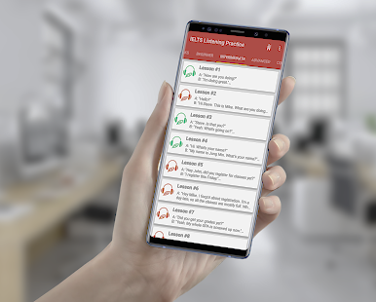
Listening skills…
Go to play store in your mobile, find IELTS listening practice - English listening text
Download the app and listen lesson one of the intermediate
How have you have felt about the text
Do you think this helps you improve your listening
Please, listen for more. You can try the advanced ones.

Slide 9
Listening skills…
Listen to the podcast in the link and https://podcasts.google.com
Talk about the one that interested you much to your classmate
What do you think are podcasts.

Slide 10
Reflection
We tried to find listening tasks from
A website
A mobile app
A podcast
Do you think you can find similar others by your own. Try for some now.
Use search terms. E.g. a podcast on listening

Slide 11
Improve your reading skills through ICT tools
Here is a reading text taken from https://learnenglish.britishcouncil.org/skills/reading/intermediate-b1/digital-habits-across-generations
Do the reading tasks as instructed in the worksheet.LearnEnglish-Reading-B1-Digital-habits-across_generations.pdf
How did you find the task?
Do you think you can use it in your own classroom? Why? Why not?

Slide 12
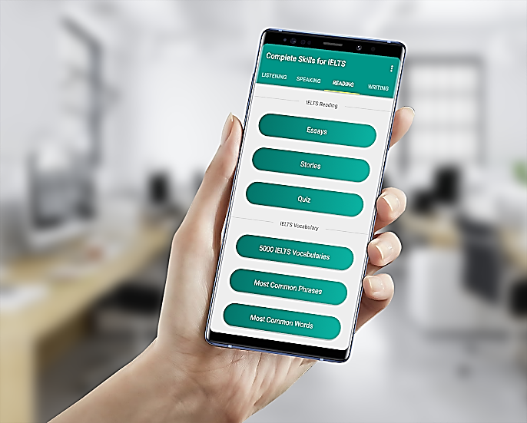
Reading skills…
Go to play store in your mobile, find Complete IELTS
Download the app and select reading
Choose one of reading essays
Tell a classmate about the essay you have read
How have you have felt about the text
Do you think this helps you improve your reading.
Please, read more inyourown time

Slide 13
Reflection
We tried to find reading tasks from
A website
A mobile app
Do you think you can find similar others by your own. Try for some now.

Slide 14
Improving your speaking
Watch a video about English 2 Hours of English Conversation Practice - Improve Speaking Skills
List the strategies they talk about 2 Hours of English Conversation Practice - Improve Speaking Skills.mp4
How did you feel about them? Do you think you can use them for yourself? Why? Why not?
In what ways the above video can improve your speaking skills? (first think individually and share in threes)
Download similar others and take them with you for further practice.

Slide 15
Improving your speaking
Watch the following video
https://www.youtube.com/watch?v=ZmUm29fc6nI
What are the places Allie and Mark have gone to?
List the different conversation context (functions) they have been in
E.g. asking for direction
Shopping
Restaurant
List some of the conversation Language used in the different topics.
You may make a table with the headings context of conversation and expressions used.

Slide 16
Improving your speaking
Language Function /context of speech | Example expressions
e.g. shopping | e.g. what is your size?

Slide 17
Improving your speaking…
Let’s do speaking tasks on persuading someone
LearnEnglish-Speaking-B2-Persuading-someone-to-do-something.pdf
And watch a video from the following link
https://learnenglish.britishcouncil.org/skills/speaking/upper-intermediate-b2/persuading-someone-to-do-something

Slide 18
Reflection
We tried to find speaking tasks from
A website
YouTube
How did you feel about the tasks?
Do you think you can find similar others by your own. Try for some now.
YouTube can be a good source.
Use ss to download.

Slide 19
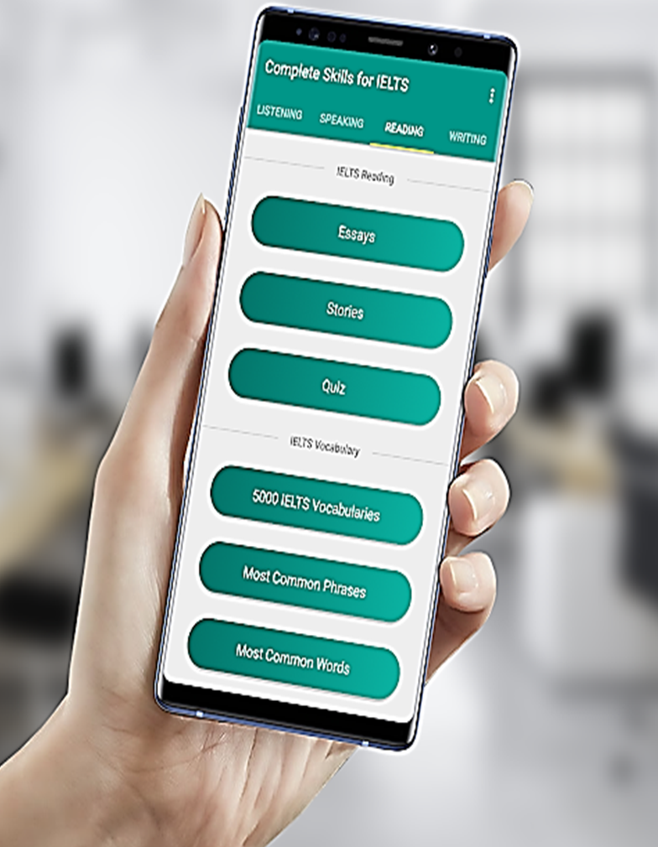
Improving your writing…
Now read the samples in the complete skills for IELTs writing
Compare yours with them
Improve yours based on the samples.

Slide 20
Improving your writing …
Choose one of writing topics below
The 21st century has begun. What changes do think this new century will bring? Use examples and details in your answer.
would you prefer to live in a traditional house or in a modern apartment building? Use specific reasons and details to support your choice.
What are some important qualities of a good supervisor (boss)? Use specific details and examples to explain why these qualities are important.

Slide 21
Using your electronic dictionary
What can you use dictionaries for?
How often do use dictionary in learning?
Find the electronic dictionary on your computer and
List five words you are unsure of their meaning and find this in the dictionary
List five words you are unsure of their pronunciation and check for this in the dictionary.
List five words that you are unsure of their grammatical forms (past, past participle, parts of speech,

Slide 22
Online Task
Go to the BBC Learn English Website with the link:
https://www.bbc.co.uk/learningenglish/english/course/newsreview/unit-13/session-138
Watch the video and complete the activity

Slide 23
Speaking Skills Task
Prepare a Presentation on the prevention methods of Coronavirus to create awareness among your community in a face-to-face setting.
Use the link(https://study.com/academy/exam/topic/developing-presentation-skills.html) to get tips on how to prepare good presentation/

Slide 24
Writing Skills Test
Write a five-paragraph expository essay on the impacts of Coronavirus on the education system of Ethiopia, focusing on secondary school education
Find an appropriate website to guide you the wrioting process.

Slide 25
Reading Task(Homework)
Go to the British Council Website using the link (http://learnenglish.britishcouncil.org/skills/reading/upper-intermediate-b2/work-life-balance ) and find the reading task there and follow the instructions to do the task

Slide 26
Homework
Activity: Grammar Test (Online Task)
Go to a Website using the link: http://learnenglish.britishcouncil.org/grammar/intermediate-to-upper-intermediate/past-perfect
and follow the steps there : Home » Grammar » Intermediate to upper intermediate, to find the exercise.

Slide 27
More Websites & YouTube Channels to improve your English
VOA Learning English YouTube Channel (https://www.youtube.com/user/VOALearningEnglish_)
VOA Learn English Website: https://learningenglish.voanews.com/
British Council Listening Practice – Podcasts and videos for various levels
English Teacher Melanie

Slide 28
Extensive tasks
12 Native English Podcasts for Learning English
1) This American Life. ...
3) Scientific American Podcast: 60-Second Science. ...
4) Freakonomics Radio. ...
5) Here's the Thing. ...
6) NPR. ...
7) Stuff You Should Know. ...
8) The Nerdist. ...
9) Entrepreneur on Fire.

Slide 29
Thank you

