Slide 1
Unit one: Introduction

Slide 2
Module Contents
Unit one: Introduction
Definition of CALL
History of CALL: Behaviouristic, Communicative and Integrative CALL
Why CAL in language learning and teaching?
Strengths and weaknesses of CALL for teaching Language

Slide 3
Definition of CALL
Different definitions exist. Some of these include:
It is an approach to language teaching and learning in which the computer is used as an aid to the presentation, reinforcement and assessment of material to be learned, usually including a substantial interactive element.
It is the search for and study of applications of the computer in language teaching and learning.

Slide 4
Definition of CALL…
CALL can be as simple as the application of word-processors (word), PowerPoint, and spreadsheet (Excel) that can be used to support language learning or as complex as the use of Web-based multimedia learning programs such as Moodle, online concordances, blog, wiki, etc.
CALL also implies applications specifically designed to develop and facilitate language learning, such as web-based interactive language learning exercises.
CALL today can also be seen from different perspectives.
These are in terms of:
the mode of delivery, it can be either web-based or static tools (CD-ROM) based,
in terms of the mix it can be purely online or a mix of online and face to face (Blended Learning),
integration of media it can be drill based or can integrate multimedia packages, CDROMs and Internet and
tools for accessing lessons, it can be mobile (Cell phone or tablets) assisted or computer (Laptops or desktops) assisted.

Slide 5
Definition of CALL…
There are a number of common terms associated to computer assisted language learning today.
To mention some:
‘CELL’ (Computer-Enhanced Language Learning),
CALI (Computer Assisted Language Instruction),
‘CBLT’ (Computer-Based Language Teaching),
‘CMC’ (Computer-Mediated Communication),
‘TELL’ (Technology-Enhanced Language Learning),
Network-Based Language Teaching (NBLT),
‘WELL’ (Web-Enhanced Language Learning) and
Information and Communication Technologies for language learning (ICT4LT) , are listed under the banner of CALL (Lamy and Hampel, 2007).

Slide 6
A brief history of CALL
The acronym CALL (Computer Assisted Language Learning) appears to have been coined at the beginning of the 1980s.
In the USA the acronym CALI (Computer Assisted Language Instruction) was initially preferred,
TESOL favoured CALL.
The term CALI then appears to have fallen out of favour because of its association with programmed learning, i.e. a teacher-centred rather than a learner-centred approach that drew heavily on behaviourism, and CALL is now the dominant term.
An alternative term to CALL emerged in the 1980s, namely Technology Enhanced Language Learning (TELL), which was felt to provide a more accurate description of the activities which fall broadly within the range of CALL.

Slide 7
A brief history of CALL…
Teshome and Islam (2002), Lamy and Hampel (2007) and Evans (2009) review that historically computer assisted language learning (CALL) has three pedagogical features.
The first is ‘Behaviouristic CALL’. Before the 1980s the computer is used as a provider of drills to a learner who (usually) responds on an individual basis. The skills most solicited are reading and writing.
The second feature is ‘Communicative CALL’. There is a move through the 1980s towards communicative CALL. In parallel with the spread of interest in communicative teaching, CALL is able to use the technology for more interactive learning and greater student choice and control. The targeted skills now included speaking and listening.
The third is ‘Integrative CALL’. The period from 1990s through to the beginning of the twenty-first century is a phase of integrative CALL. During this period a variety of media (text, hypertext, graphics, sound, animation, and video) and the written, visual or spoken productions of human beings have been made accessed in an integrated fashion from a multimedia networked computer.

Slide 8
Why CALL…
Some specific reasons presented below can be attributed to why we opt for CALL in the learning-teaching of language in particular.
It increases access to authentic texts (Mitchell, 2009 and Eastment, 1999). These are texts which are meant for native speakers,
helps the learners to have more control over the language learning process which allows them to do language learning in their own time and interest (Sagarra and Zapata 2008),
enables them interact and receive feedback not only from their teachers but also other learners (Comas-Quinn,2011),
provides learners with invaluable opportunities to practice the language in and outside the classroom (Comas-Quinn,2011),
provides opportunities for linguistic input for the learner. These are texts to read or videos to watch and listen to. (Chapelle, 2008) and (Hubackova, et al, 2011), and
helps teachers to provide students with a great amount of resources that usually they cannot show in the classroom due to the lack of time (Martín-Blas and Serrano-Fernández 2009).

Slide 9
Why CALL…
Computer as a tutor for language drills or practices (reading, speaking, etc)
Computer as a tool for language learning (writing, presenting, listening and researching, etc)
Computer as a medium for communication (synchronous & asynchronous)

Slide 10
Why CAL?...(General)
Technology is changing today’s classroom
We educate learners for global competition
Online learning is expanding
It makes education more efficient
Students want it
Addresses shortages of:
Experienced teachers
Quality materials
Physical facilities

Slide 11
Strength of CALL
Here are some of the benefits of ICT that have been identified by teachers:
ICT is motivating both for students and for teachers. It makes the learning process more enjoyable.
ICT offers a wide range of multimedia resources enabling text, still images, audio and video to be combined in interesting and stimulating ways for presentation purposes in the classroom, using a data projector and an interactive whiteboard.
ICT offers opportunities for intensive one-to-one learning in a multimedia computer lab.
ICT offers access to a rich resource of authentic materials on the Internet.
ICT offers access to a wide range of authentic materials on CD-ROM and DVD.
ICT makes worldwide communication possible via email and via audio- and videoconferencing with native speakers.
ICT can open up a new range of self-access and distance learning opportunities, thereby making access to learning more widely available to students who have to study outside normal hours, who live in remote areas, or who have special needs.

Slide 12
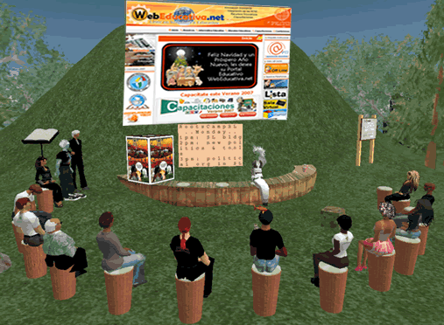
Weaknesses of CALL

Slide 13
Weaknesses OF CALL
Although there are many advantages of computer, the application of current computer technology still has its limitations and disadvantages.
Less-handy equipment. The CAL program is different from traditional books that can be carried around and studied wherever and whenever they wish: on a train, at home, in the middle of the night, and so on. School computers or language laboratory can only be accessed in restricted hours, so CALL program only benefits people who have computers at home or personal notebook.
Increased educational costs. CALL will increase educational cost, since computers become a basic requirement for students to purchase, and low-budget school and low income students cannot afford a computer
Need for training. It is necessary for teachers and students to have basic technology knowledge before applying computer technology in second language teaching and learning. Therefore, computers will only benefit those who are familiar with computer.

Slide 14
Weaknesses OF CALL…
Imperfect current CALL programs: At present, the software of CALL mainly deals with reading, listening, and writing skills. There are some speaking programs have been developed recently, but their functions are still limited.
Collaboration Startegies: Students have to develop group strategies, interpersonal relationships and determine the working process Software mediation vs. teachers intervention
Guidance: If a clearly defined scope and sequence is missing students may get disoriented and distracted. Students have to determine goals and priorities.

Slide 15
Issues
Lack of enough locally working cases/examples
Lack of promotion
Most teachers feel they are not ‘digital natives’
Teachers fear of further complicating their lives
General reluctance to change

Slide 16
Some associated terms
What do you think are these terms?
MALL
BALL
Flipped
Hybrid
Blended
Virtual
Podcast

Slide 17
Some links
Computer assisted language learning | Elt World Wiki | Fandom
Computer-assisted language learning - Wikipedia

Slide 18
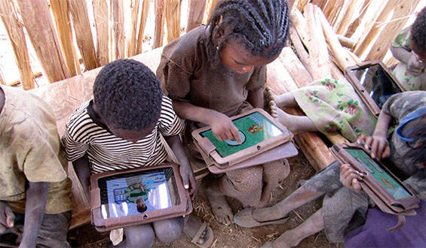
Opportunities…
“Given Tablets but No Teachers, Ethiopian Children Teach Themselves”

