Slide 1
Teaching English Using ICT Tools
Sawla Secondary & preparatory school

Slide 2
Google classroom for e-learning

Slide 3
Introduction
Moodle requires a server for hosting lessons but google classroom solves this through cloud hosting.
Google Classroom integrates
Google Docs,
Drive, and
Gmail in order to create and collect assignments in a paperless environment
you can create assignments for one or multiple classes, and assign the assignment to each student or a group of students
As a teacher, you can view who has or has not completed assignments, provide feedback during and after assignments, and assign grades

Slide 4
Introduction
Functions:
Signing into Google Classroom,
Creating a Class,
Changing a Class Theme,
Adding a Teacher Photo to the Class,
Renaming or Deleting a Class,
Adding a Class Resource Page,
Adding/Removing Student by Class Code,
Resetting the Class Code,
Creating an Assignment,
Viewing an Assignment,
Grading and Returning an Assignment,
Changing a Grade,
Posting Announcements and
Adding and Deleting Comments.

Slide 5
Google Classroom Workflow
Teacher creates assignment and attaches one or all of the following:
File(s), Google Drive Item(s), Video(s). Link(s)
Teacher chooses to send the assignment to each individual student, a group of students, or to the whole class along with privileges: Edit or View.
Student receives a notification that an assignment is due.
Student turns in the assignment and loses editing privileges once assignment is turned in.
The teacher edits the document to grade the assignment, returns it to the student with feedback when necessary.
Student receives document with grade and has gained editing access again to write comments.

Slide 6
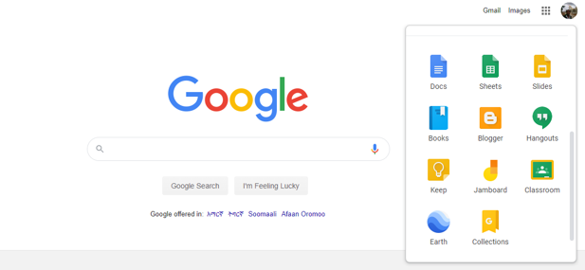
Creating a Class

Slide 7
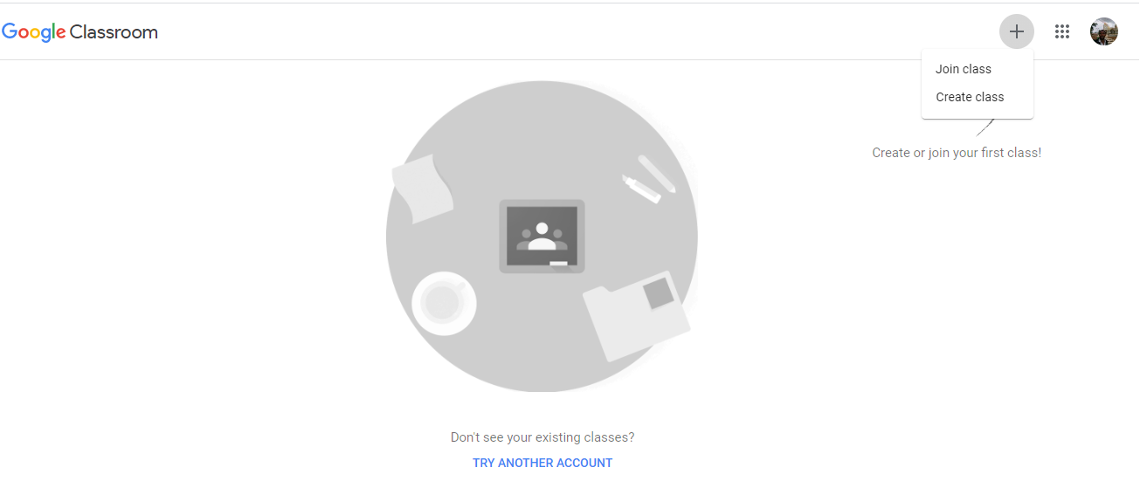
Creating a Class

Slide 8
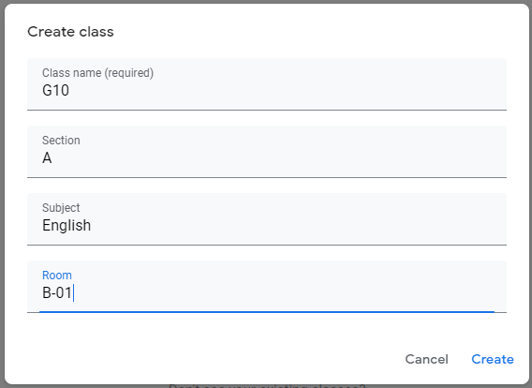
Creating a Class

Slide 9
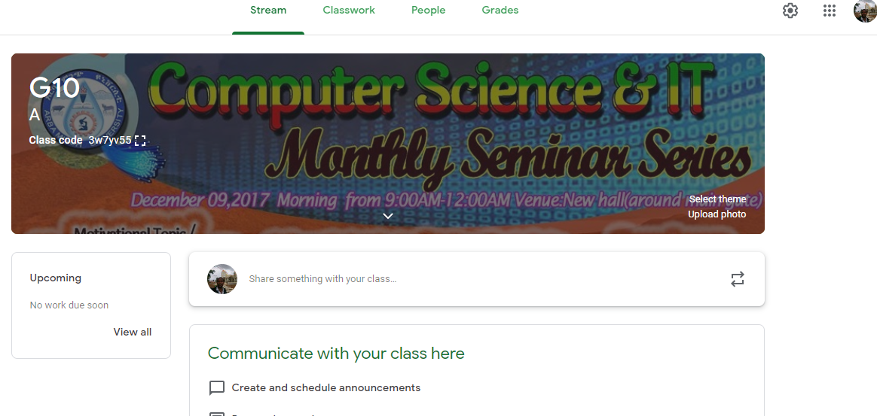
Creating a Class

Slide 10
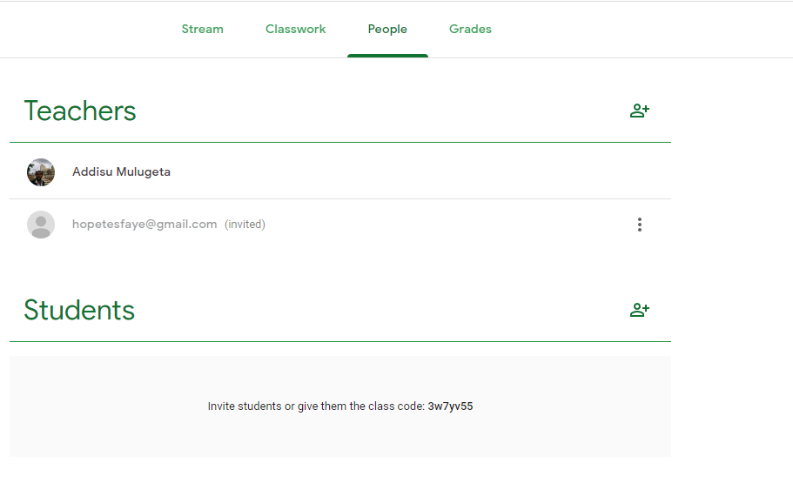
Adding Teachers

Slide 11
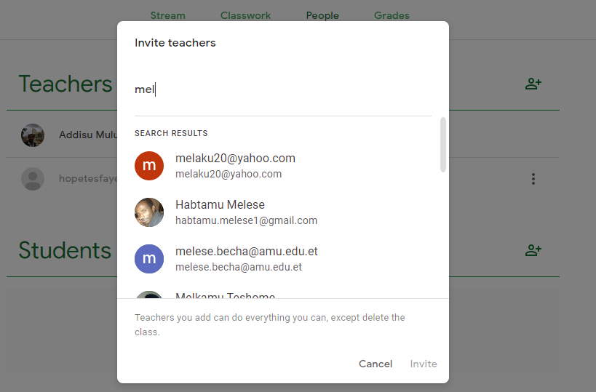
Adding Teachers

Slide 12
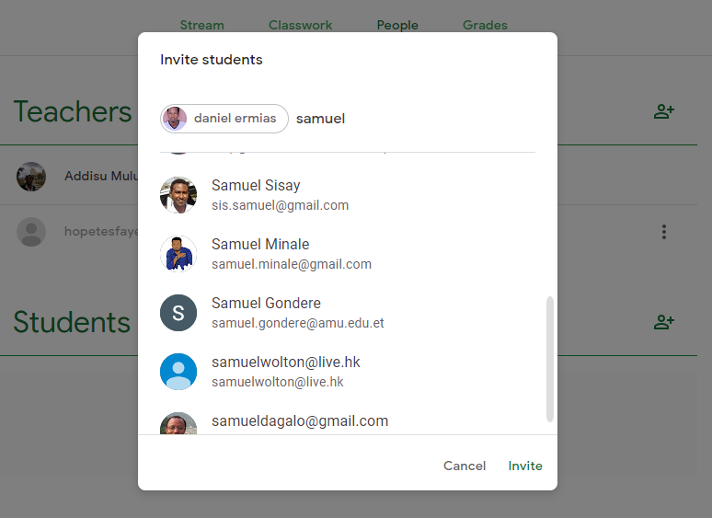
Adding Students

Slide 13
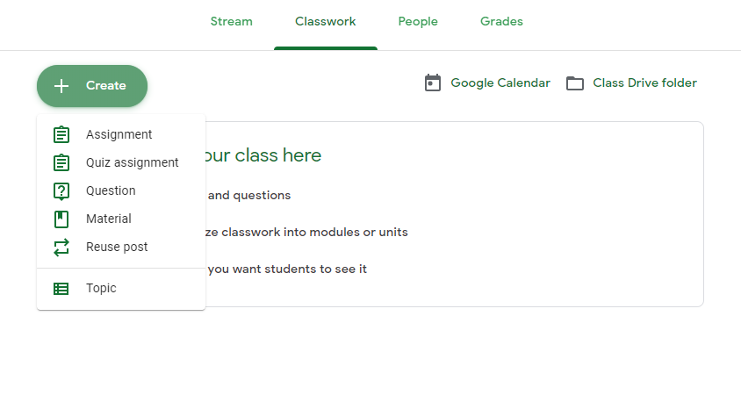
Creating ….

Slide 14
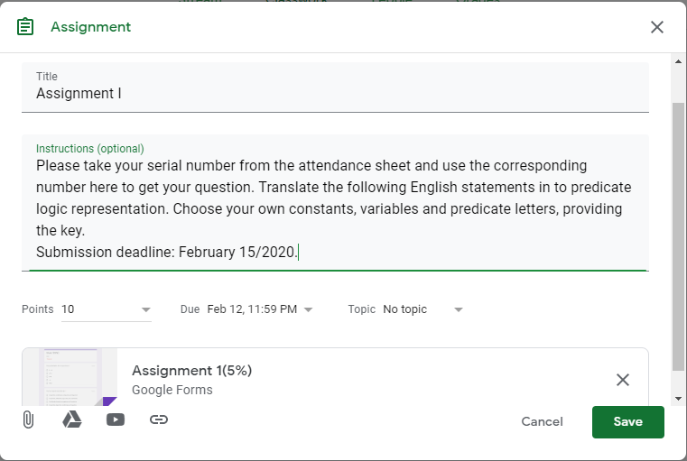
Create Assignment

Slide 15
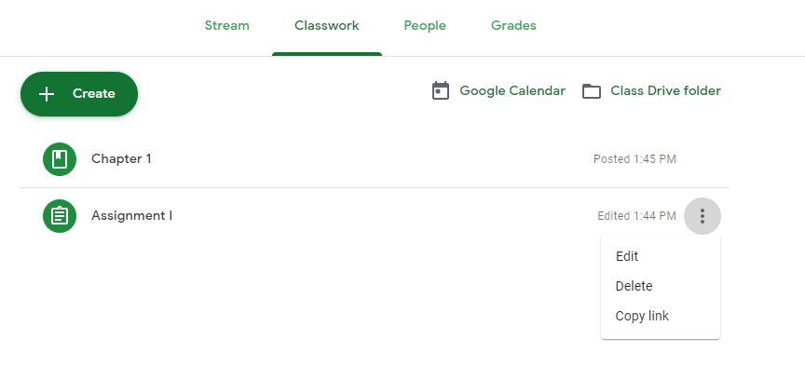
Edit, Delete…

Slide 16
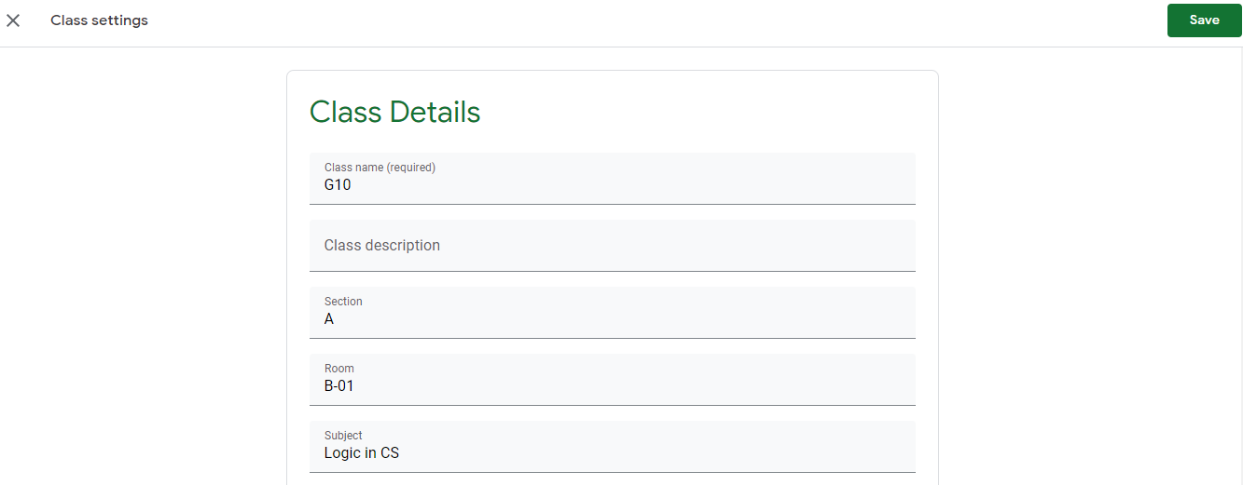
Class Setting

Slide 17
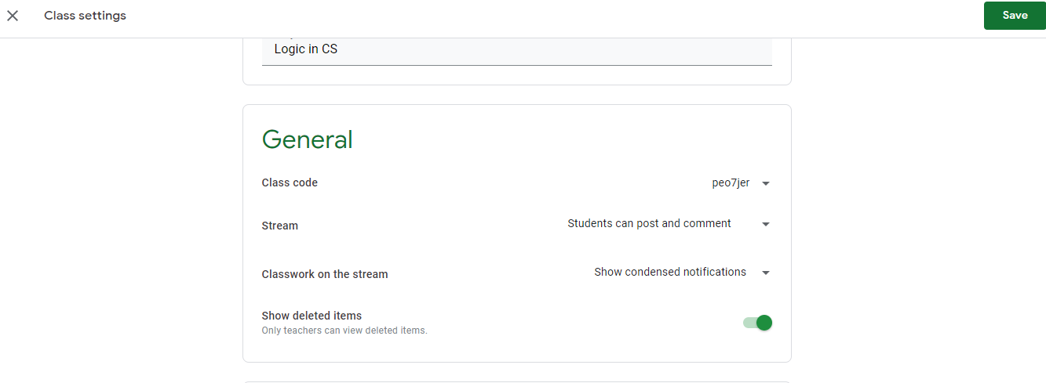
Class Setting

Slide 18
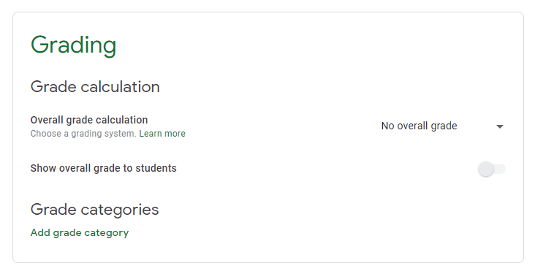
Class Setting

Slide 19
Any Question
???

