Slide 1
Artificial Intelligence
AMU-IUC workshop
Johan Loeckx
April 9th, 2019 jloeckx@ai.vub.ac.be

Slide 2
Agenda
Background on the lab
Changing context of universities in Europe
How we try to cope with them (mission & strategy)
Proposal collaboration with AMU!

Slide 3
Background

Slide 4
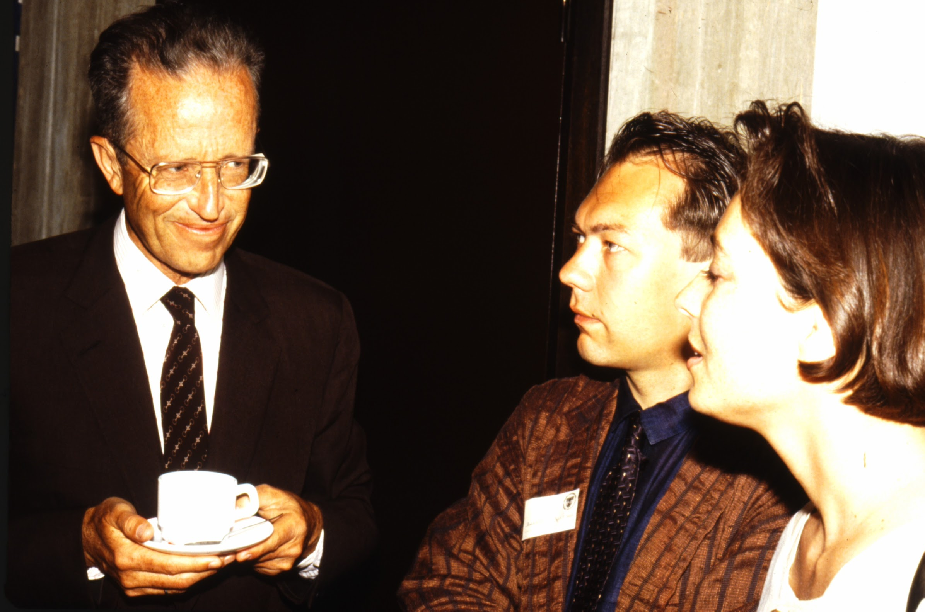
A little history…
Founded in 1983 by Luc Steels
~50 researchers from >15 countries
50 PhDs, 5 spin-offs, >850 pubs, >24000 citations, ...
Notes:
First lab on European mainland => sales talk; 3 kings

Slide 5
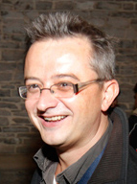
Our team
Ann Nowé
Bernard Manderick
Geraint Wiggins
Bart de Boer
Tom Lenaerts
Simon Keizer
Katrien Beuls
Johan Loeckx
+ 25 doctoral students
+ 12 post-doctoral researchers
‹#›

Slide 6
Pillars
Fundamental research
Reinforcement learning
Precision language processing
Computational creativity
Applied research
Grounded information extraction
Recommender systems
game theory, bioinformatics, multi-agent systems

Slide 7
Three kinds of analytics
Descriptive → understand the past
Predictive → predict the future
Prescriptive → make the future

Slide 8
Prescriptive analytics
Traditional view: “data is the truth” → data mining / machine learning
But your actions have impact on your data! → e.g. marketing campaign targeting youth / police patrols US → Are sales good because of - my actions - because the weather was exceptionally good?

Slide 9
Going the extra mile
Descriptive: what did I do right/wrong? → what actions in the past led to my current success? (credit assignment problem)
Predictive: simulate what-if scenario’s → what results will I obtain, given future actions that I will take?
Prescriptive: what should I do next?
→ what actions to take to obtain a desired result? Causality?

Slide 10
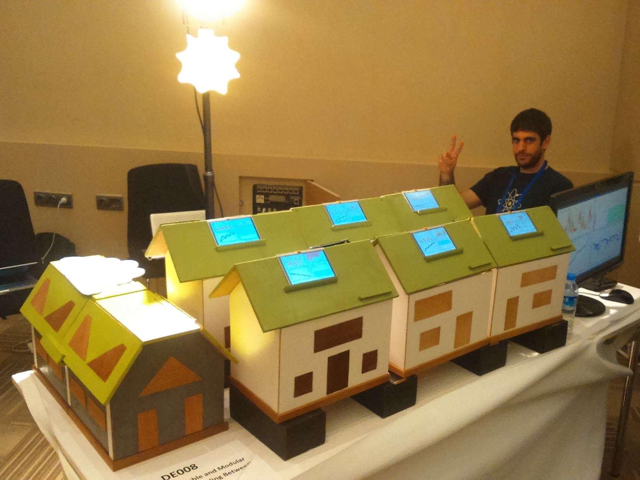
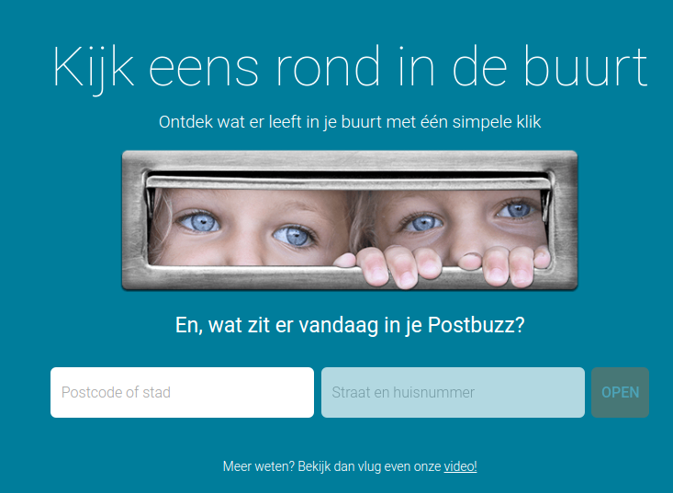
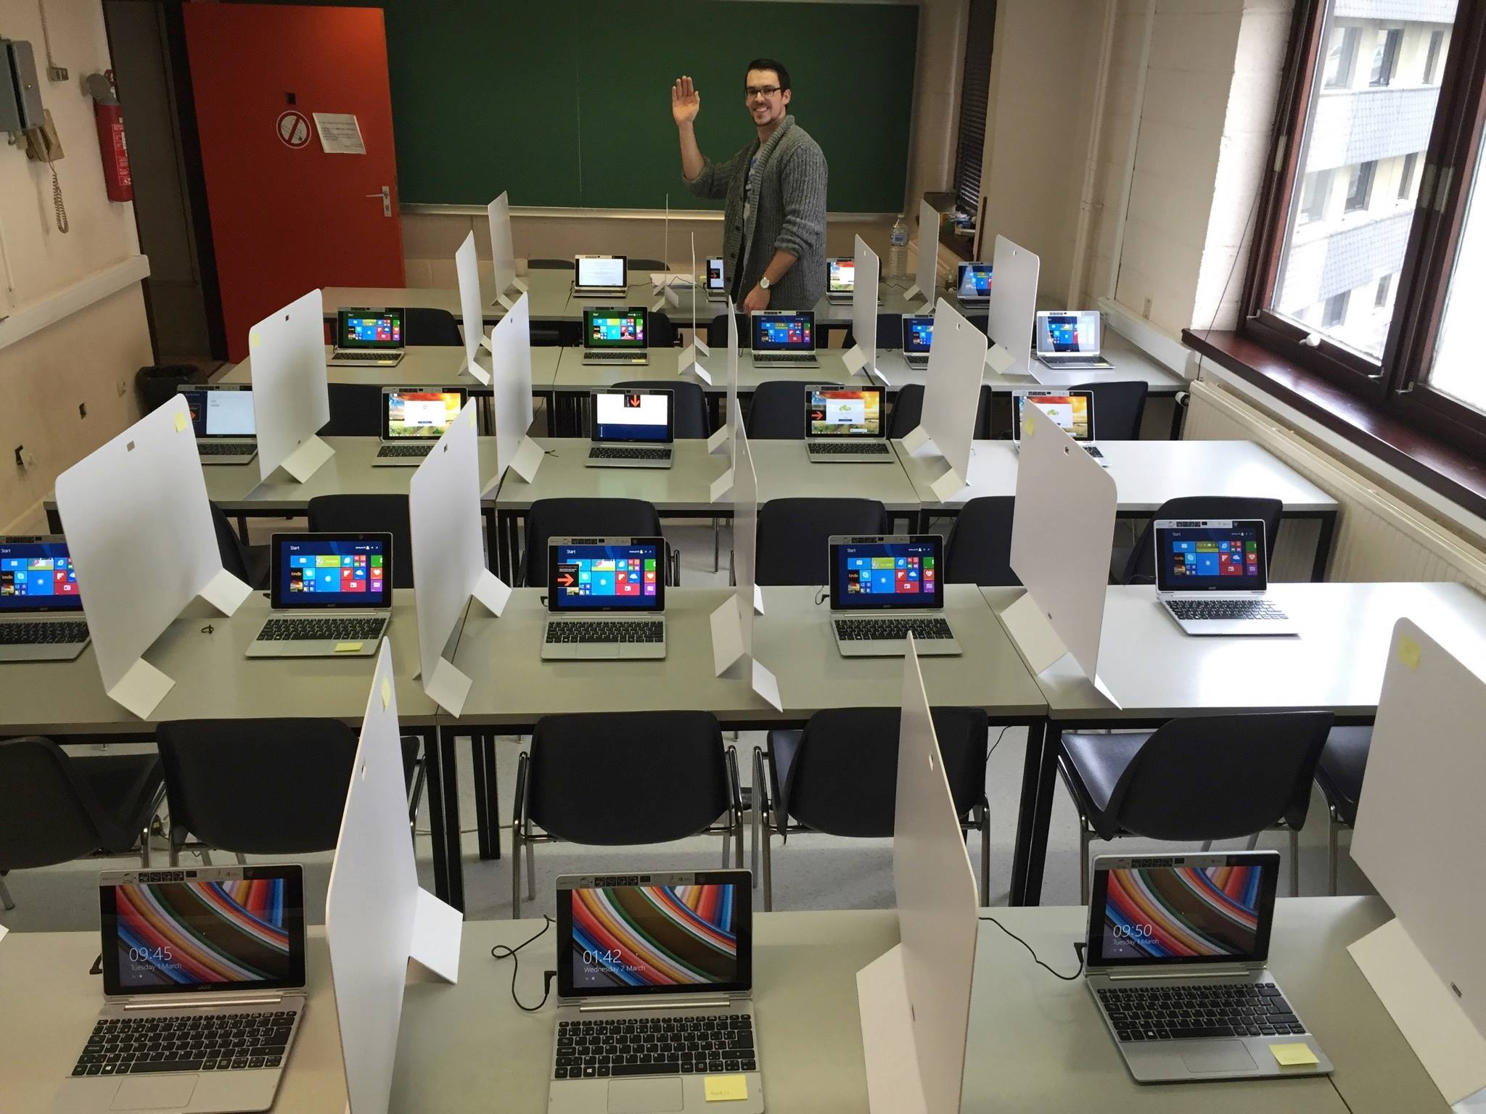

Slide 12
Changing context

Slide 13
Universities are under pressure
We identify four main challenges:
Globalization & speed of change
Lifelong learning & digitization
Battle for talent
Liberalization

Slide 14
Globalization & speed of change
Beware of what happened to the web: research in AI >>>> than in universities alone. The world is big, and changing fast. Therefore:
get your foundations right: teach math, math, math.
pick your fight, “kill your darlings”, focus: choose your domain and become best in the world.

Slide 15
Lifelong learning & digitization
People born now will live in 2110
Curriculum-based education only one part of the story
meta-cognitive skills (“learning to learn”)
learning happens everywhere and in different forms.
More diverse backgrounds and learning goals for students.
Therefore:
modularize courses and training materials
prepare for blended learning settings
keep in touch & engage with private sector!
move towards badges

Slide 16
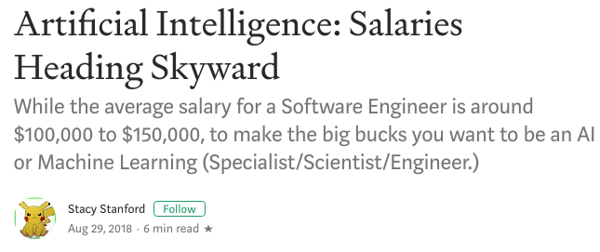
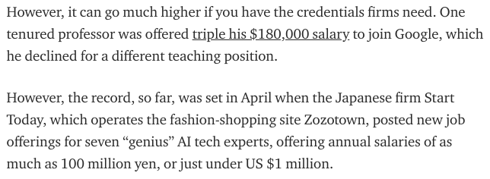

Slide 17
Battle for talent
Big tech is hiring talent, you cannot compete on salary:
Build an inspiring place.
fun, creative, ahead of its time
international, open.
Be a place of excellence: raise the bar!!!
Get your PR right; activate your alumni

Slide 18
Liberalization
Universities and companies are becoming equal partners, and government funding is moving away from unis:
diversify financial income streams
provide services to enterprises
keep enough touchpoints

Slide 19
Mission & strategy

Slide 20
Mission & strategy

Slide 21
Running a lab…
Legal & IP
Contract negotiations (NDAs, IPs)
Interesting project results
Project accepted
Personnel
Job offer & scouting of candidate
Recruitment (selection)
Administration for hiring
Employee welcoming & leaving
Educational support
PhD meetings
PhD supervision
ZAP meetings
Community building
EU
Businesses
Flanders
Bru-Wallonia
Infrastructure
Keep the lab clean
Maintain coffee machine
IT infrastructure
Public relations
Blogs & Quora
Twitter
Linkedin alumni
Dashboard @ coffee
Welcome students, bachelor info event
Talks
Website design (e.g. conferences)
Project related
New dataset
Publication accepted
Conference / talk
Important milestone / interesting results
Fundamental research related
Publication accepted
Important news, scientific breakthrough in the field
Funding management
EU
BE applied
BE fundamental
BE strategic
Proposal writing & submission
Concept & body of idea
Generic parts
State-of-the-art
Submission
Accepted
Knowledge & tech management
research meetings: invite, organize data management
science watch (publications & field)
tech watch (libraries)
market watch (companies) policy watch
internal procedures & knowledge
content management
Trainings
Organise training
Internships & joint BA theses
Industrial liaison
BA/MA/internships with industry
company interested in collaboration
Lab visits
Demos

Slide 22
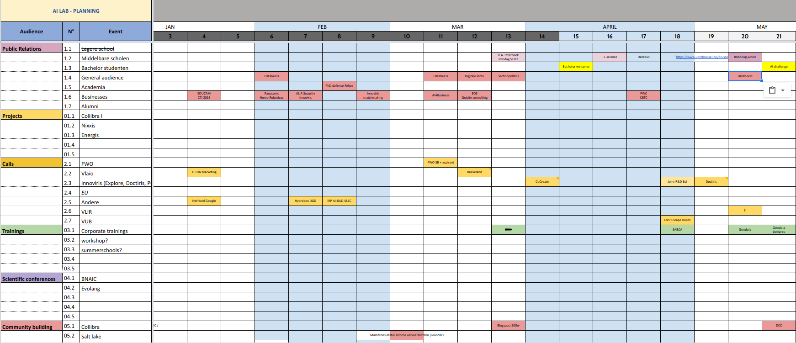
Coordinate activities

Slide 23
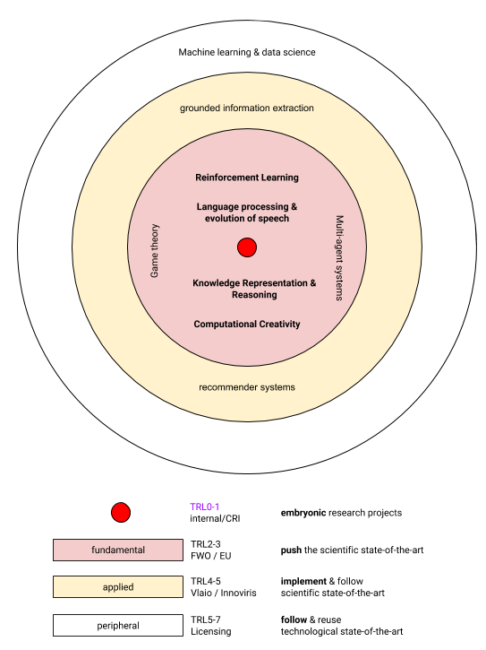
Knowledge management
Focus
Economies of scale (e.g. researcher’s exchange)
Inertia: build up reputation

Slide 25
Technology management
Code versioning system (gitlab)
Stimulate re-use and collaboration
Keep track of TRL!
Choose projects wisely

Slide 26
Sustainable
collaboration

Slide 27
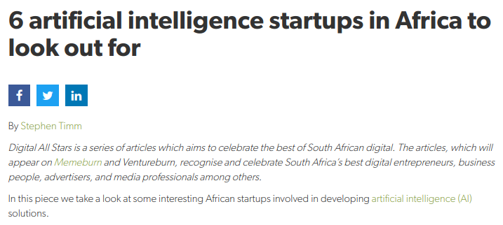
Africa & AI

Slide 28
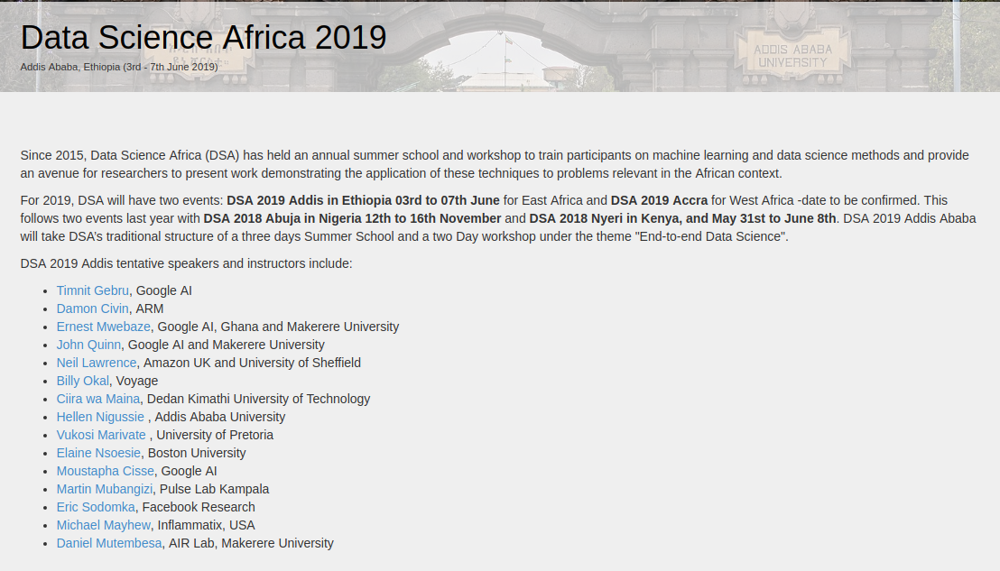
Africa & AI

Slide 29
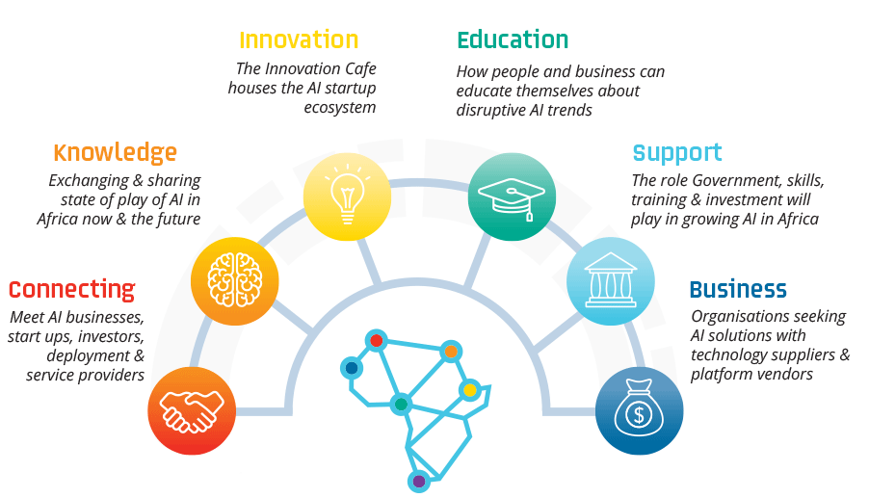
Africa & AI

Slide 30
Potential is endless
No “handicap of a head start”
Link with IoT & mobile revolution
Skills >> infrastructure
Innovation = hard: you need digitization / data / across departments, etc…

Slide 31
Agriculture
Automation of processes
Logistics & SCM
Preventive maintenance
Optimization of yield
Collaborative robots
AVs & robotization
Crop prediction; irrigation management; crop health mgmt

Slide 32
Energy & health
Hydrobox
container with a mini hydro plant
attract investment by transparency (blockchain & sensors)
preventive maintenance and timely ordering of parts
remote management
Aajoh: diagnose patients through an app.

Slide 33
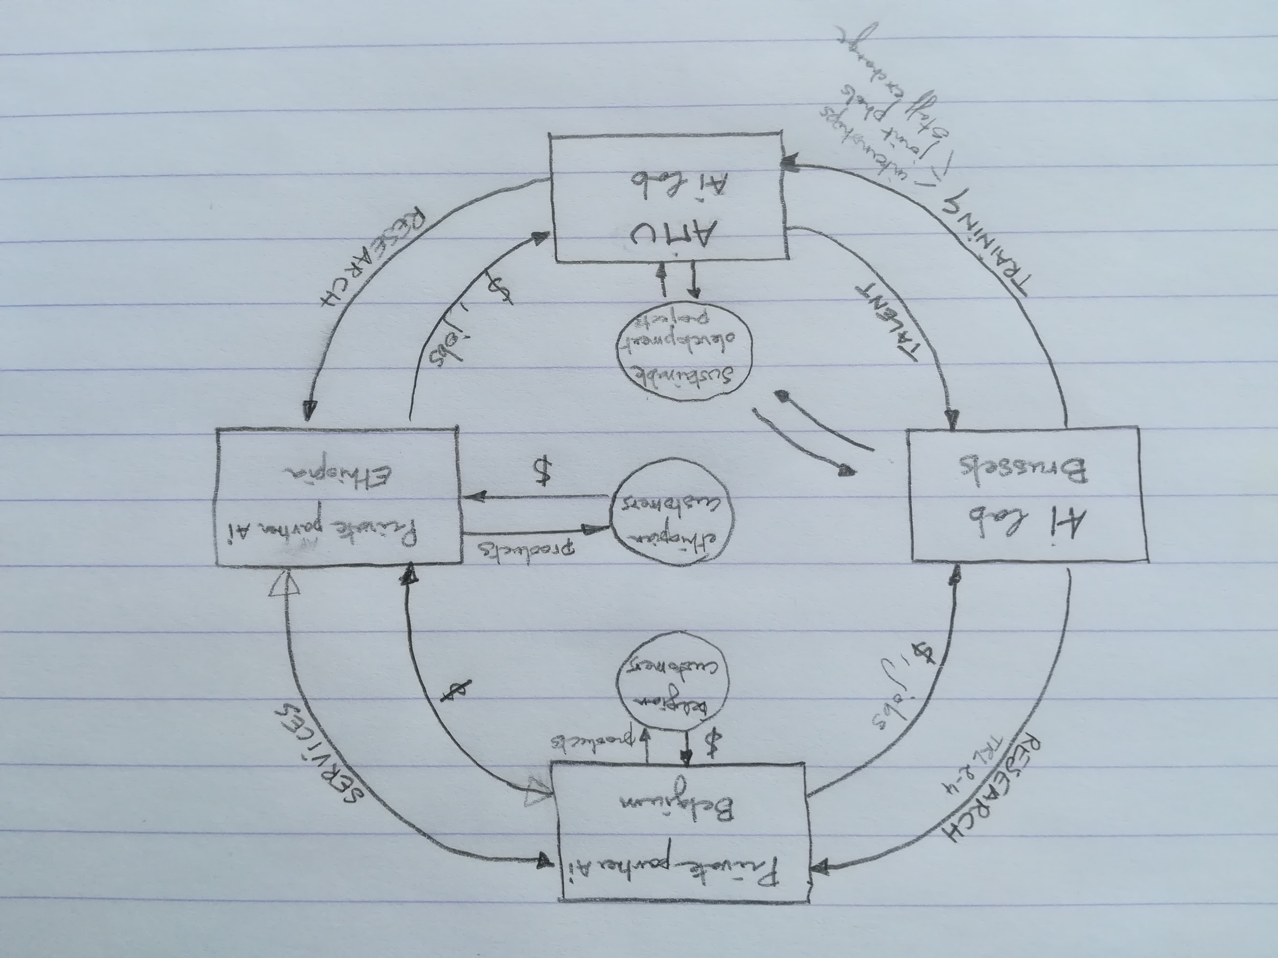
Proposal

Slide 34
Questions to you...
Questions?
Does this sound exciting?
(Where) do you want to start?
Who & how?

Slide 35
Links
http://www.datascienceafrica.org/dsa2019addis/
https://www.nature.com/articles/d41586-018-07104-7
http://aiexpoafrica.com/
https://clevva.com/pressrelease/6-artificial-intelligence-startups-africa-look/
https://ourworld.unu.edu/en/ai-in-africa-is-a-double-edged-sword
https://ourworld.unu.edu/en/ai-in-africa-is-a-double-edged-sword

Slide 36
Questions?
Johan Loeckx
jloeckx@ai.vub.ac.be
https://ai.vub.ac.be
+32(0)486 37 98 71
@aibrussels

